Slide 1
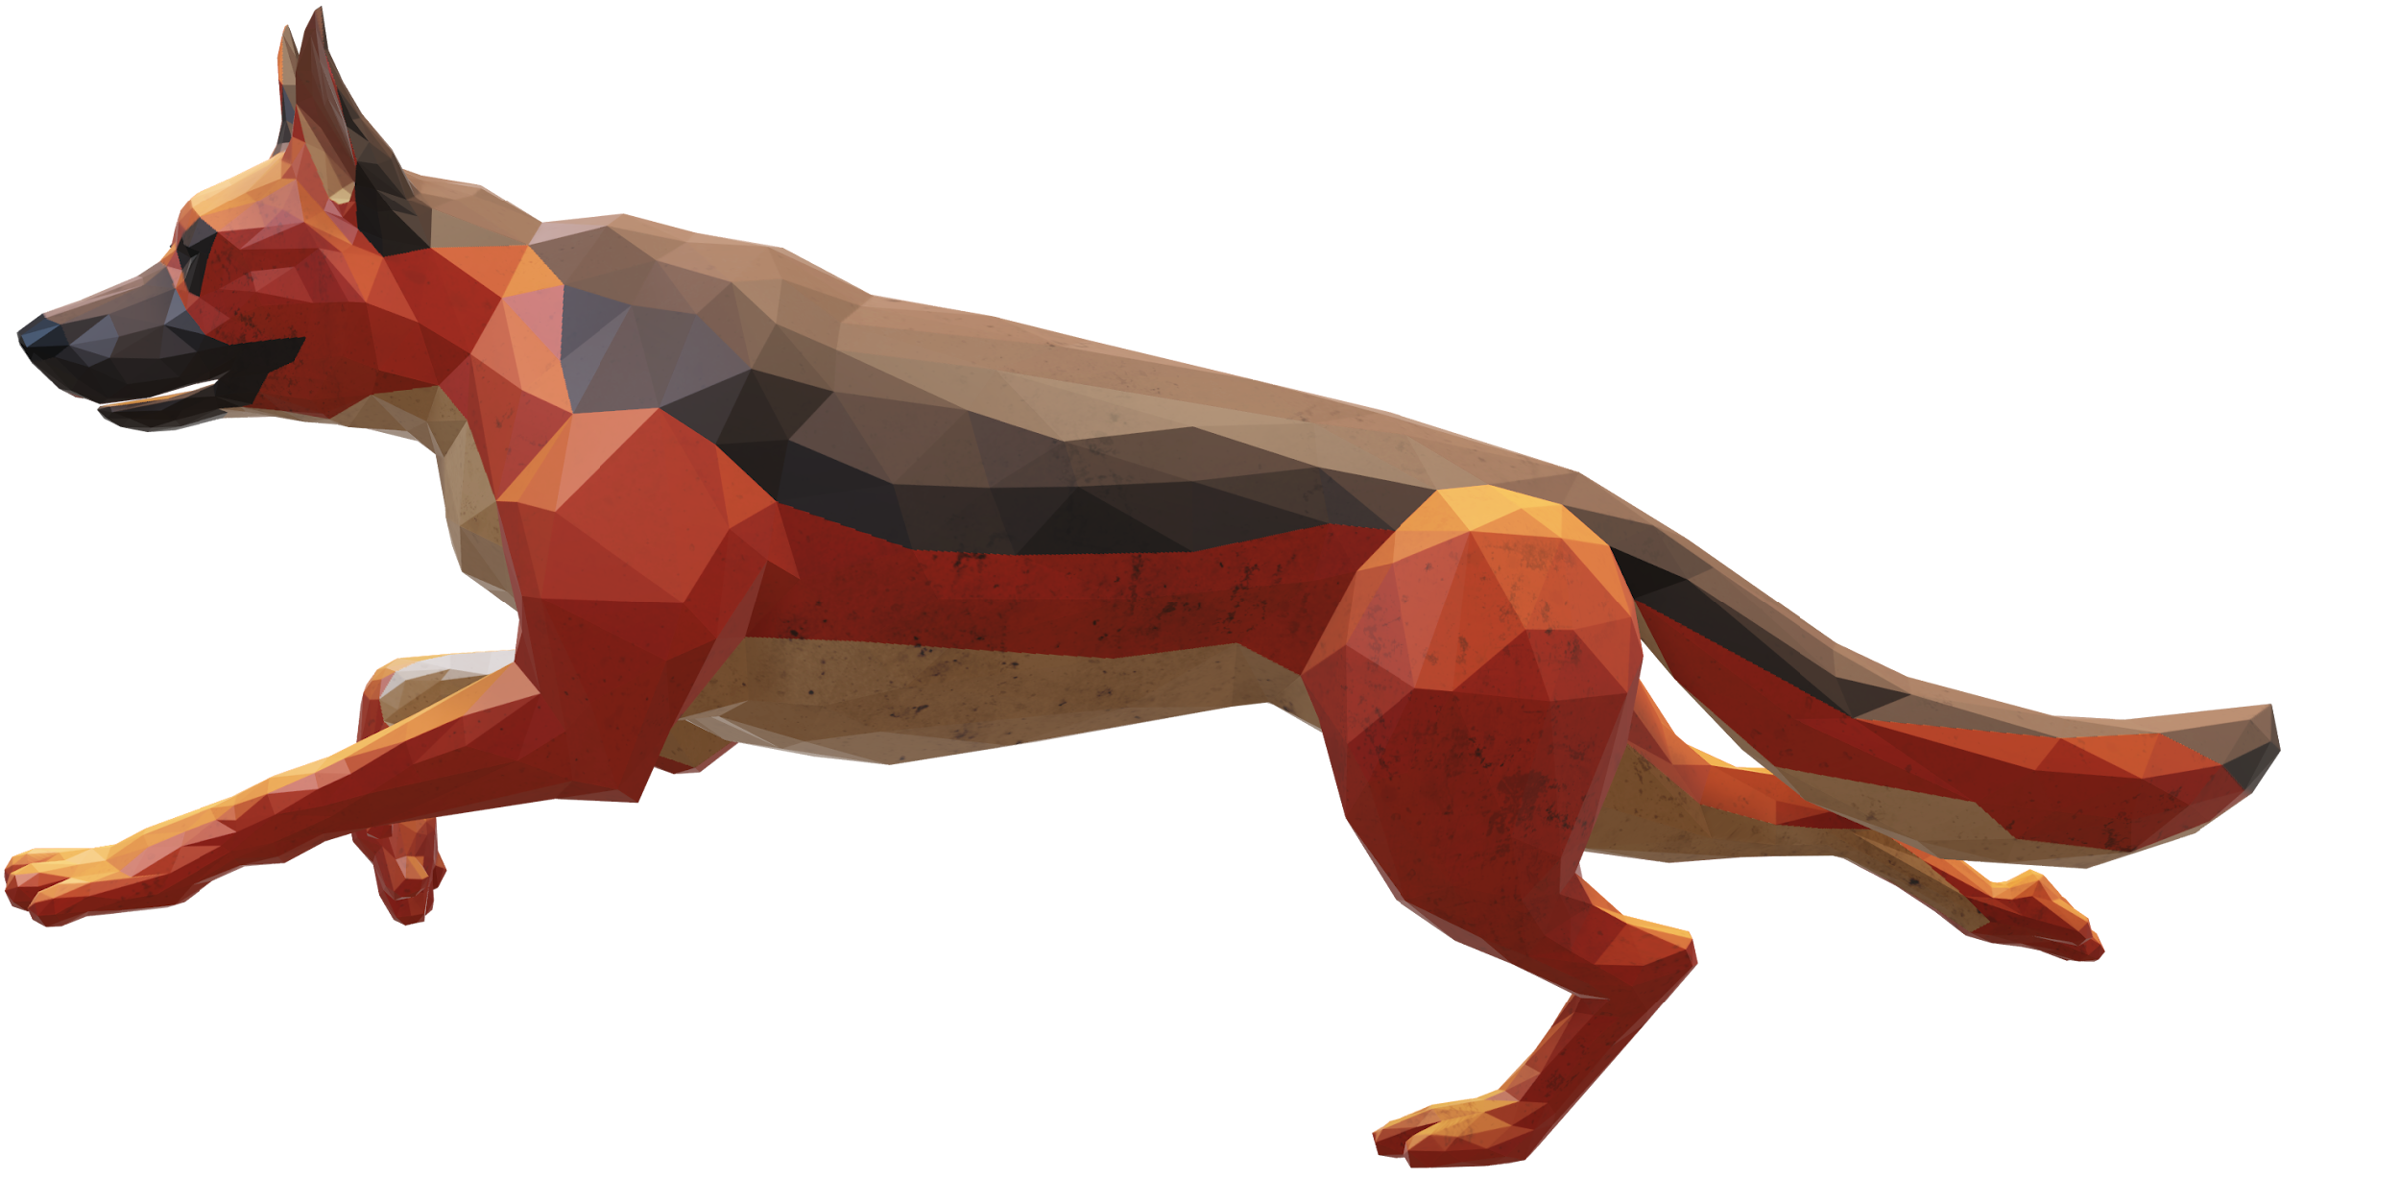
PAWSOME
Team
We care for your awesome pets.
Abin Joy,
studying veterinary medicine from College of Veterinary and Animal Sciences,Kerala.

Slide 2
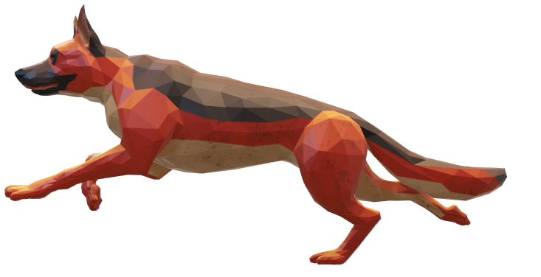
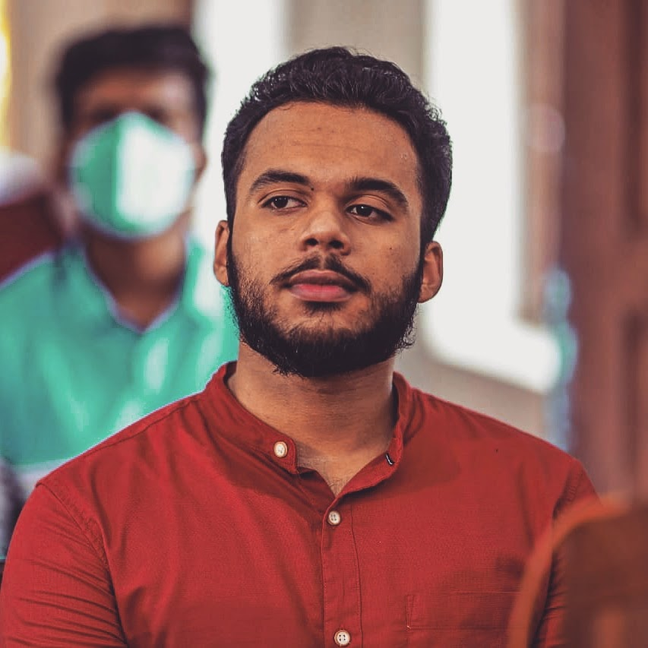
Team
PAWSOME
We care for your awesome pets.
Abin Joy
Febin Joy
Abin Joy- CEO
Veterinary medicine student
Adoni Zedek - CTO
Founder & CEO of Realweb

Slide 3
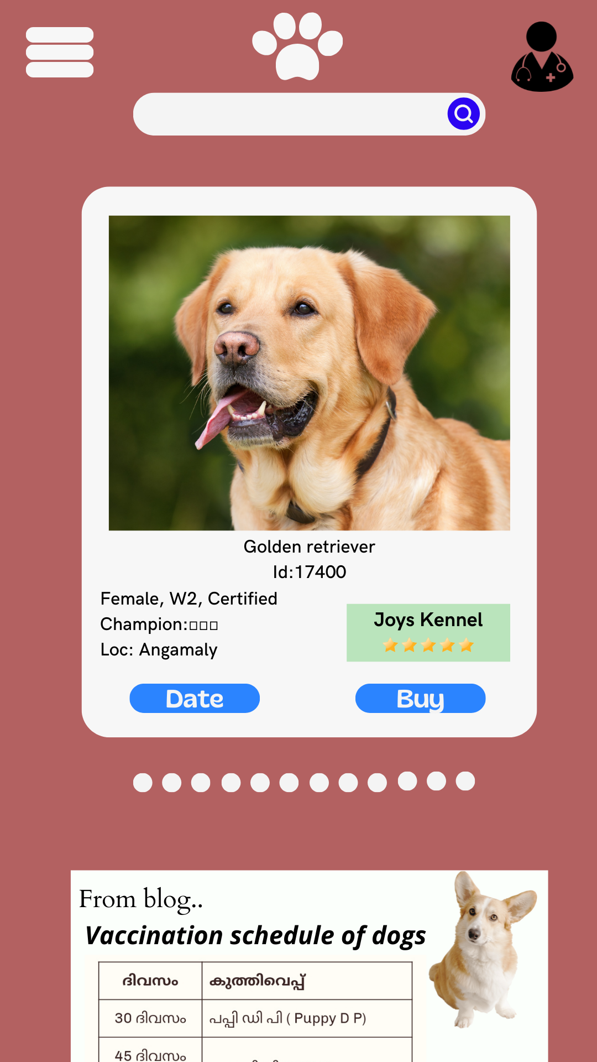
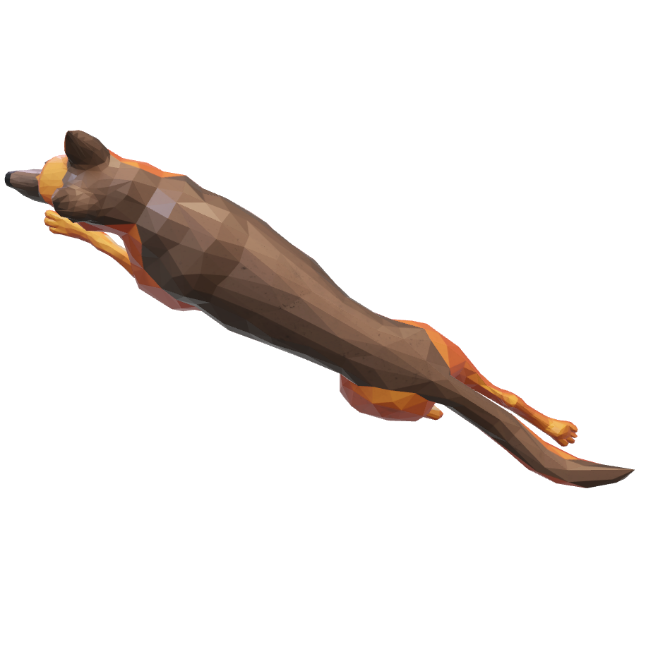
Problem
Breeders don’t follow norms and customers don’t have transparency in understanding the audacity of the breeders
People have less knowledge about good quality animals and good breeding practices
Many things practiced are against animal welfare and animal ethics
There is no Matrimonial site for animals
There is less availability of good quality animals
People usually want to mate their animals with superior quality animals of the same breed. This is done to keep the pureline of the breed. Offsprings of animals that has got championships or awards also fetch far better price
Eureka Moment
-We are creating an online site where people can visit and choose the animal of their interest and specifications.
-Our idea is superior because it gives people thousands of opportunities to choose from. People can sort based on breed,colour,location,championships won,pedigree,cost of mating…

Slide 4
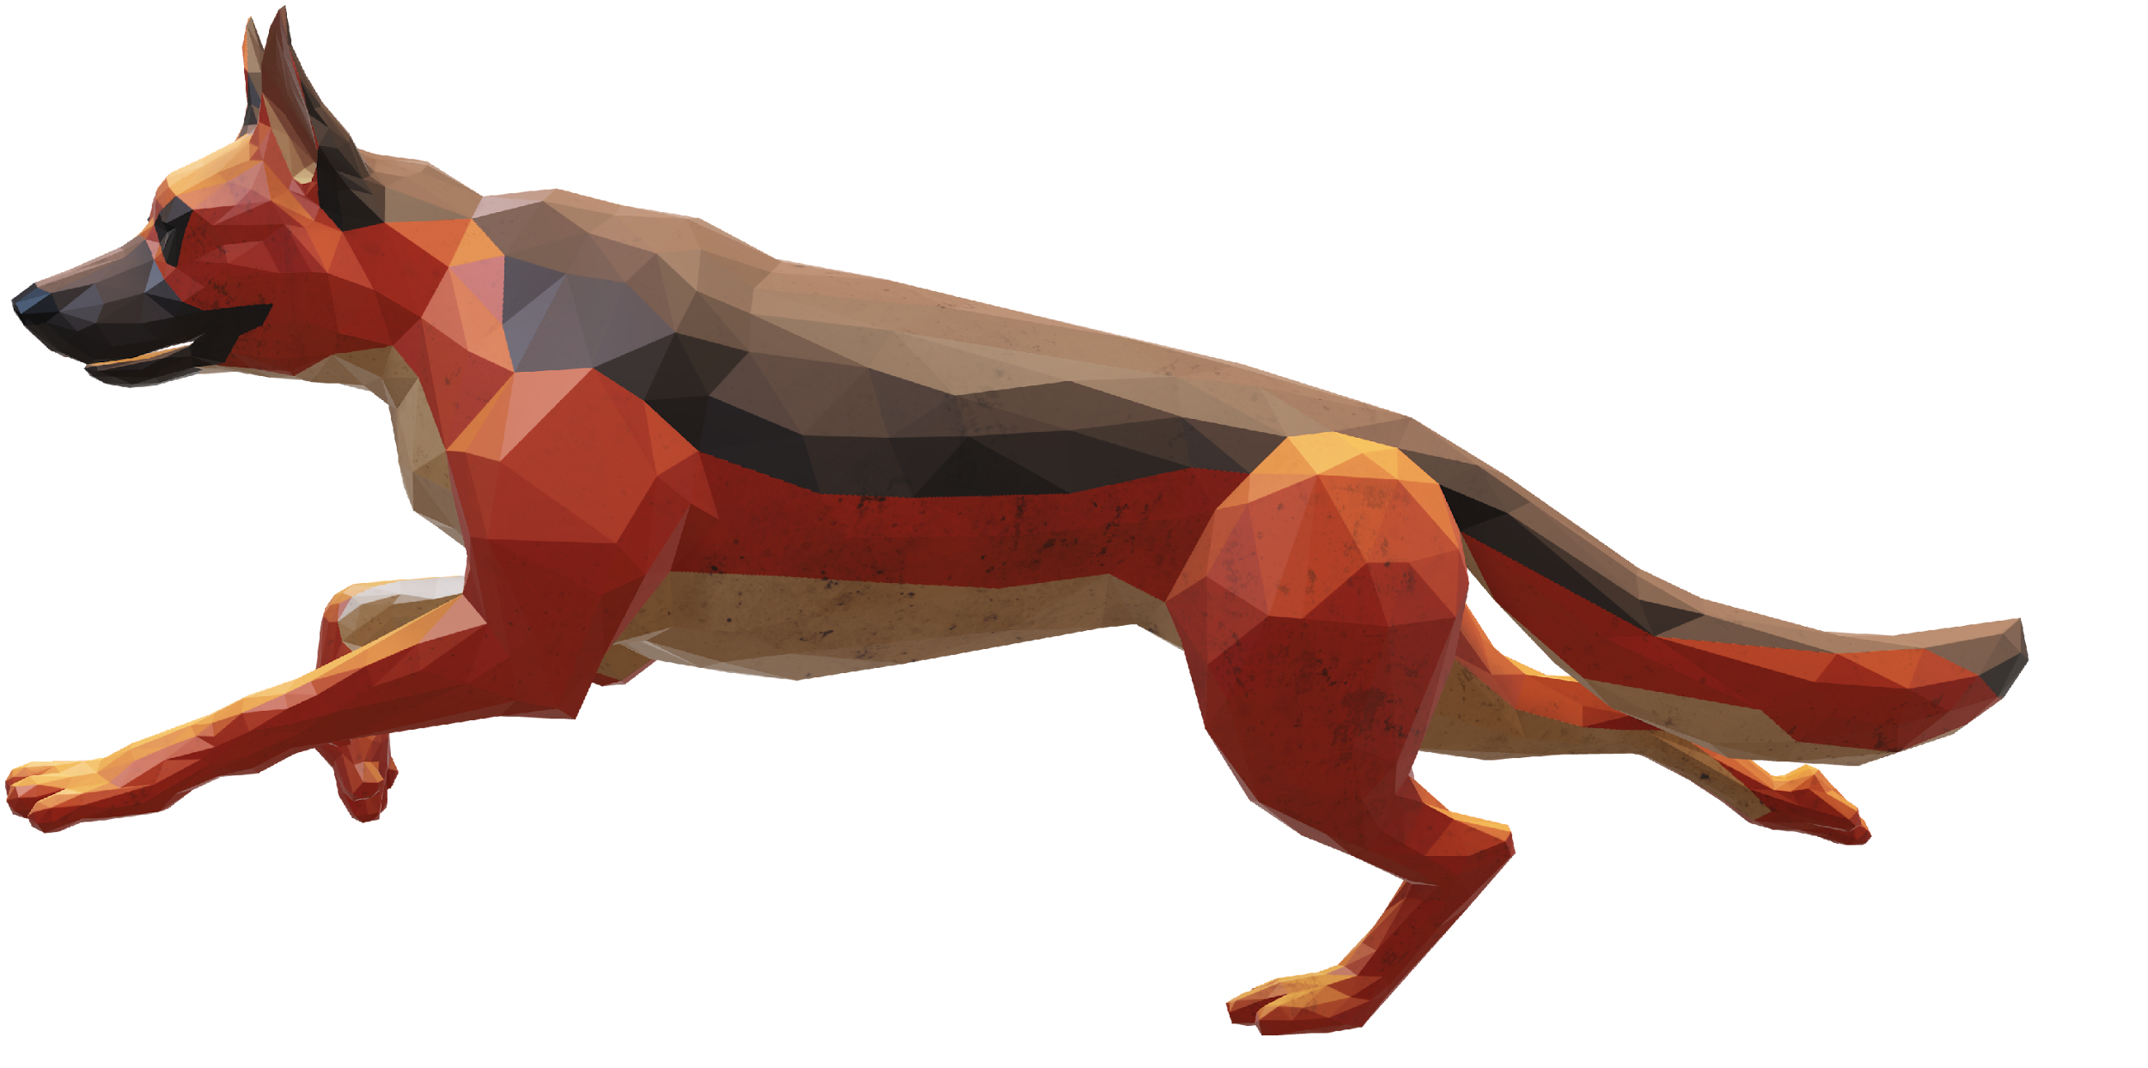
Solution
Create a platform to enable transparency of knowledge between customers, breeders and veterinarians
-We are creating an online site where people can visit and choose the animal of their interest and specifications.
People can sort based on breed, colour, location, championships won, pedigree, cost of mating…

Slide 5
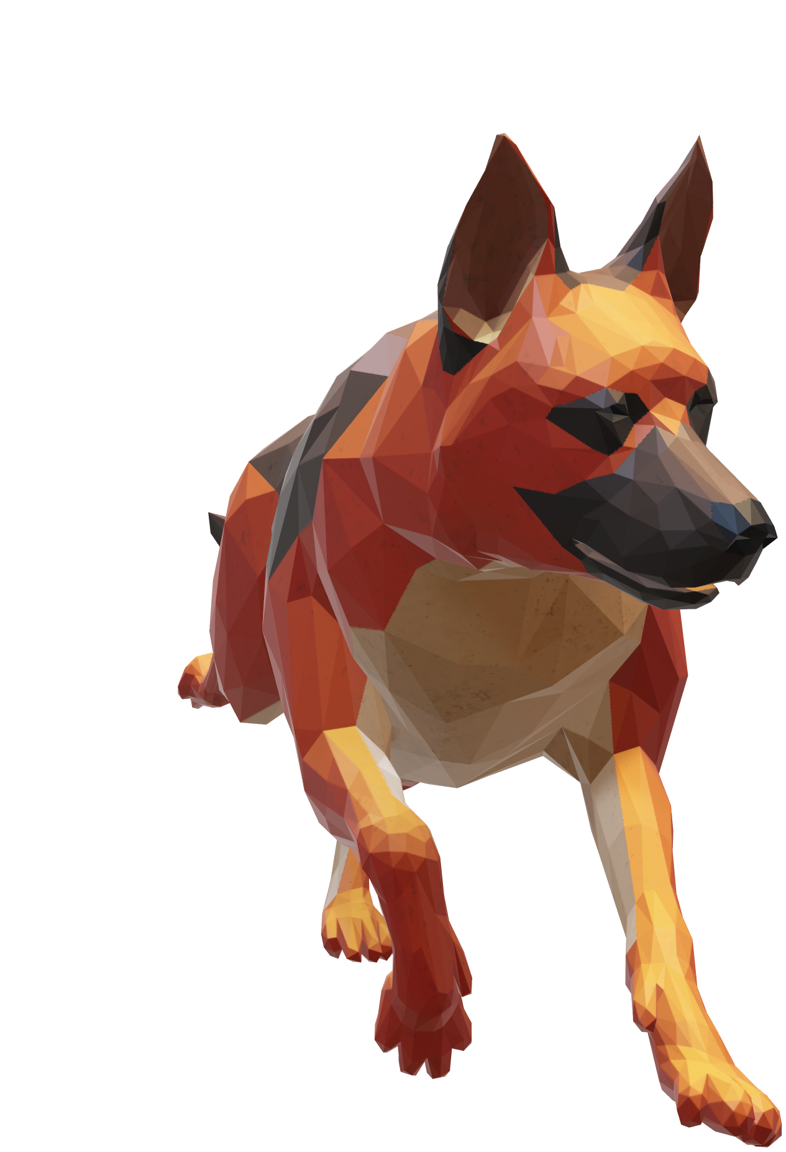
Alternatives | Our edge
Usual method is though personal contacts. But it gives very less choices. | -Mating with the same breedline (of a friend or a neighbour) can cause inbreeding depression. We can prevent this.
Other options are through whatsApp groups. But it is not useful when we have a not-so-common breed or when we have specifications. | -Whatsapp and fb groups dont provide guarentee about the animal ethics that is practiced or the quality of their parents

Slide 6
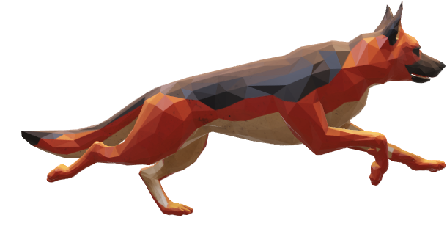
Competitive analysis
Company name | Key focus | Their weakness
petmeetly | Pet matrimony | No verification by vets
Dog bazar | it has a provision for dog marriages | They aspire relocation of pets
Dogexpress | it's a information blog for dogs | Nothing regarding individual pets or their mating
petplanets india | it’s a hospital + blog + pet product store | Nothing regarding mating

Slide 7
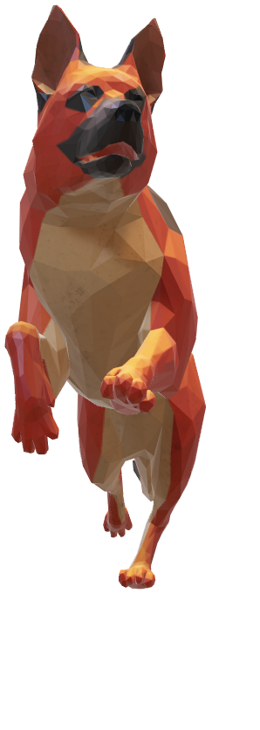
Our benefits:
We offer quality by verification of breeders, verification of pedigree/lineage
Choices to buy and sell the animals
We also mediate management consultations by veterinary doctors
We are providing blogs to disseminate useful information to the users, moreover in their local language
ONE STOP SOLUTION FOR ALL YOUR PET’S NEEDS

Slide 8
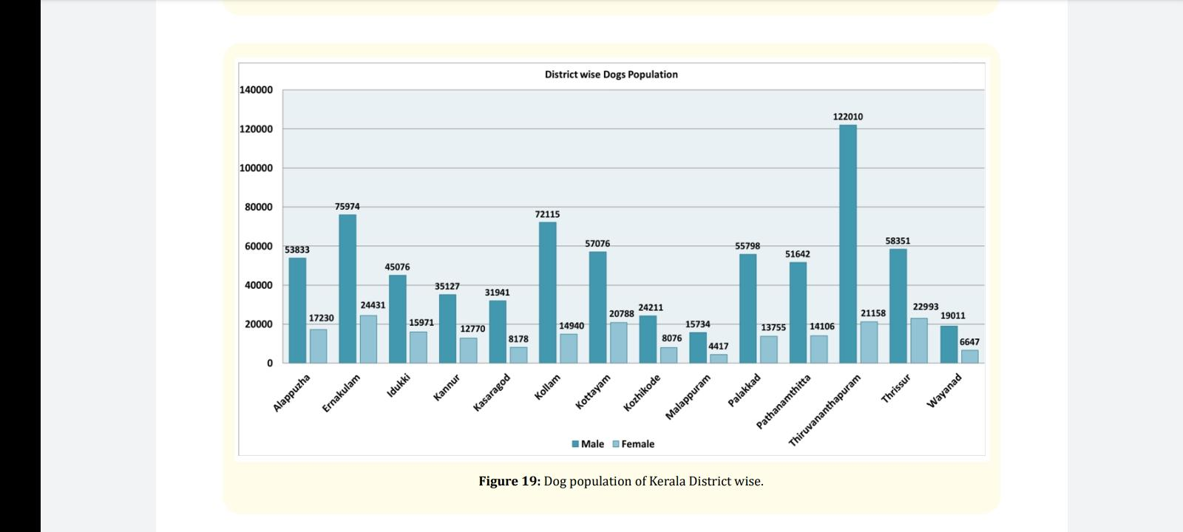
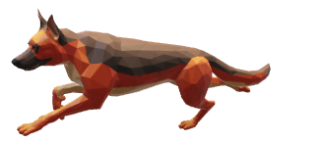
Market Potential
As per industry data, the pet population here in India is around 29 million
Based on the 20th livestock census, Kerala is home to 8.36 lakh dog population.
The Indian pet food industry is worth about Rs. 2,500 crore. (www.businessinsider.com)

Slide 9
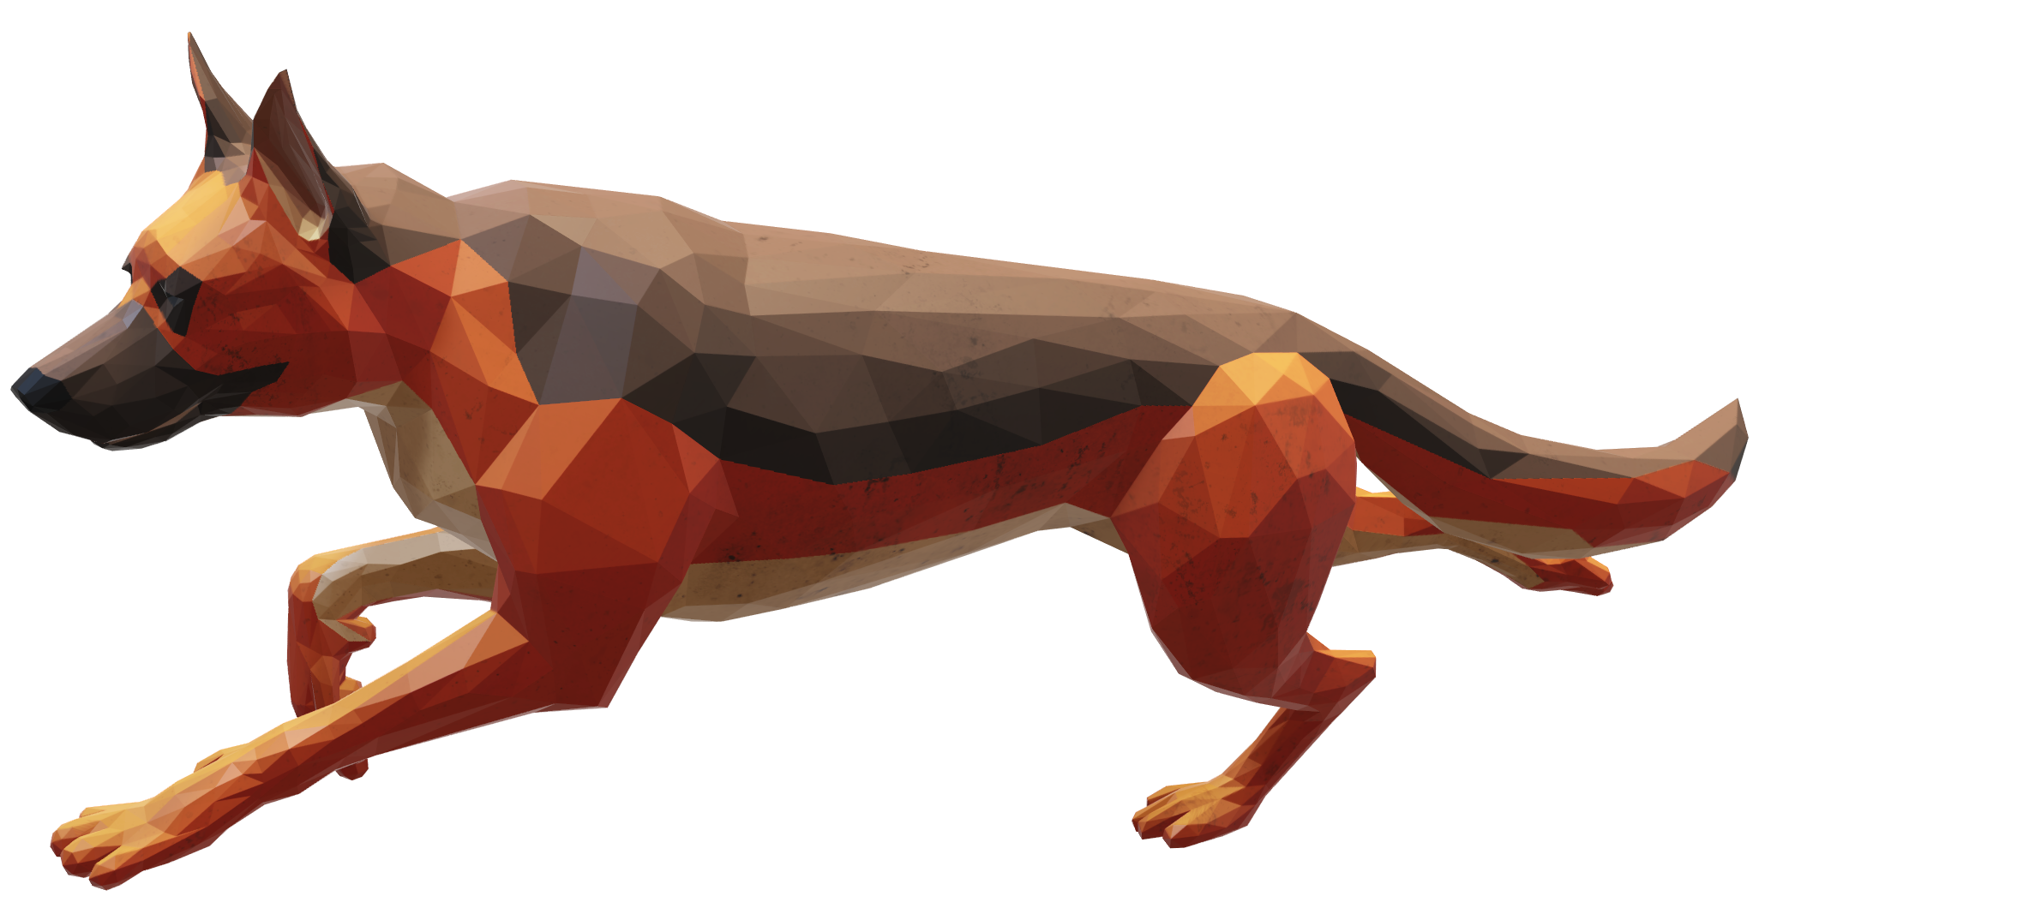
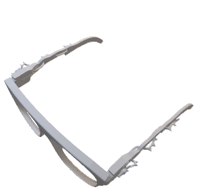
Revenue Model
Subscription : We will buy Rs.500 for subscription for each month
Veterinary Consultation
Advertisements
Commissions
We will also take brokership charges for sale from the animal owners. We will be taking 10% of the cost as our income. Profit can range between Rs.800-80,000 depending upon the breed
We shall also provide links to services like grooming, dog daycare & sale of pet products. From these too, we shall generate an income through affiliate marketing.

Slide 10
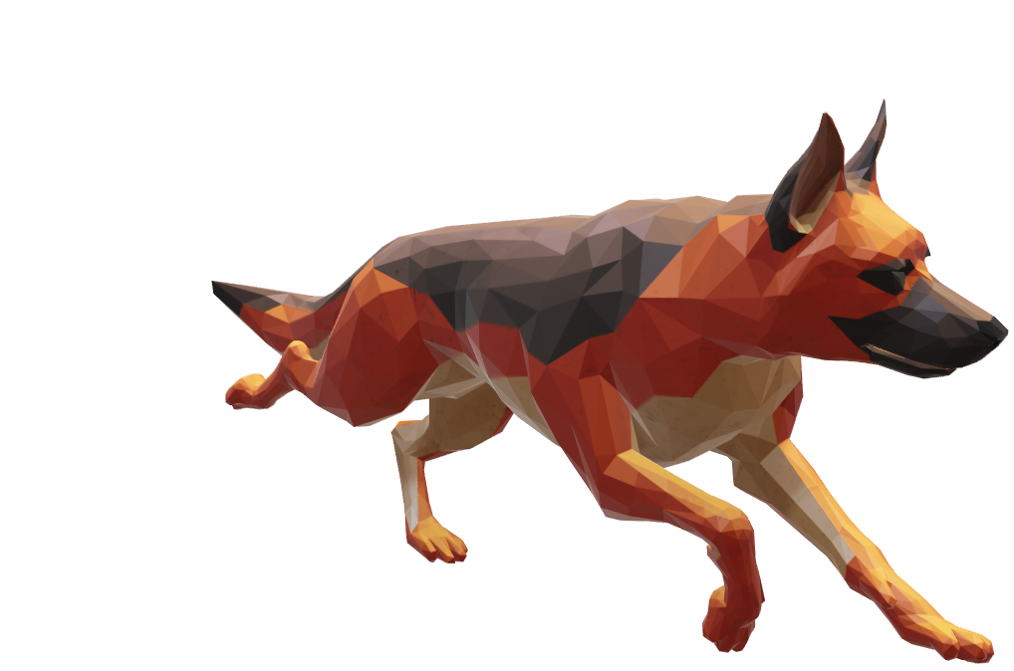
Cost Structure
We are expecting a total cost of 21 lakhs for the first year
3 lakhs for creating the web app platform and hosting it
9 lakhs for marketing it and creating a brand
9 lakhs for 3 PR staffs

Slide 11
Investment needed
Investment needed : 15 L
Total Revenue :
Matrimony : 15 *14* 500 Rs * 5 months= 5 L
Vet : 20% of 500 * 80 * 5= 0.2 L
Advertising : 0.5 L
Total Cost : 21 L
15 L

Slide 12
Early Adopters
Early adopters?
People with rare breeds, people in the outskirts of city, people who aspire for prizes in competition and higher amounts for their puppies
Plan to market
We are basically veterinarians by profession. We plan to market it through our seniors who are basically at every veterinary dispensaries.

Slide 13
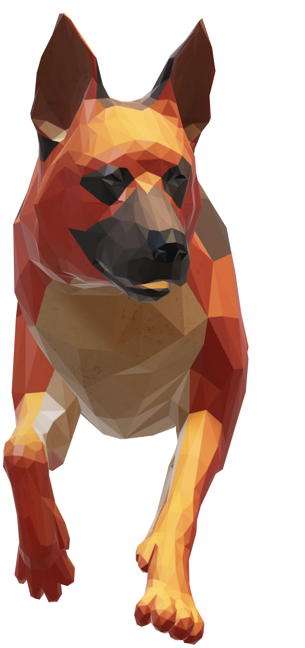
Prototype
https://pawsomepetmatrimony.com/
We have already launched our MVP. We are running some market test and creating a brand value

Slide 14
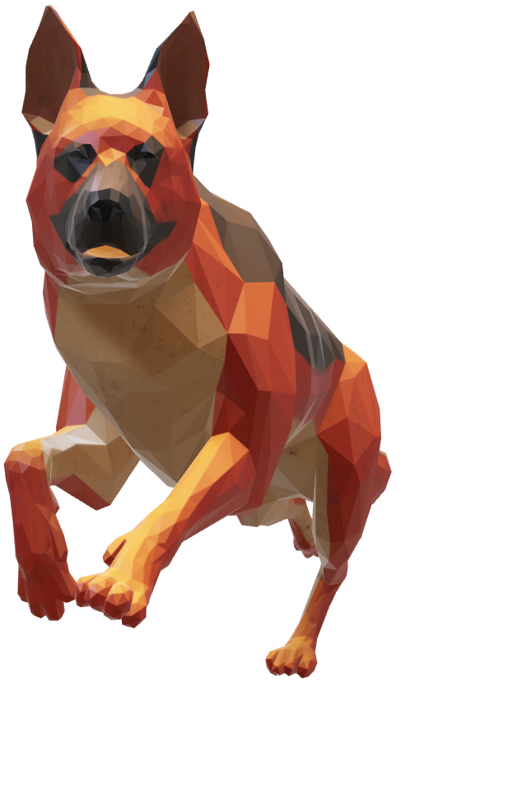
THANK YOU!
Powered By Realweb

