Slide 1

Hello Everyone!

Slide 2
INTRODUCTION
Hi. my name is Vedith, I am 10 years old i like playing video games and soccer and i live in Plymouth minnesota .today I will be doing a show and tell.

Slide 3
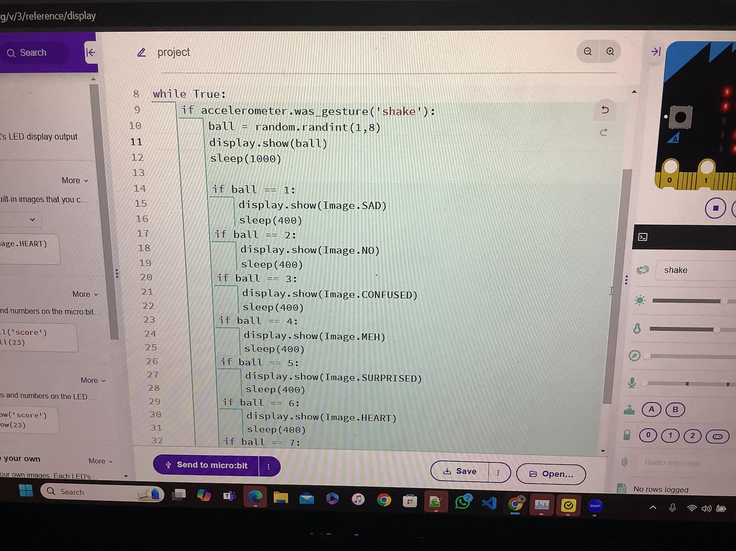
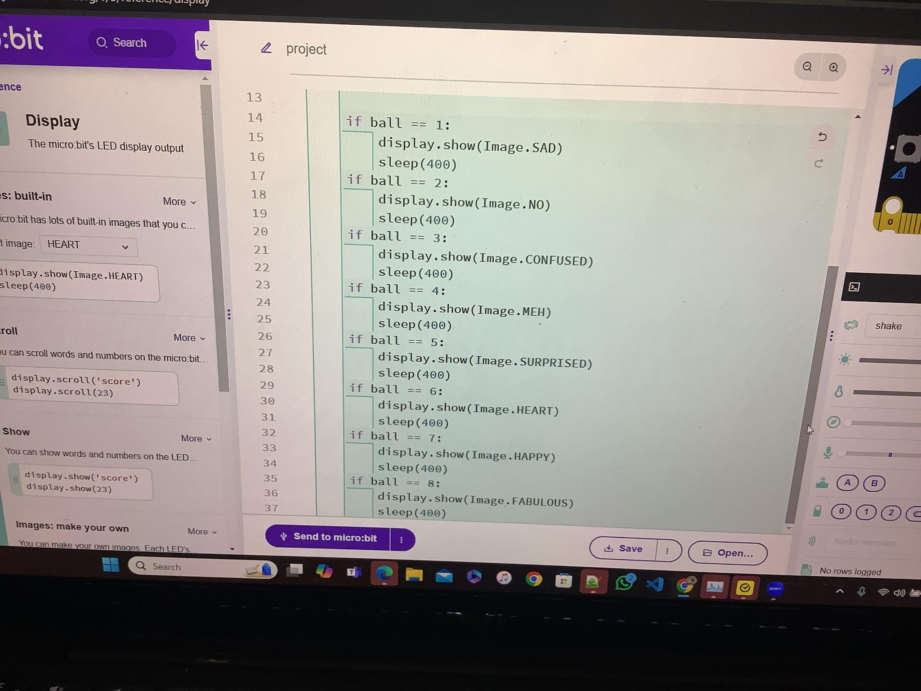
SHOW AND TELL TOPIC
Today in my show & tell project I have made a made a magic 8 ball that goes up to 1 and 8
Here is 2 photos of the code that i used for my 8 ball

Slide 4
PROJECT HIGHLIGHTS
In my code I have used various codes but some of the most important ones are.
1. Random.randint
This command is the command that makes my magic 8 ball random
2.if accelerometer.was_gesture('shake')
This command is the one that lets the code work properly

Slide 5
Thank you

