Slide 1



INTRODUCTION
Hi my name is Laasya.I’m going to tell you about me,I love reading books and going to the library.I also like playing a game called roblox,and in my free time I do either read a book or play with my brother.And so that is all for today about me.

Slide 2
SHOW AND TELL TOPIC
My show and tell topic is called Number Animations.
What it does is for each number you get, a specific image will be seen.
For example, you rolled 3 the picture you might get is a house,
and if you roll 2 the picture you might get is a Pen and so on…..

Slide 3




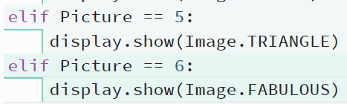

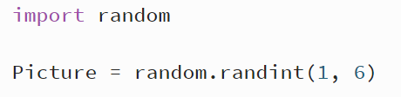


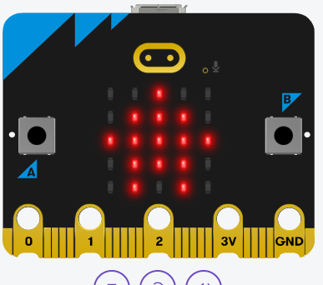


PROJECT HIGHLIGHTS

Slide 4



THANK
YOU!

