Slide 1



Hello Everyone!

Slide 2
INTRODUCTION
Hello my name is zane I am 9 years old and i like to travel around and take trips to one place and a another and I like games at the time and this project will involve random numbers or as i call it random dice and it is a two player game

Slide 3
TWO PLAYER DICE GAME
Guidelines:
Each player pick a team either 1 or 2
Shake the microbit
Wait for the microbit to give out the random numbers
Wait for the microbit to show who won the game
Repeat for every game
Notes:
Can you unmute your mic one by one and shay hello?
If any of them is unable to do that, only then share your ppt and show them how to mute and unmute.

Slide 4
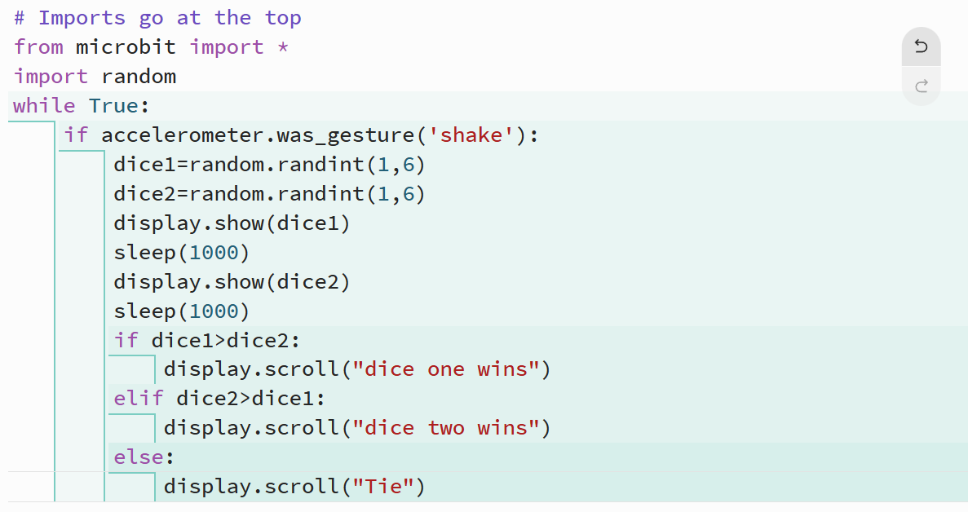
CODE

Slide 5

Thank you for listening!

