Slide 1




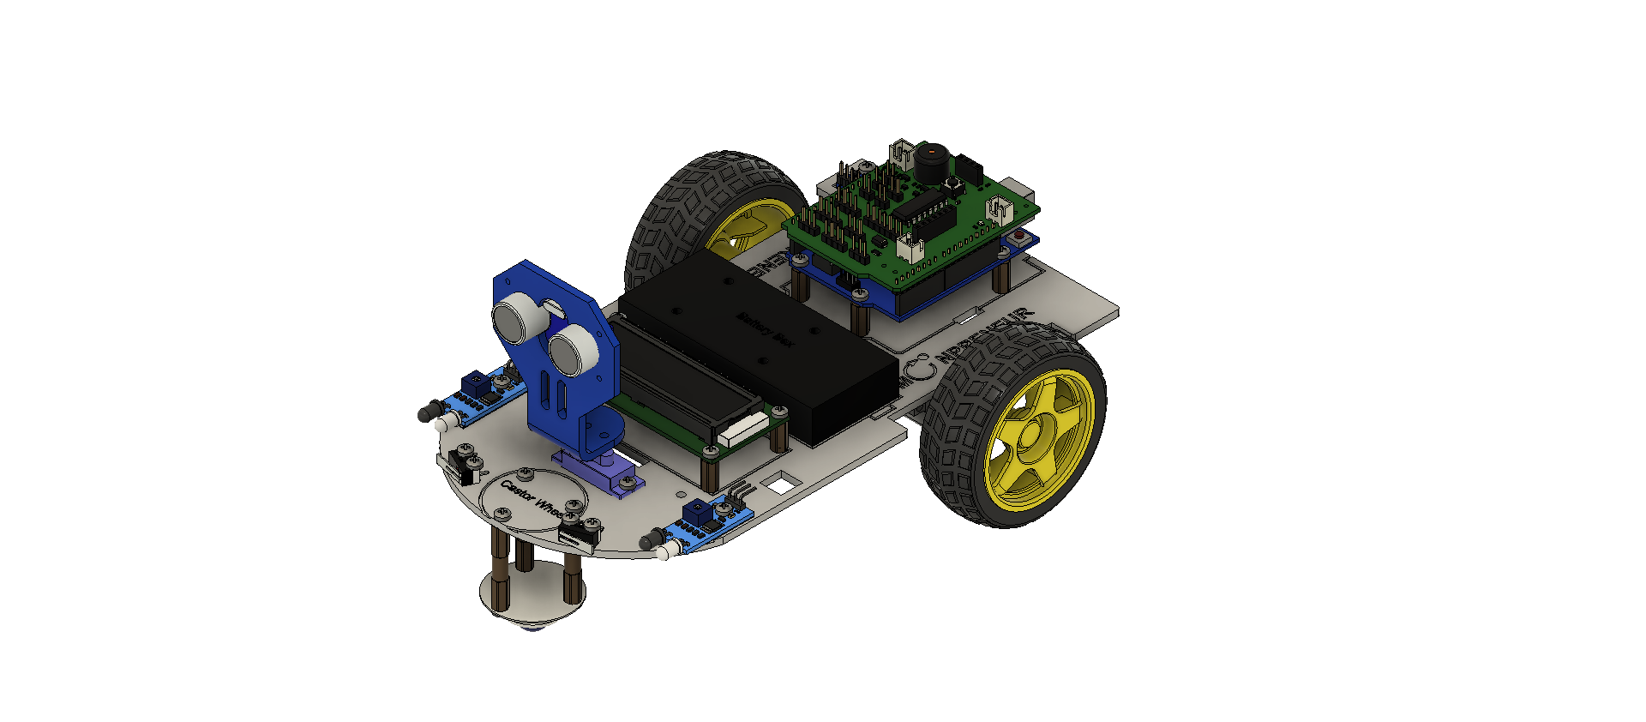



Dice roll

Slide 2


INTRODUCTION
Hi! my name is tilak I am Turning 8 this 28th I am in 2nd Grade My show and tell topic is dice roll

Slide 3
SHOW AND TELL TOPIC
Dice roll. Ever forgot your dice, And you have your microbit you can follow a simple code to make a dice all you need is the if block, the on shake block, and the on start block and the variable num

Slide 4








PROJECT HIGHLIGHTS
Usefull for trips and bord games increases luck for big numbers Twice and is easy to make

Slide 5


THANK
YOU!

