Slide 1



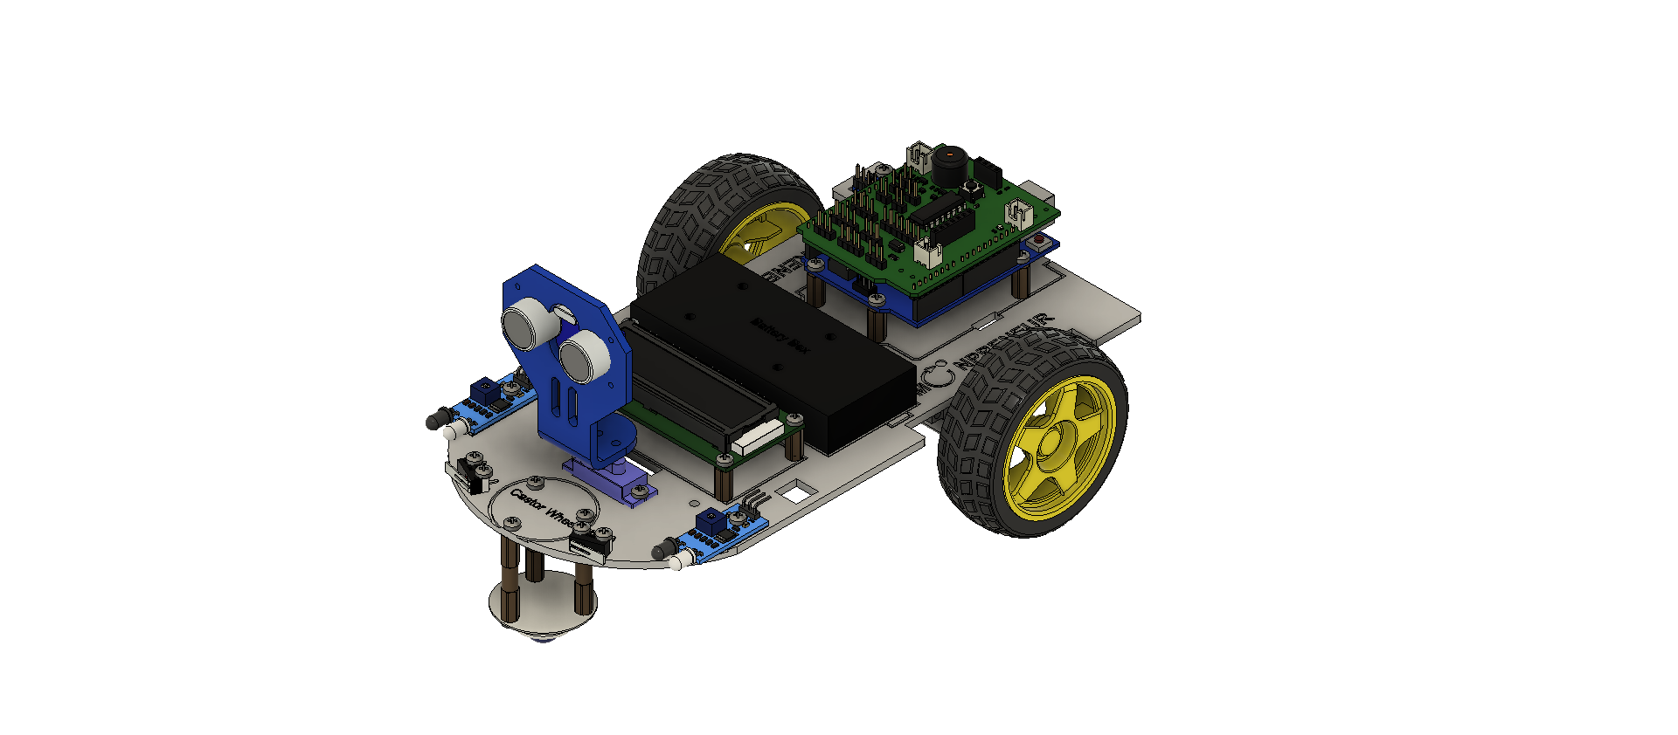
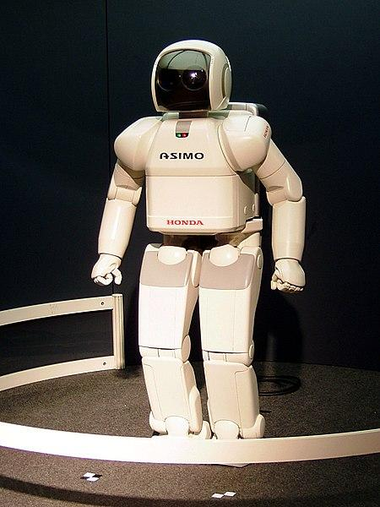



Roboroom Project
BY ANGAD

Slide 2
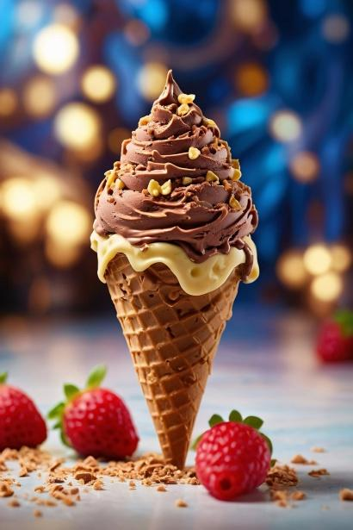




ice cream
INTRODUCTION
My name is angad and today I will share a project I worked on.
This is my fav team

Slide 3
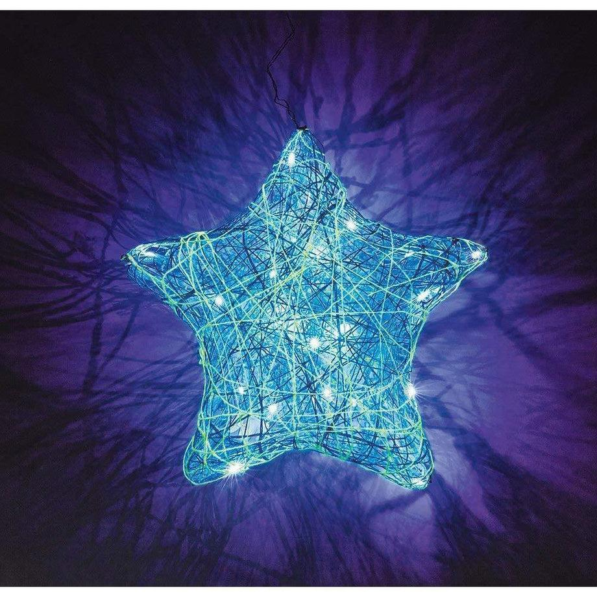
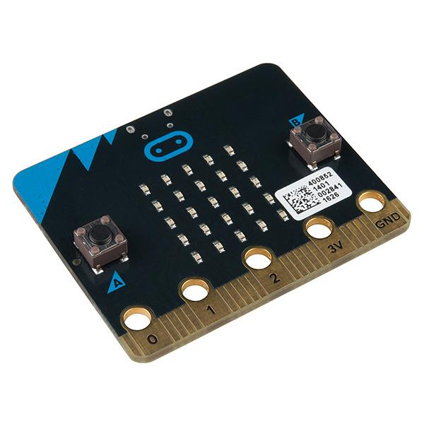
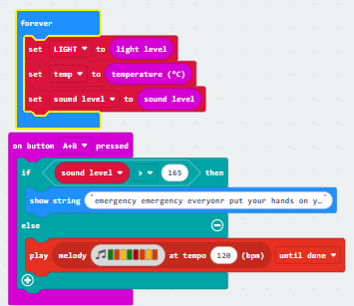
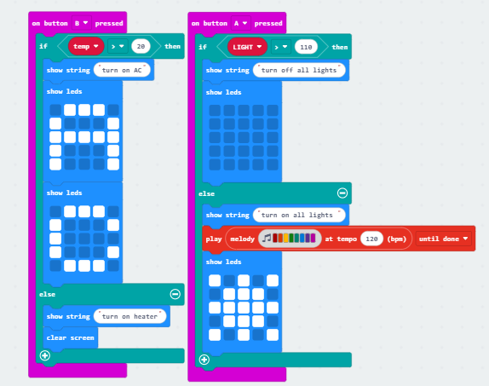


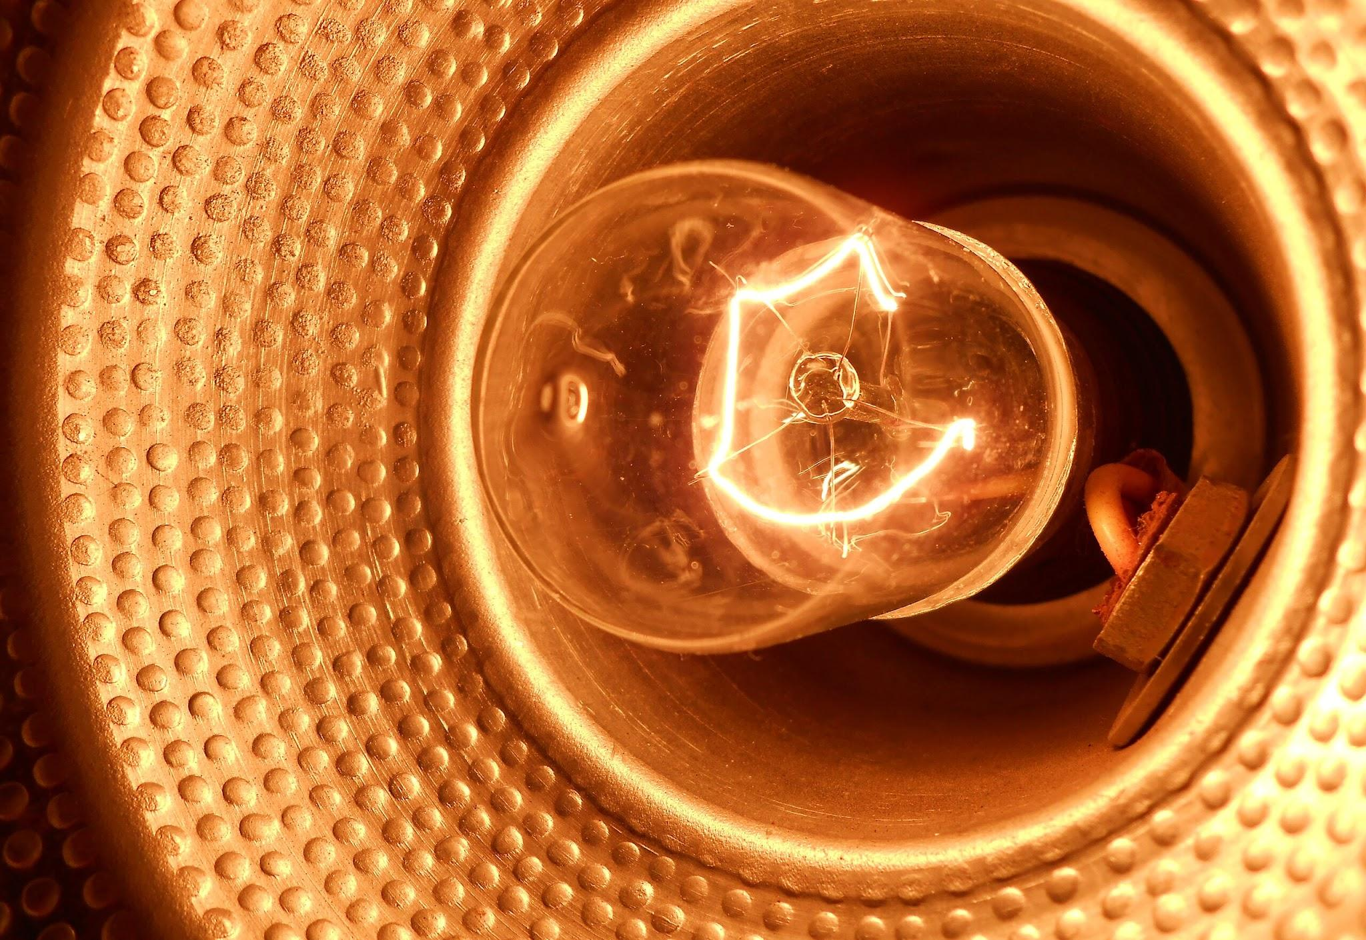
SHOW AND TELL TOPIC
Roboroom has a light sensor,a sound sensor and a temperature sensor.
temp light

Slide 4








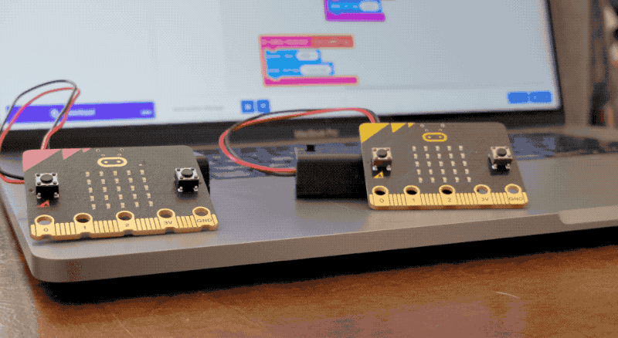

PROJECT HIGHLIGHTS
This is my project link–
https://makecode.microbit.org/S14397-61657-60386-88720

Slide 5


THANK
YOU!

