Slide 1
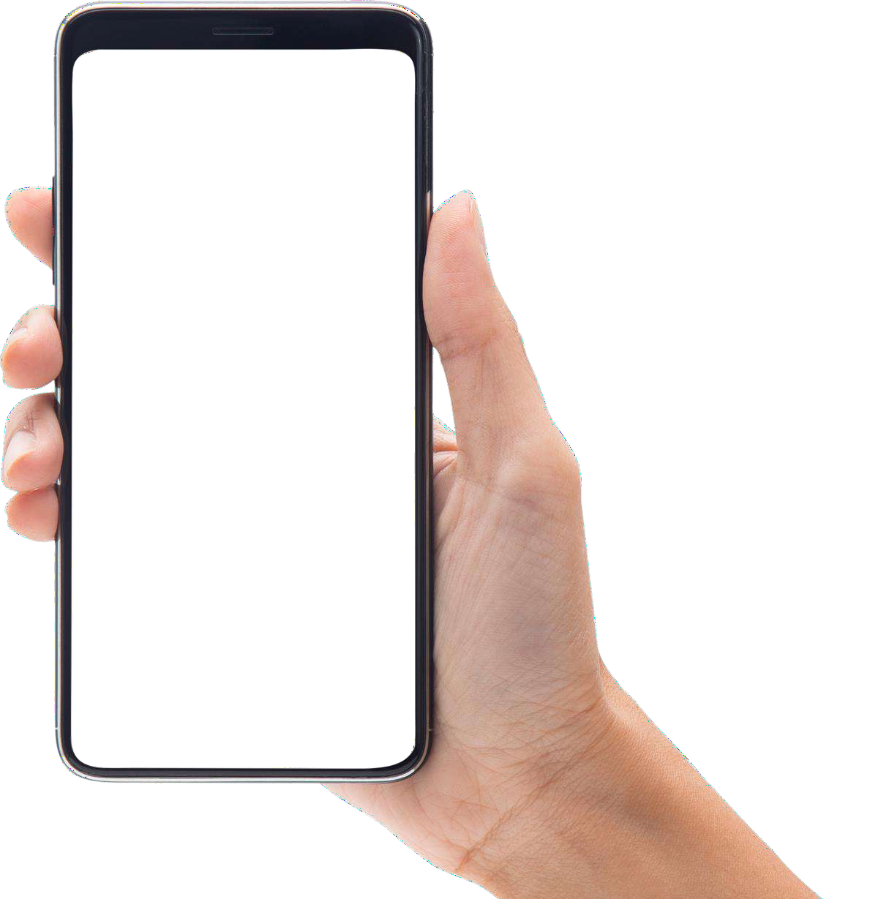
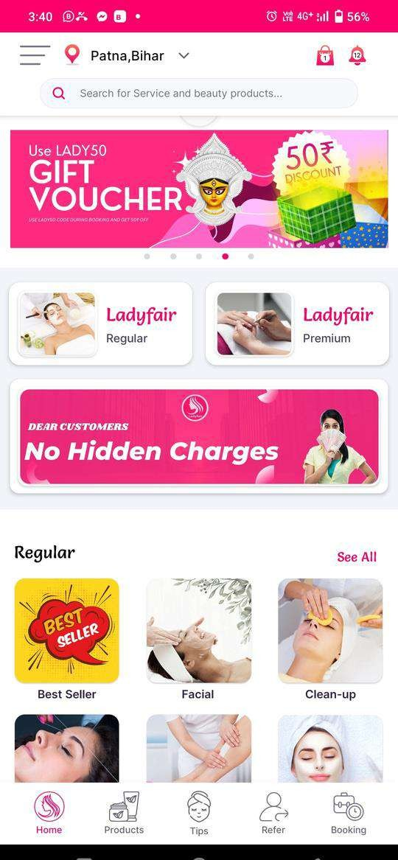
SALON AT HOME
Quality Service, Fair Pricing, Comfort of your Home

Slide 2
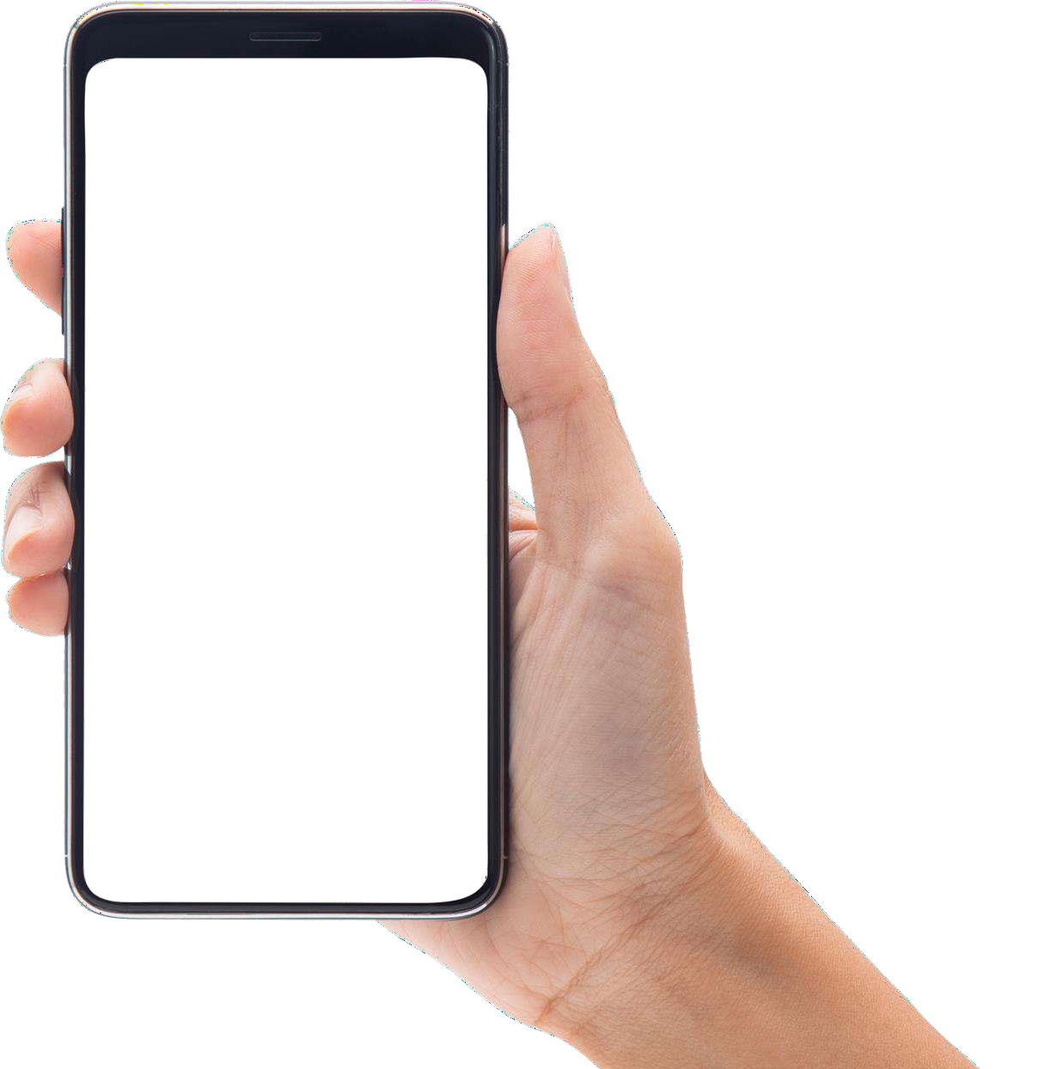
Ladyfair – A Quick & Hassel Free solution for SALON & BRIDAL Services for women from the COMFORT of their HOME.
It is an Online Beauty Service App revolutionizing the way consumers make Salon & Bridal Services appointment.
Started from Patna in 2019 & Currently operating in 12 cites.

Slide 3
PROBLEM
Long Waiting Hours
Customers face long waiting Hours
Sometimes not getting desired slot too
This creates lot of frustration & inconvenience
Appointment Scheduling Issues
Mistakes in appointment scheduling,
Double- bookings, or cancellations by the salon can disrupt customers' plans.
Hygiene and Cleanliness
Cleanliness and hygiene issues in the salon
Dirty tools or unclean workstations, which can be concerning.
Pricing and Hidden Costs:
Unexpected / Hidden charges or
Unclear Pricing can lead to customer frustration & disputes over the final bill.

Slide 4
PROBLEM
Lack of
Privacy:
Customers may feel uncomfortable if they perceive a lack of privacy during certain treatments, such as waxing or massages
Talent NOT available in Local Areas
No brand available in local villages for salon at home service for female.
Rural India lacks proper salon service
Inadequate Product Information
Customers may not receive sufficient information about the products used during their treatments, making it difficult for them to make informed decisions

Slide 5
SOLUTION
Online Booking: Appointments through the app. Reducing the risk of scheduling errors.
Real-Time Availability: The app show real-time slots, allowing customers to choose convenient times.
Appointment Scheduling and Management
Automatic Reminders: Send automated appointment reminders to reduce no-shows and late arrivals.
Precise Scheduling: App-based services can optimize scheduling to minimize wait times.
Detailed Profiles: The app can provide detailed profiles of stylists/technicians, including reviews & ratings, helping
customers choose experienced professionals. (In Process)
Instant Feedback: Customers' instant feedback on services, help to maintain quality.
Unsatisfactory Services:
In-App Communication: Offer in-app chat or call options to facilitate communication between the customer and stylist/technician. (In Process)
Customer Care Support : Strong customer care support to redress customer’s issue very efficiently.
Communication
Problems:
1.Quality Control: Implement strict hygiene and cleanliness standards and provide customers with assurances through
the app.
2.Encourage customers to leave reviews about Quality and hygiene.
Hygiene and Cleanliness

Slide 6
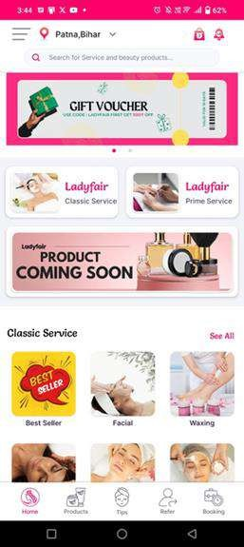
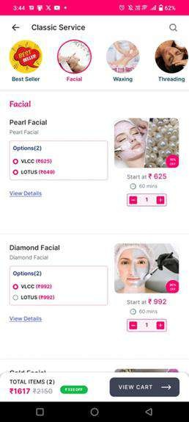
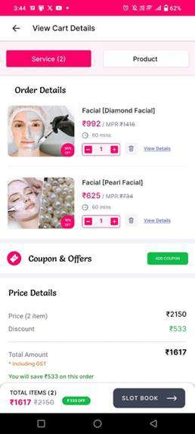
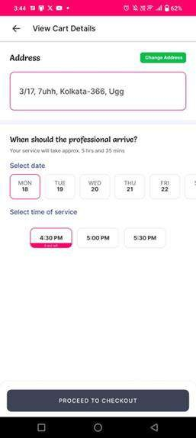
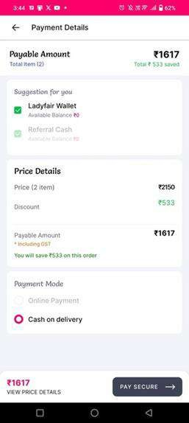
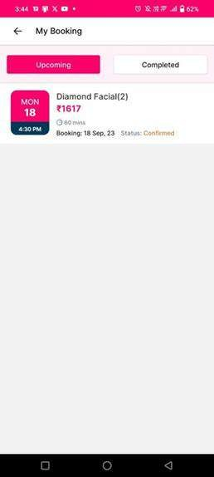
How Solution Works By App
Step-1
Download & Install
Step-2
Chose Services
Step-3
Review and Apply coupon
Step-4
Put address, & Select Slot
Step-5
Chose payment Method
Step-6
Booking Confirmed
After getting appointment our Beauticians will arrive @location ON TIME with complete kit and provide scheduled services.

Slide 7
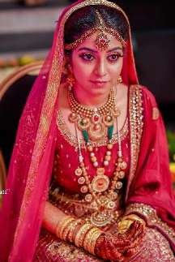
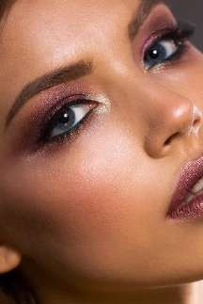
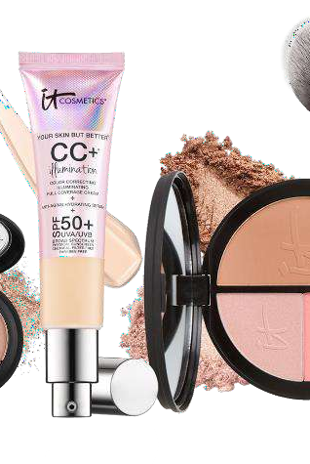
USP
Focus on Tier 2 & 3 Cities of India
No Hidden Charges
End to End Bridal Services
Free Beauty Consultant
Customer’s Choice of
Products & Service

Slide 8
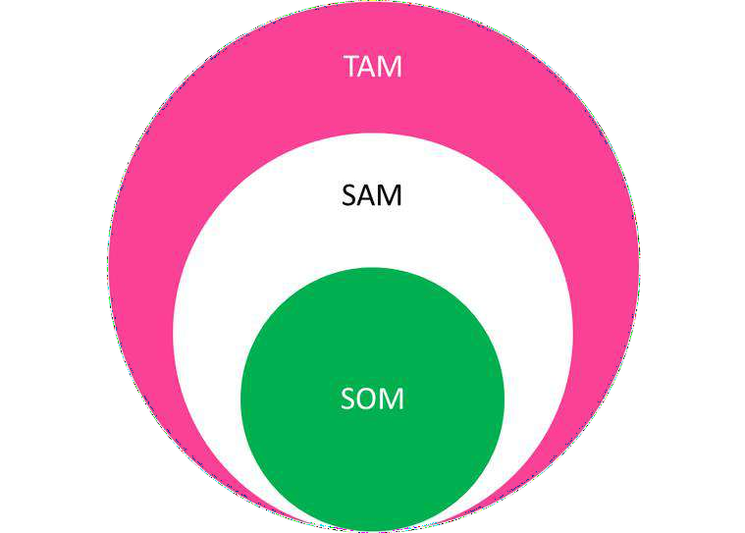
MARKET
Data according to ‘’STATISTA’’
₹ 2440 Bn
₹ 1200 Bn
₹ 800 Bn

Slide 9
OUR IDEAL CLIENT
Sex - Females
Age – 16 plus years
Occupation – All
Income Category – Upper Middle Class (Medium & High Income Range - 5lac plus per annum family income)
Geographic - Semi Urban Cities - Focusing on fast economically growing semi-urban / Tier 3 Cities.
Interest – Females interested in Self Care, Grooming & Beauty
Special Focus – Brides & their allied or Females appearing for any special occasion in their life
Pain Points – Don’t get High Quality Beauty Service in their location, Want complete comfort
& value for money

Slide 10
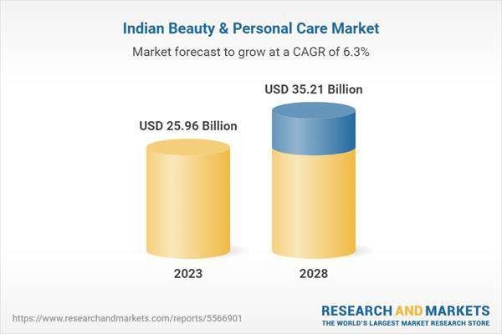
ANALYSIS
MARKET SEGMENTATION:-
By Products :- Hair Care Products, Skin Care Products, Bath & Shower, Oral Care, Cosmetics & Makeup, and Beauty Tools & Accessories.
By Type :- Conventional and Organic.
By Category :- Mass and Premium.
By Distribution Channel :- Online and Offline.
CAGR OF BEAUTY INDUSTRY AS PER LIVERMINT IS 11% & MODOR INTELLIGENCE IS 10.91

Slide 11
ANALYSIS
As per our survey in rural areas with 1000 females - 80% of females prefer salon services at home. But unable to get the
service due to lack of availability of adequate services - lack of time and restriction of going to salon. So Ladyfair - online
saloon services is going to cater all these issues in rural areas.
Avg Populat ion – 2 lakhs
TIER 3
City
200
Cities
LADYFAIR
Targeted Female - 50000
We capture 100
Cities
No of Service or Revenue of INR 1000 per day = 50 = INR 50000/day
Revenue = INR 50 lakhs / day

Slide 12
ANALYSIS
BASIC PROBLEM with THIS BUSINESS MODEL –
MARKETING EXPENSES:
Concentrating on organic marketing
SEO / Promotion on social media with customers feedback video, reels & referral promotion offers.
CUSTOMER RETENTION:
Proper quality and safety/security standard.
Additional feedback via call. For repeat customers & bookings we will provide some lucrative offers as discounts & additional services.
If they share in 3 What's app Group INR 300 discount etc. or give 3 referrals INR 150 discount to the referral and the refereed client
We try to make the customers aware of the problem they will face, if they call the beautician direct- like product / safety / security. As a brand, we are more responsible to customer than any beautician.
BEAUTICIAN ISSUES - They get paid 70% flat and no hidden deductions. If we get service then, they gain.

Slide 13
SERVICES
Makeup services - Skin Care - Hair care – Tattoo - Mehndi
This Photo by Unknown Author is licensed under CC BY This Photo by Unknown Author is licensed under CC BY

Slide 14
REVENUE MODEL
We are 2 source of Revenue
Charging for Service, Subscription from Customers
Franchise Fee and % Royality from Franchise.

Slide 15
CURRENT STAGE
Present Margin in Service : 15%
Margin in Make-Up Service : 25%
Present Revenue from Service per Quarter : INR 350,000
Revenue from Make-Up Service per Quarter : INR 250,000
Present servicing 3-5 clients per day of avg ticket size : INR 1000
Having a term sheet of 2cr in the exchange of 10% equity from Eskeyn Venture

Slide 16
Unit Economy
Our minimum booking Ticket size is 1k
1000₹
300₹
700₹
100₹
30₹
20₹
150₹
300₹
Marketing
Office Expenses
Income
Gross Margin
For Ladyfair
Salary
For Beautician
Net Profit
150₹

Slide 17
FUTURE PLAN
Timeline | Customers Served | Expenses (In Lacs) | Revenue (In Lacs) | Commission (In Lacs) | Net P&L (In Lacs)
6th Month | 25 *180 =4500 | 27 | 45 | 9 | -18
12th Month | 75*180=13500 | 33 | 135 | 27 | -6
18th Month | 150*180=27000 | 45 | 270 | 54 | 9
24th Month | 300*180=54000 | 57 | 504 | 108 | 51
30th Month | 450*180=81000 | 69 | 845 | 162 | 93
36th Month | 600*180=108000 | 81 | 1008 | 216 | 102
Our minimum booking Ticket size is 1k
We will served 25 customers per day in first 6 months and so on.
Expenses Break up – Ad : 67 % , Office & Misc – 11% & Support Staff : 22%

Slide 18
ASK
Estimated Fund Utilization Breakup
Celebrity Face For Branding – 10 Lacs
Scale-up ONLINE CAMPAIGN to acquire customers - 50 Lacs for 1 year
(75k customers can be acquired )
EXPAND TEAM : Hiring and Quality control 2 person ( 6 Lakh / Annum )
BDM –Marketing and Revenue generation ( 12 Lakh / Annum)
Managing Booking and Beauticians : 2 Persons ( 6 Lakh / Annum )
2 Crores in Exchange of 10% Equity
Present Expenditure : 36 Lakhs / Annum
MOBILE APP for Beautician : 15 Lakh
Build in House Technical Team to SERVICE & SUPPORT our MOBILE APP/WEB (Outsource) :
5 Lakhs / Annum
Trainer & TRAINING PROCEDURE for the Beautician : 12 Lakhs Per Annum

Slide 19
GO TO MARKET AFTER FUNDING
1. Expand Service Offerings: Consider adding new services or packages to attract a wider range of customers. Offer specialized treatments such as hydra facials, ayurvedic massages, skincare consultations, or virtual makeup sessions.
2. Tie-up with Specialised Service provider like Swedish massage, specialized Ayurvedic massage, Anti-ageing treatment, Oxygen facial etc, and list them on the App on commission basis.
3. Tie-up with dermatologist for Skin Treatment Services & advise
4. Collaborating for White levelling of products & selling
5. Event Sponsorship and Partnerships: Identifying sponsorship opportunities and establishing partnerships with relevant events in the industry to enhance the company's market presence.
6. Collaborate with Marriage houses, beauticians & Customers for lead of Bridal Makeup
7.Beautician & Partners Training Programs: Developing and conducting training programs for our beautician and partners, on product usage, application techniques and industry best practices. Ensuring that customer get’s the feel of ‘service’ from a Luxury Brand.
8. Special Promotions and Loyalty Programs: Offer special promotions, discounts, and loyalty programs to reward repeat customers and attract new ones. Consider offering referral bonuses to encourage satisfied customers to refer their friends and family.
9. Hospitality and Customer Relations: Applying hospitality skills & offers to elevate customer experience, manage client relationships and ensure outstanding service delivery.
B2B Plan
Tie- up with Hotels, Resorts, Marriage Halls for Co-Branding.
District wise franchise.
Beauty and Makeup Training institute.
Coupon Co-Branding with Spencer’s , Dmart, Pantaloons, Jewellers Etc

Slide 20
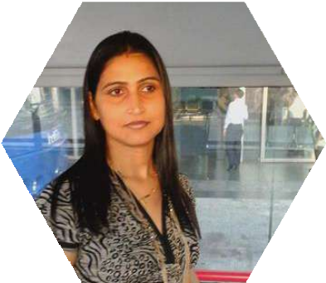
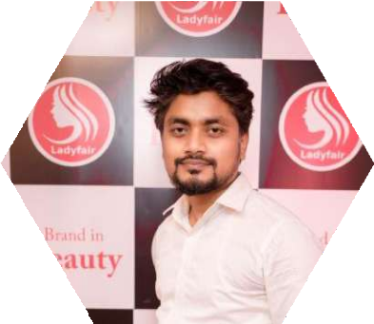
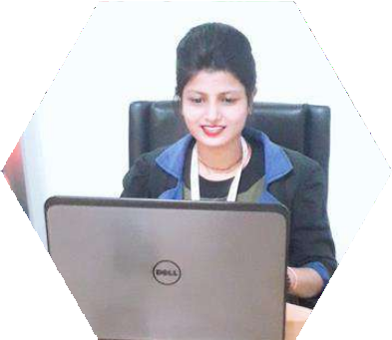
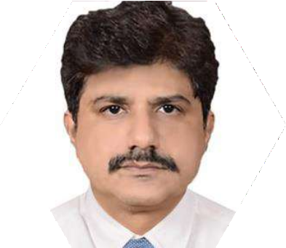
TEAM
SARIKA SUKLA
CO-FOUNDER
RISHI RANJAN
FOUNDER
PRAGATI SRIVASTVA
MANAGER
ARADHNA NASHKAR
QUALITY MANAGER
Vivek Vyavhare
SEO Expert & Digital Marketing
ARUN K. SUKLA
HEAD – BUSINESS
DEVELOPMENT
NEELANJAN B.
CHIEF MARKETING OFFICER

Slide 21
THANK YOU

