Slide 1
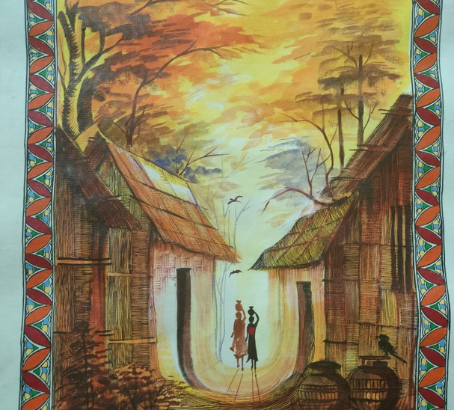
PITCH DECK

Slide 2
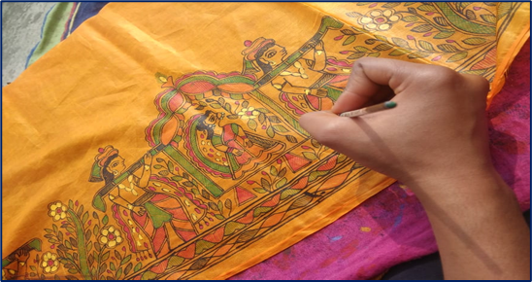
ABOUT KALAAPLANET
KalaaPlanet is a purpose-driven enterprise that aims to breathe new life into traditional handmade paintings.
What sets KalaaPlanet's handmade paintings apart is our meticulous process in reimagining art through our niche fusion paintings.
Use of technology and sustainable practices ensures 100% authenticity and high-quality work.

Slide 3
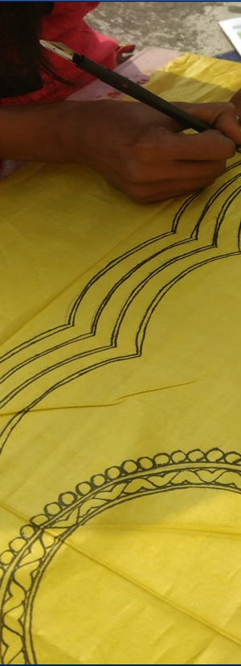
ABOUT US
Founders:
Annishree Tiwari, B.Tech
Annu Shree, Commerce background
Present Offerings- Handmade Paintings, Home Decor items, Fabrics, Items for Corporate Giftings
Online marketplace equipped with Technology
INCUBATED AT

Slide 4
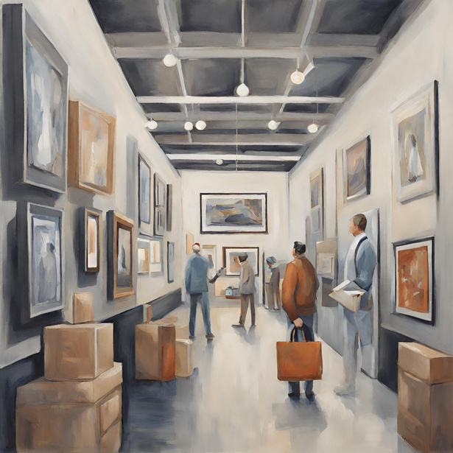
THE PROBLEMS
Our target market currently faces the following problems
LOW AWARENESS OF ART
PRODUCT AUTHENTICITY/
PRICE ASSURANCE
LOGISTICS
ISSUE
Notes:
1. Low awareness of Art-
"Art is considered an Elite affair"
Low awareness about:
which are the best artists in the market,
where to buy the art piece,
which artist is expert in the theme that I require,
what is the authenticity of the work, is it being offered at the right price –
are some of the common issues an early-stage art enthusiast struggles with while making a purchase.
2. what is the authenticity of the work, is it being offered at the right price – are some of the common issues an early-stage art enthusiast struggles with while making a purchase.
3. Gap between the artists and the collectors. Buying art is not an easy task for an art enthusiast. There were limitations such as narrow exhibition windows, waiting in long queues at established galleries and smoothly getting the purchase delivered to home.

Slide 5
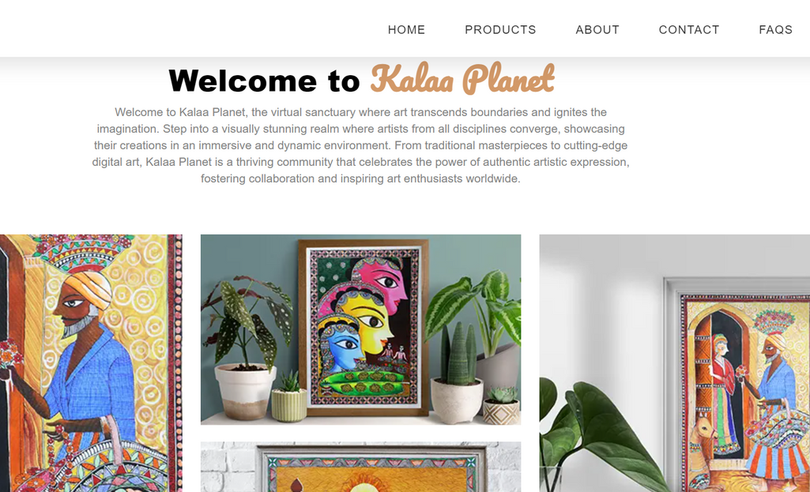
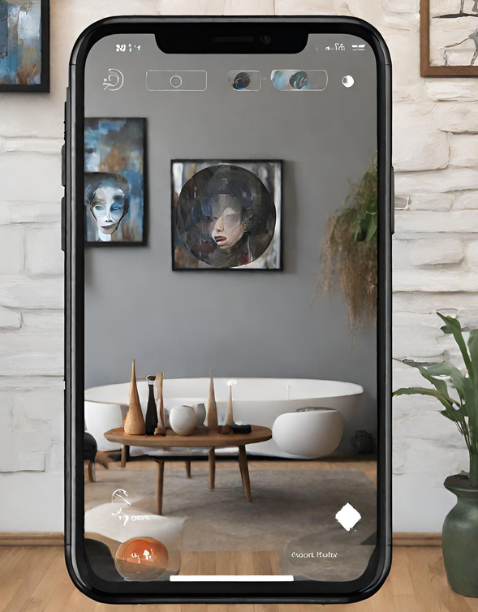
SOLUTION
Integrated Market Place for Art
a)Accessibility at right price point
b)Control of Value Chain-100% quality
c)Sustainability as core theme
Application of Technology a) AR/VR-solve logistics hassles b) Blockchain-100% authenticity c) Biz Model- Subscription based

Slide 6
MILESTONES
FIRST PHASE
SECOND PHASE
THIRD PHASE
Introducing different art forms and more emphasis on Fusion Paintings
Fully functional website and vibrant social media handles
Product Diversification- Corporate Gifting
Implementing new technologies which assure customers of authenticity of our products
Focus on Export Market.
Notes:
received 120+ orders through digital channels in the last three months
Being appreciated in the Corporate Gifting space. Excellent Product Packaging- with focus on sustainability theme pulling customers
Introduced 5+ new products keeping the Festival season- products include mobile stand, table paintings, miniature art forms, etc.

Slide 7
VALUE PROPOSITION
COMPETITIVE ADVANTAGES
GROWTH
/MARKET POTENTIAL
TARGET
SEGMENTS
USP
MARKETING MESSAGE
Best artists onboarded
End to end control of value chain
technology implementation making the art buying experience hassle free for everyone
HNIs
Hotels & Resorts
Restaurants
Art Galleries
Business and corporate houses
Real estate / co-working spaces.
Household
Authentic artists
7 days return policy (money back guarantee / Quality guaranteed)
Exchange/Buy out of artifacts after the lock-in period - buyback system for paintings.
Use of technology to track the origin and present status of the painting.
Fusion artwork
Untapped potential in this sector with the following trends that supports growth:
rise in No. of HNI in the country,
India’s share in the global art industry stood at a miniscule 0.5 per cent in 2016.
Patronage of corporate

Slide 8
Traction
01
Funding
Obtained seed funding from IIM Lucknow
Business
B2B , B2C
Corporate gifting
02
Revenue Generating
03
04
First technology based platform to market traditional artforms

Slide 9
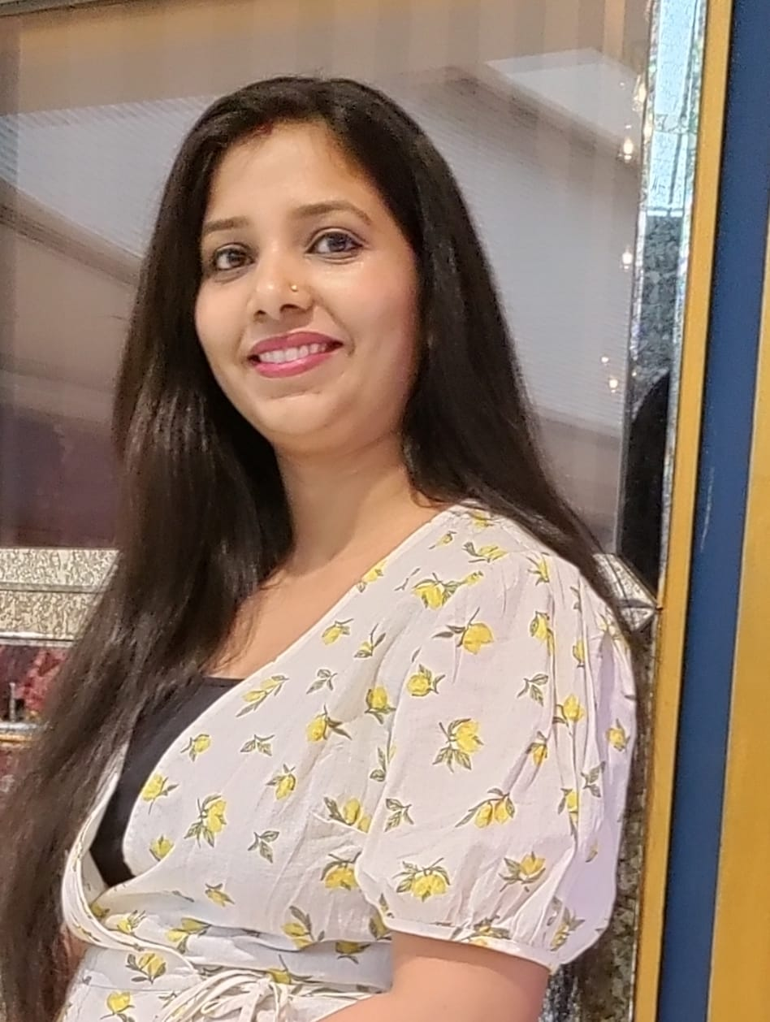
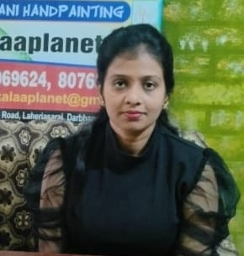
Team Members
Directors of Kalaa Planet –
Annishree Tiwari Annu Shree
annishree.28@gmail.com annushree048@gmail.com
Mentor- Rupam Bhattacharyajee
Advisor - Rishi Raj

Slide 10
Thank You!
Creativity
is a way of life

