Slide 6
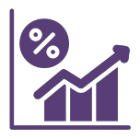
Vision & Value Proposition
Empower cattle farmers by staying committed to innovation, sustainability and nutrition
AI driven model to provide customized feed formulations based on nutritional requirements
Seamless integration of veterinarian and insurance services
Boost milk production in cattle by 15% to 20% with pineapple waste based herbal feed
Embracing sustainability with zero feed waste

Slide 7
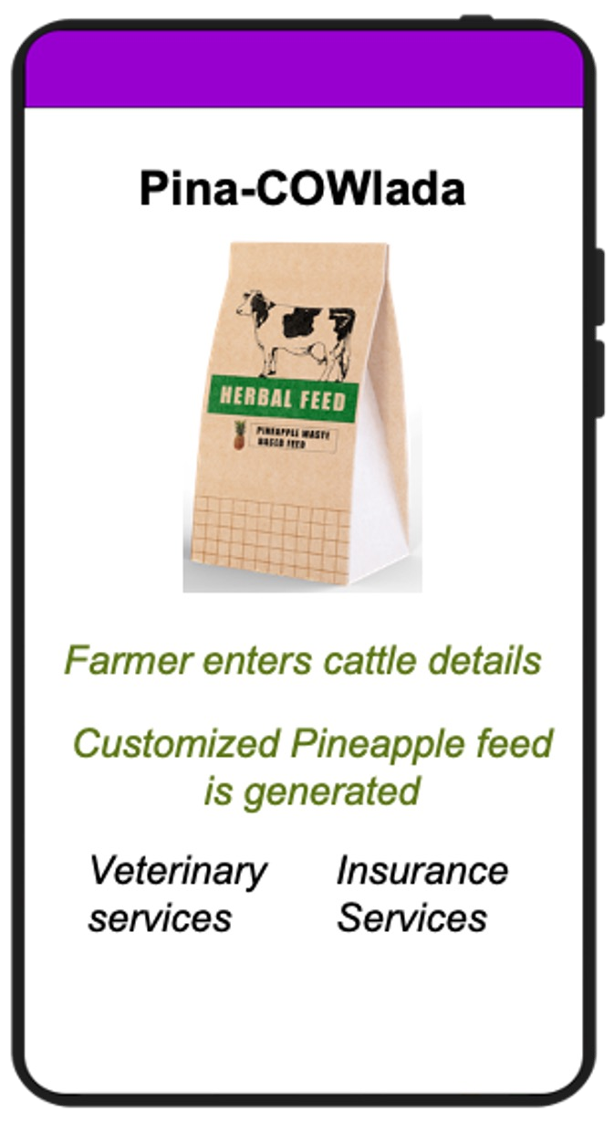
Ideation
Empower farmers with pineapple waste herbal feed based on cost- efficient feed balancing using our AI based prediction model to cater to specific nutrition needs of the cattle, thereby enhancing health and yield via online platform/app

Slide 8
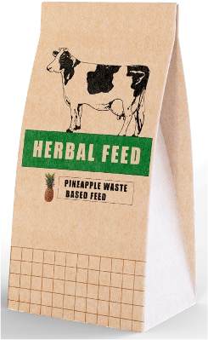
Ideation
Herbal Cattle Feed from Pineapple Waste
ENTER INPUTS
AI based prediction model for feed profile
RECOMMENDATIONS
OBJECTIVE
RECOMMENDED NUTRITION PROFILE :
? Pineapple leaf waste is
BODY WEIGHT
MILK FAT
? Input data (Objectives, Cattle data & Environment Data) is entered by user to determine optimum feed profile
compacted into pellets as the waste contains high fibre (48.7 g/100 g) which has high digestibility potential in animals, thereby enhancing milk production by 20%.
DRY MATTER INTAKE (DMI)
2.522 Kg
MILK YEILD
CRUDE PROTEIN (CP)
0.287 Kg
CATTLE DATA
TOTAL DIGESTIBLE NUTRIENTS (TDN)
1.232 Kg
BODY WEIGHT
OPTIMUM FEED MIX BASED ON NUTRITION PROFILE
ORDER FEED
AGE (IN YRS)
BREED
PREG. STATUS
? Nutrient Requirement = F1 + (MY x F2) + F3
Fl, F2 & F3 are objective functions with respect to body weight, milk fat & months of pregnancy respectively and MY is milk yield
INSURANCE SERVICE
BODY FAT %
ENVIRONMENT DATA
? Herbal feed comprises bioactive fractions/herbs like Ashwagandha, Halim, Amla, Giloy etc. which increase bioavailability of essential nutrients and improve intestinal absorption of nutrients
TEMPERATURE
HUMIDITY
RAINFALL
CALCULATE OPTIMUM FEED
? Analyse the given data using AI models to generate nutrition
profile which is used to generate low-cost feed profile
□ Hassle-free cattle insurance
services with cattle tagging, veterinary reports services.

Slide 9
Competitive Analysis
Product / Services
Target Audience
Price Structure
Key Advantage
Smart dairy farming solutions
Dairy farmers
Transaction and commission based
Comprehensive dairy management platform
Livestock marketplace
Livestock buyers and sellers
Commission based pricing
First mover advantage
Dairy farm management software
Dairy farmers
Transaction based pricing
Real time data insights and analytics
Livestock marketplace
Livestock buyers and sellers
Commission based pricing
Strong focus on customer service

Slide 10
Competitive Analysis
Product / Services
Target Audience
Price Structure
Key Advantage
Smart dairy farming solutions
Dairy farmers
Transaction and commission based
Comprehensive dairy management platform
Livestock marketplace
Livestock buyers and sellers
Commission based pricing
First mover advantage
Dairy farm management software
Dairy farmers
Transaction based pricing
Real time data insights and analytics
Livestock marketplace
Livestock buyers and sellers
Commission based pricing
Strong focus on customer service

Slide 13
Thank you!

