Slide 1
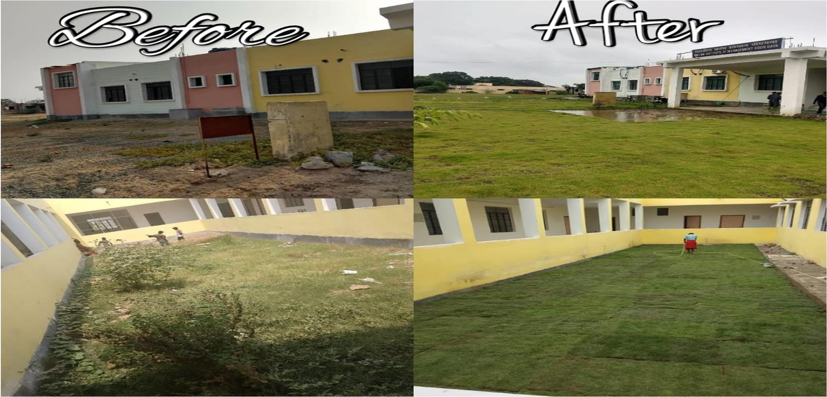
“Outdoor Living spaces for Next Generation”
EcoVenture is an agri-tech Platform from where one can get Personalized Garden and Garden Maintenance services from the network of qualified professionals with transparency in prices.
We are like “LivSpace for Gardening services”.
IIM Bodhgaya

Slide 2
Problem
Discovery of Qualified Professionals.
On an average one spend 20-30 percent more than actual rate due to lack of price transparency.
Qualified Gardener on any single platform to maintain the garden
Think !!!
But what if you could get a one stop destination where your dream garden comes true. No more hassle in finding the qualified professional for the work. No more fear of losing the hard-earned money due to poor execution or even incomplete execution of work. No more waste of time to ensure the quality of work. What if there was a simple way to turn your dream garden a reality with a click?

Slide 3
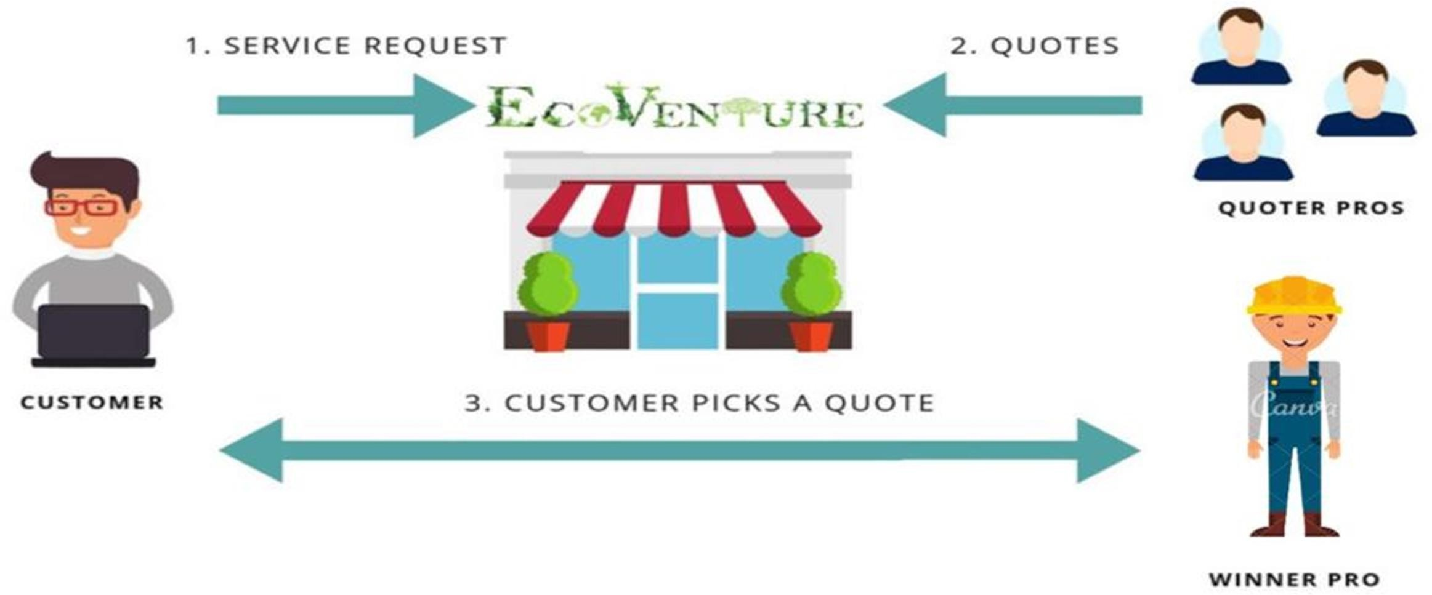
Solution / Business Model
Introducing EcoVenture, India’s biggest network for gardening professionals which is Redefining green decor experience. We bring you a complete garden network. Forget your garden projects tension now with us.
Marketplace pay per quote Model

Slide 4
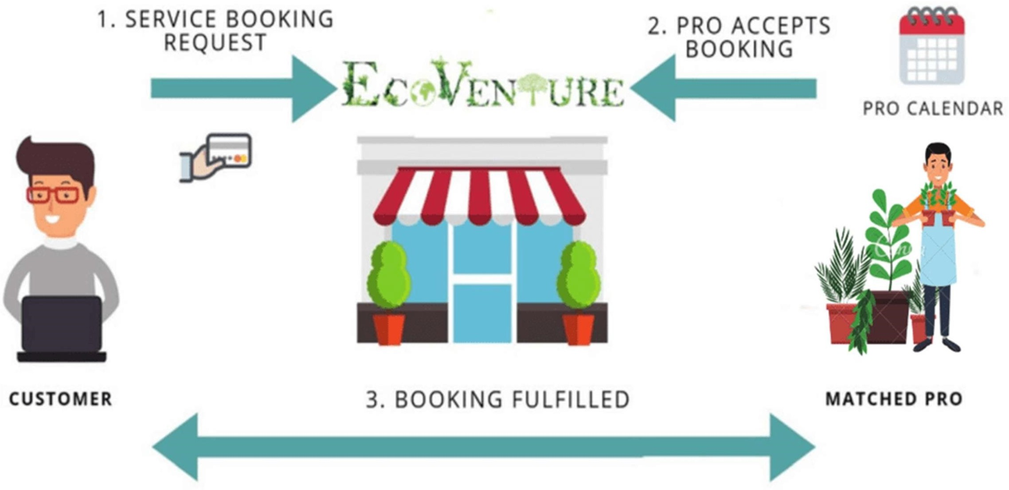
To Book Qualified Gardener Post Service
Book Now Model

Slide 5
Product & Service

Slide 6
Value Proposition

Slide 7
USP

Slide 8
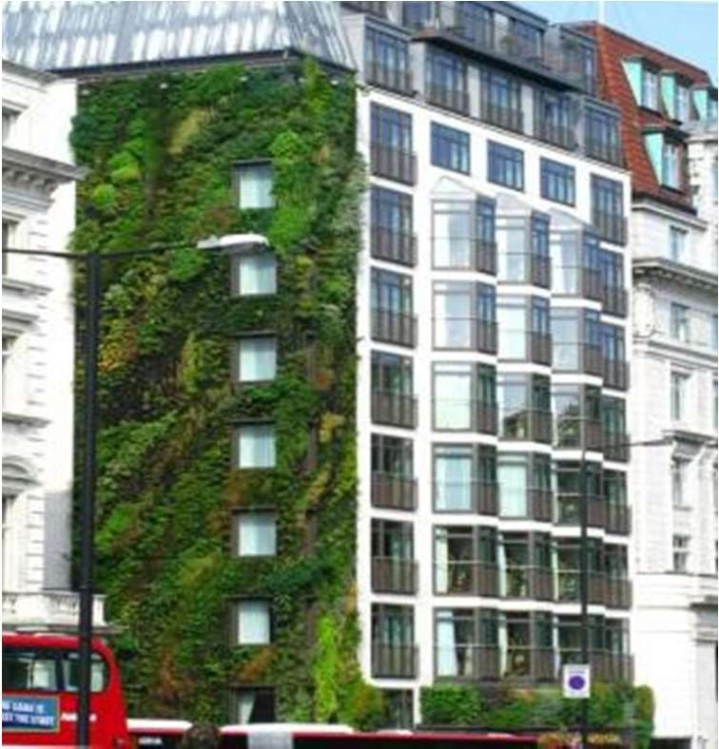
Segment (Residential + Commercial)
Hotels and restaurant / Cafe
Bungalow, Villa
Public Places(Airport, Flyover, Park)
Habitat Centre
Schools/Colleges/Universities
Societies
Corporate Houses etc.

Slide 9
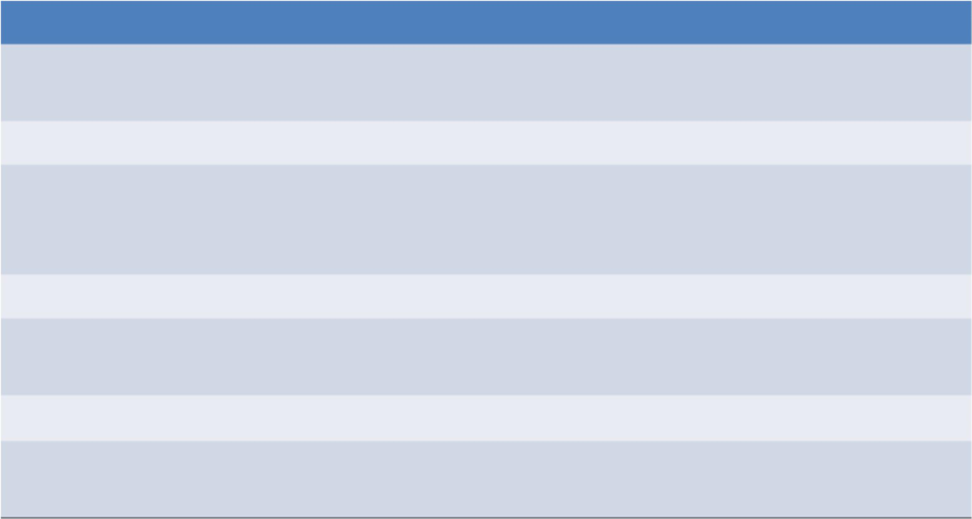
Competition and Barrier to Entry
 | x1 | x2 | EcoVenture
Tech Driven Platform | NO | N O | YES
Tech Driven Standardized Operations | NO | NO | YES
Marketplace Model | NO | NO | YES
After Sales Service | NO | NO | YES
Unskilled people
can be a threat to the company as they project
themselves as a skilled one just to get the services from the client but unable to execute in a professional manner. Same in the case, with the
unskilled Mali
for the maintenance services of the garden. But with the
availability of such platforms, these issues will be resolved.

Slide 10
Achievement So Far
Received a Fund of 10 Lakhs from Bihar Government under Bihar Startup Policy.
Received a Grant of 6 lakhs under RVKY RAFTAAR scheme.
Featured by Artha impact. (impact investing arm of Rianta Capital)
Enrolled in a cohort program of “Startupguru.co” and we have received a commitment of 100k $ on the completion of the cohort . (Guy Kawasaki is one of the investor on this platform)
Recognised by DIPP / StartupIndia .
We have started our journey in 2018 and generates a cumulative revenue of around 1.5 crore till date from Patna only and we are profitable as well.
Featured by yourstory and MSMEx Incubated by AIC-V , BIA, BAU

Slide 11
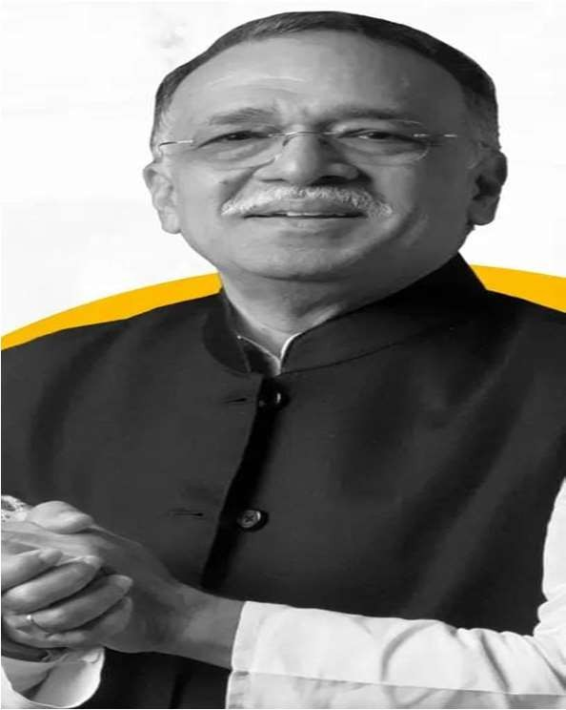
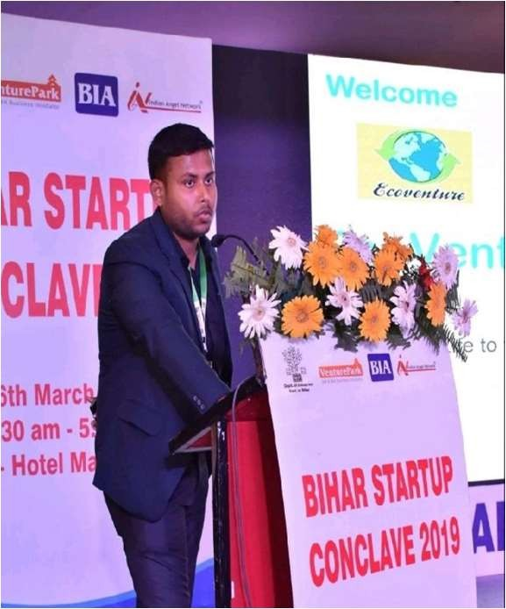
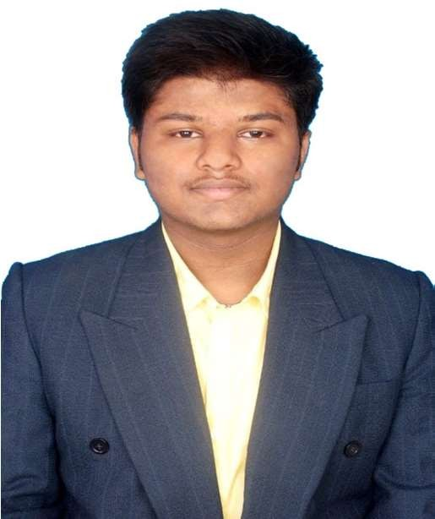
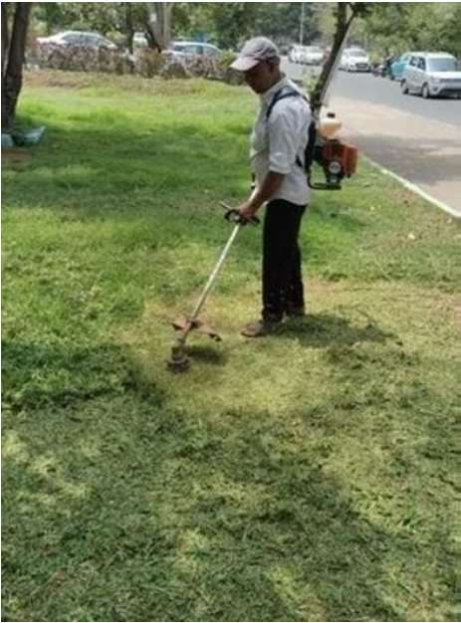
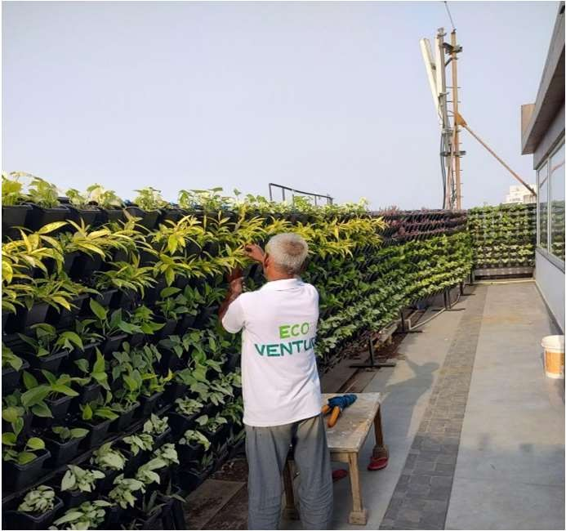
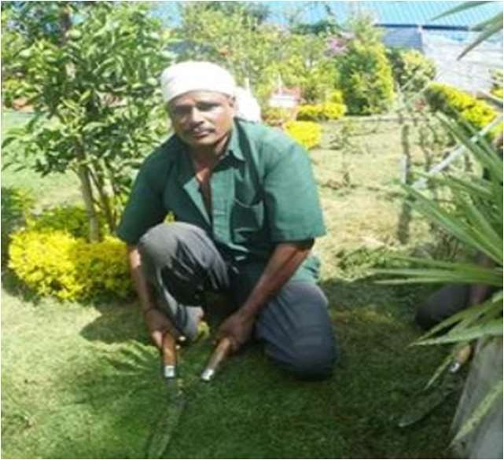
Team
Pramath Raj Sinha Mentor
(MD Harappa Education)
Rahul Kumar – Founder and CEO (Takes care of Sales and Marketing)
Rahul Kumar –Landscape designer / Operation (NIT Patna)
Tech Partner from Gujara
(Made first version of OYO)

Slide 12
Growth Forecast
Traction
 | 30,00,00,000
 | 25,00,00,000
 | 20,00,00,000
 | 15,00,00,000
 | 10,00,00,000
 | 5,00,00,000
-
2021-22
2022-23
2023-24
2024-25
2025-26
EBITDA
2023-24
2021-22
2022-23
2024-25
2025-26
27.50
25.00
26.00
27.00
15.00
EBITDA (Ratio,%)

Slide 13
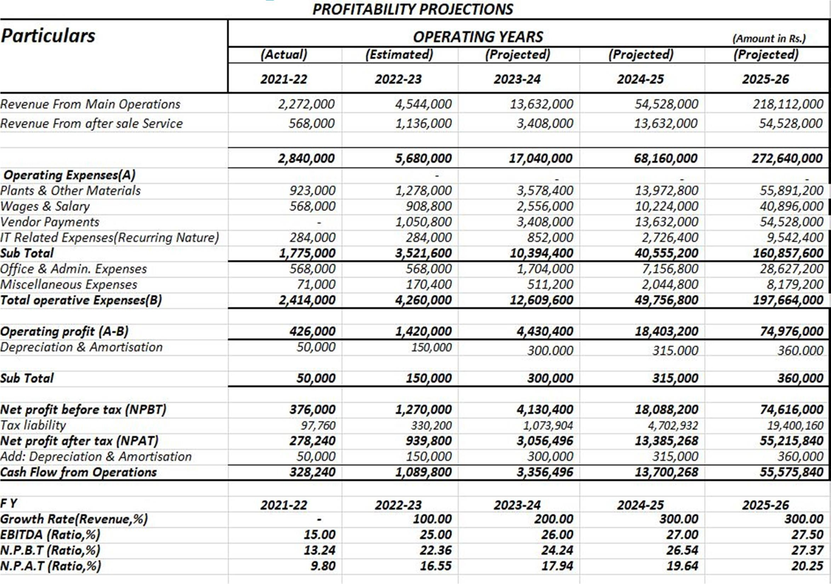
Financial Projections

Slide 14
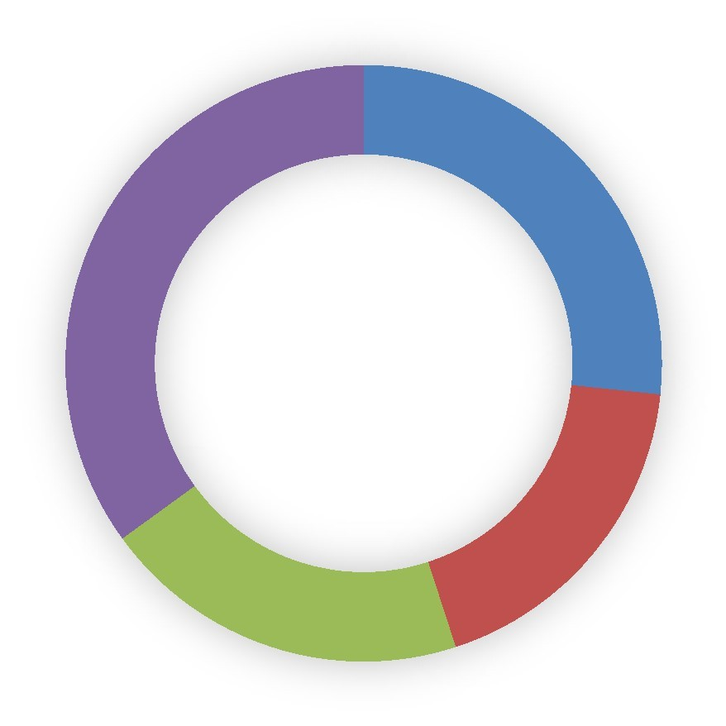
Our Ask
80 Lakhs for 6% of equity
Mentorship in taking it to the next level
Corporate Connects
Fund Utilization
27%
35%
18%
20%
Technology
core Team
Marketing
Growth

Slide 15
Why we are building EcoVenture !
We built EcoVenture because we believe that life is incomplete without a garden but finding the trustworthy and qualified professionals who can make the dream a reality is very hard, fear of losing hard earned money to the unqualified professionals as there is no surety to the quality in execution as well as there is lack in the price transparency for the projects. We knew there was a better way to get around so we decided to build it ourselves.

Slide 16
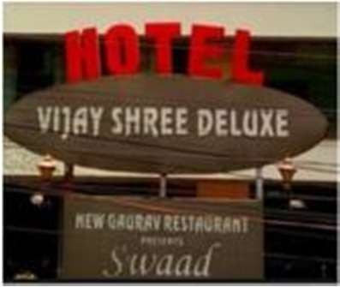
Some of Our Clientele (Public Places):

Slide 17
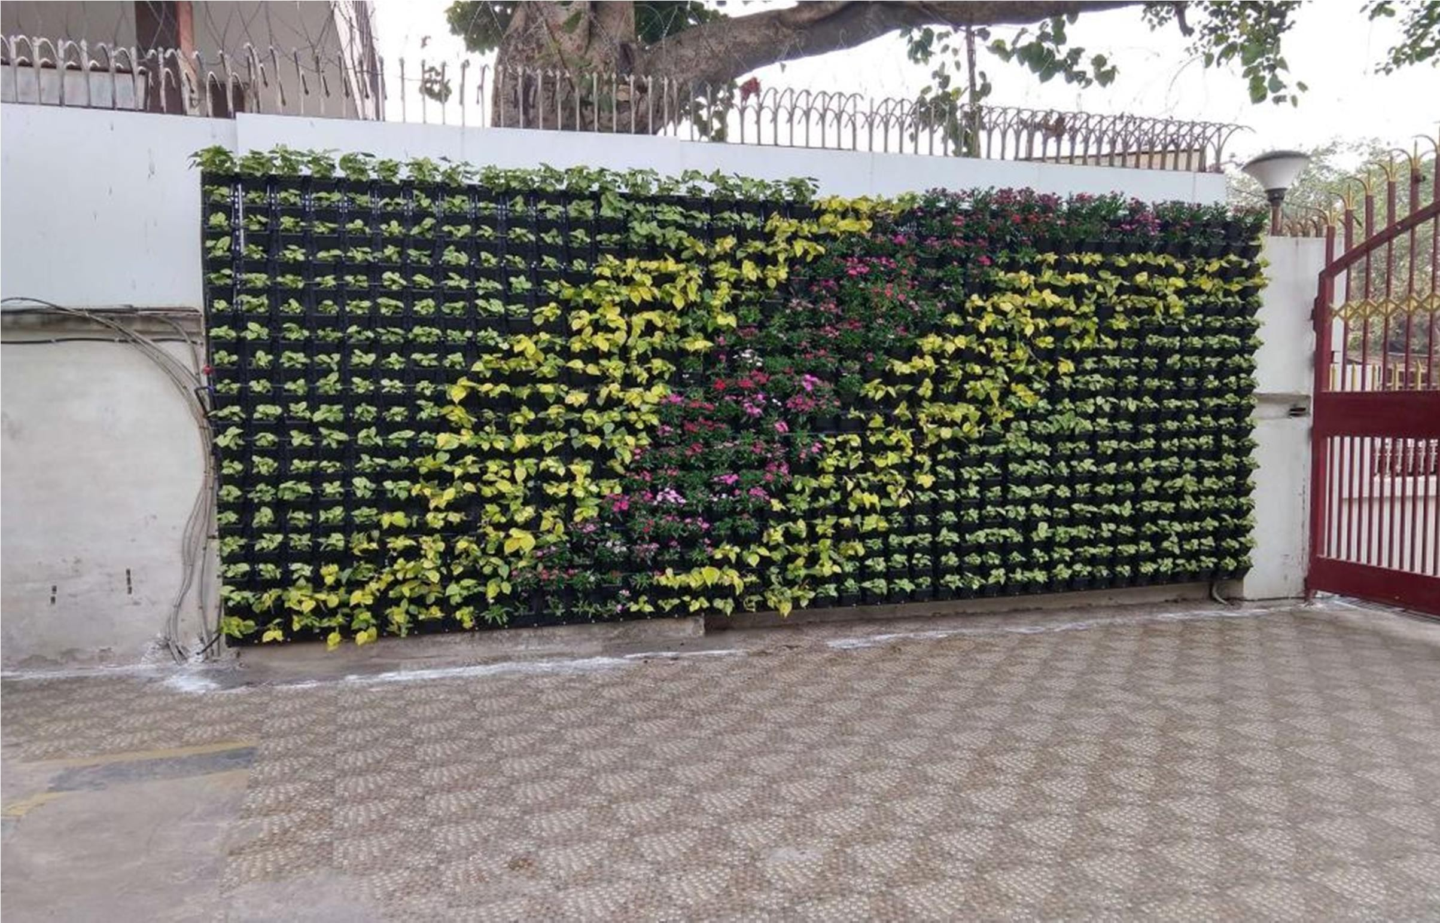
Reserve Bank of India:

Slide 18
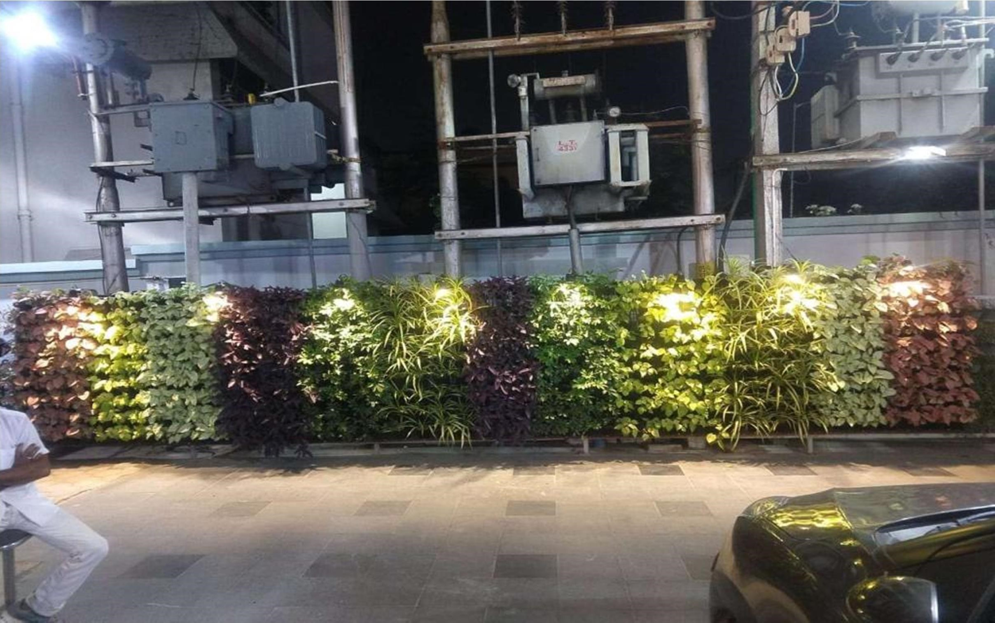
Alankar Jewellers

Slide 19
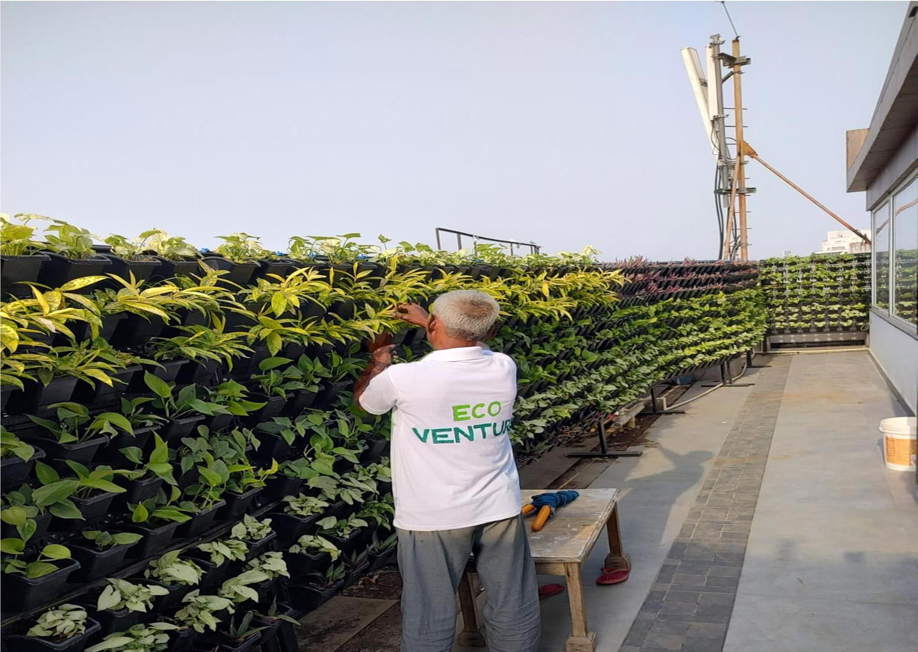
Windsor Hotel

Slide 20
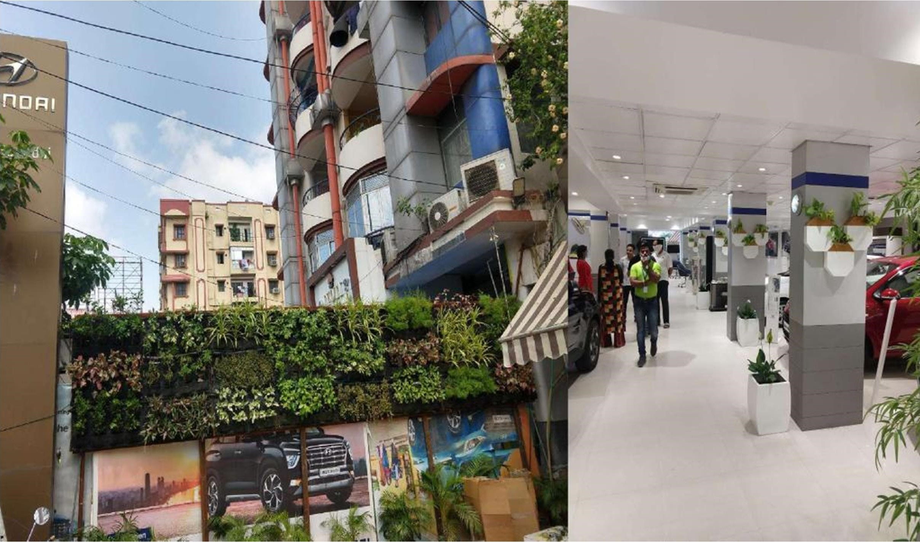
Krrish Motors

Slide 21
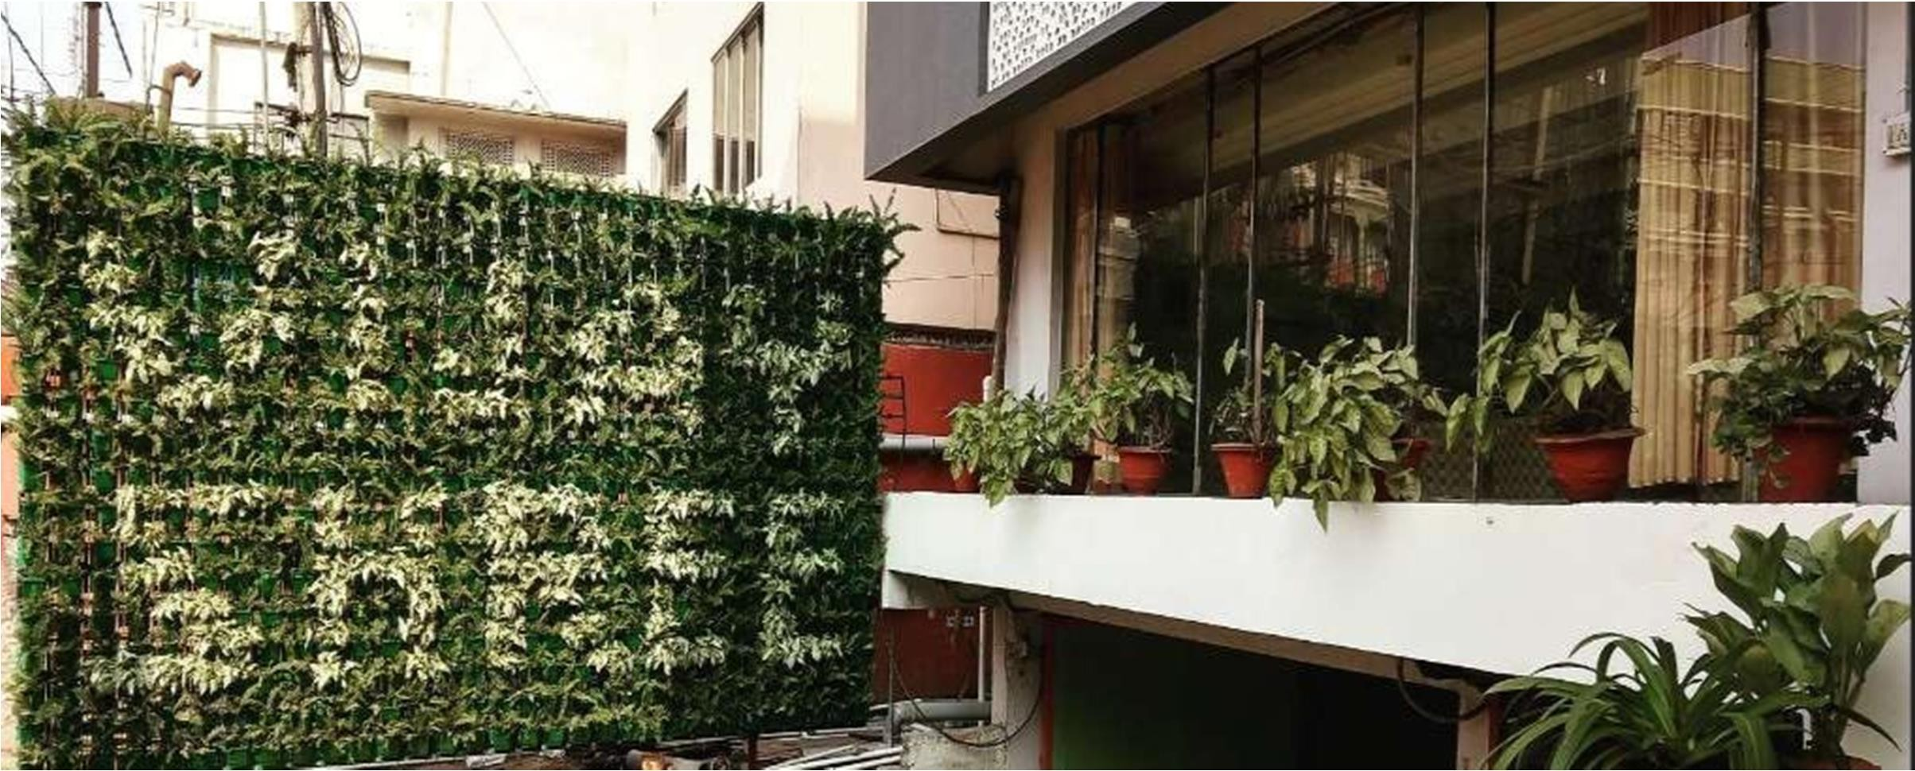
VijayShree Deluxe Hotel

Slide 22
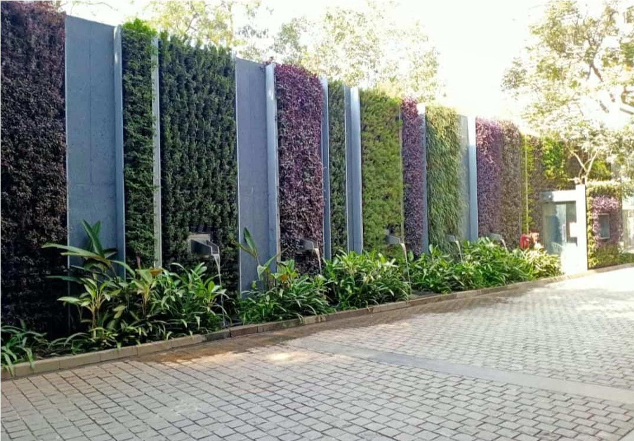
Residential Project

Slide 23
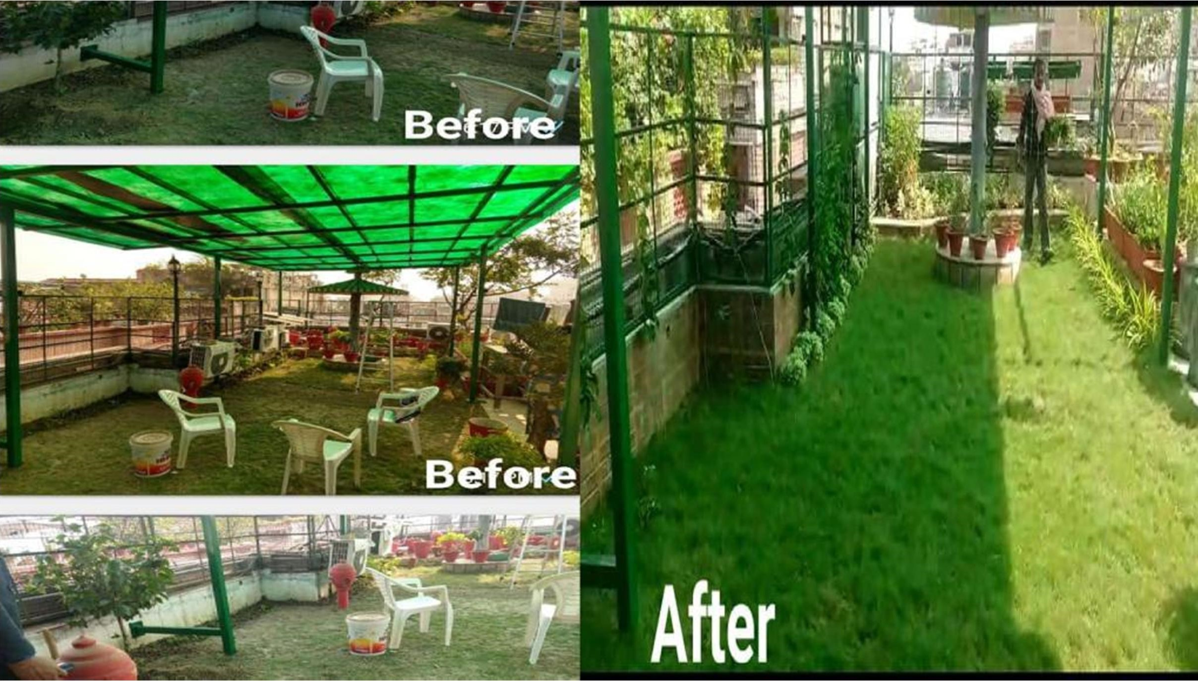
Private Household

Slide 24
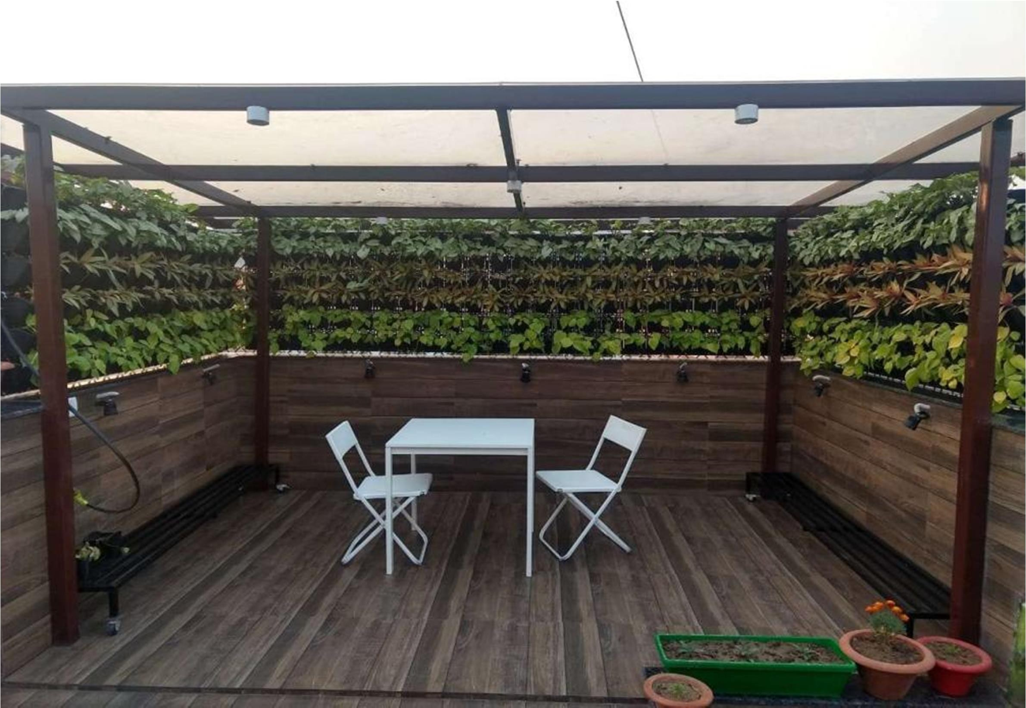
Private Household

Slide 25
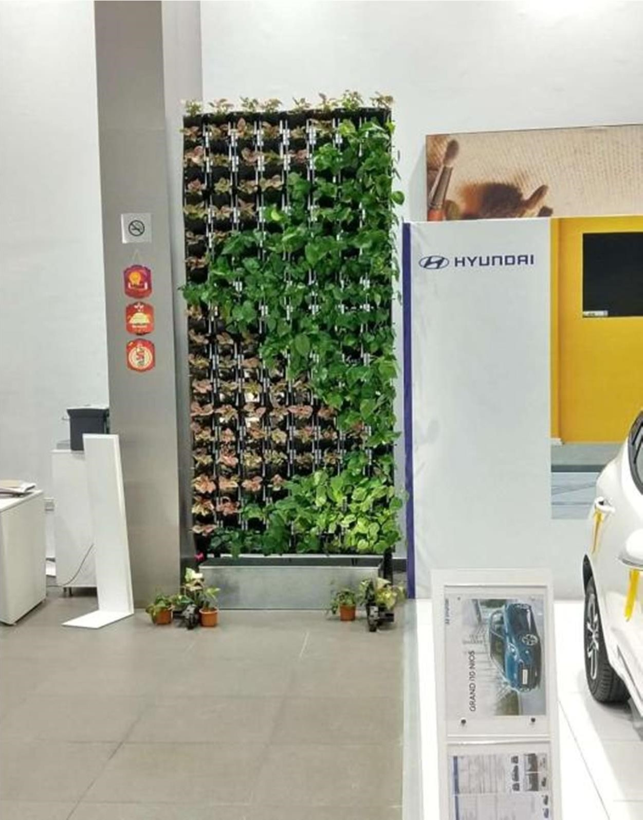
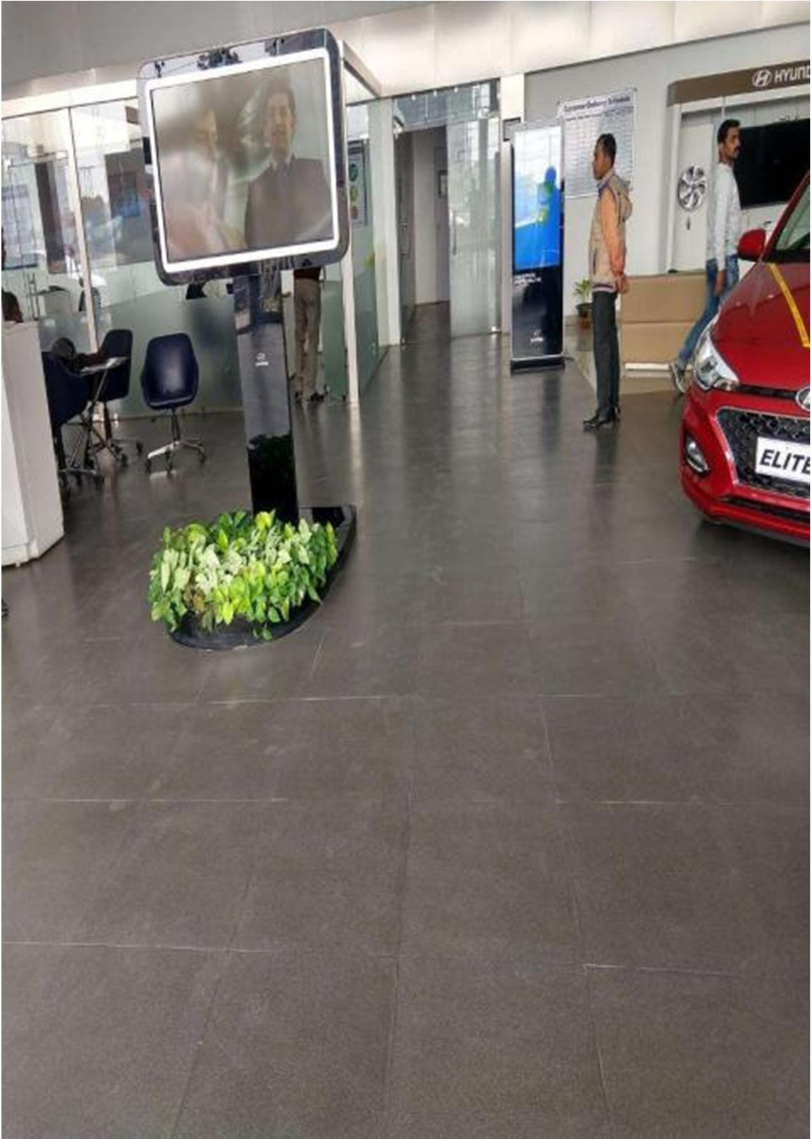
Krrish Hyundai

Slide 26
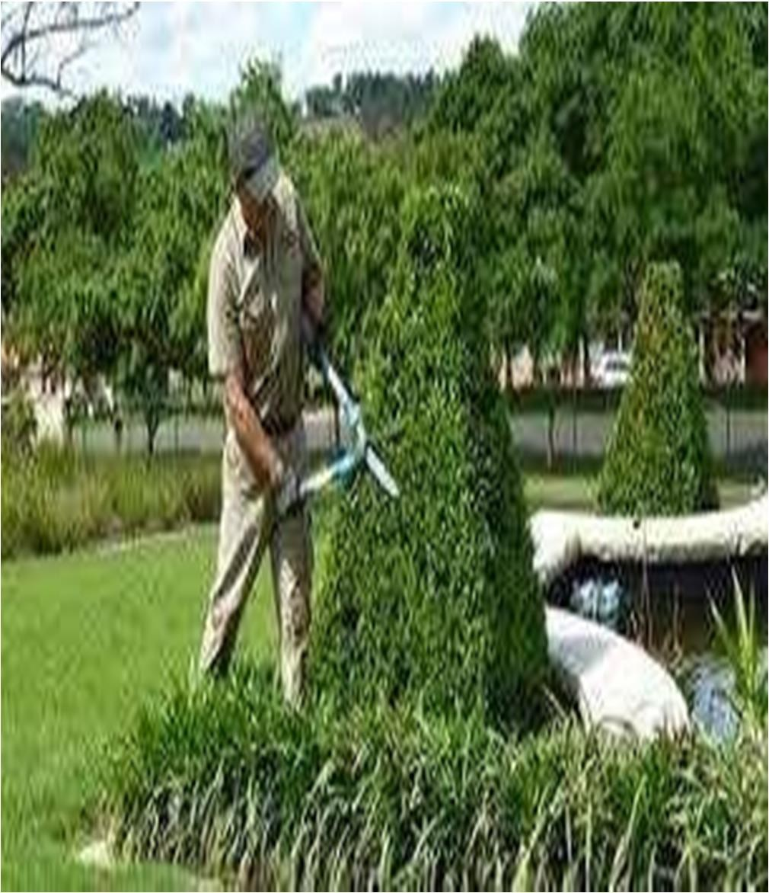
Farmer Welfare :
Skill Development and sending them for maintenance

