Slide 1
Tanuj Handa
Bioillus Designs
Your scientific illustration support ☺

Slide 2
May not always be clear and concise
Inaccurate or poorly executed illustrations
Proper training and education in scientific illustration techniques
Inconsistent or outdated design elements
The lack of standardization
PROBLEM
STATEMENT
FAILED COMMUNICATION OF RESEARCH

Slide 3
IDEA
Transforming complex data into beautiful visuals that bring new ideas to the table.
At Bioillus Designs, we help make your research come to life! Our expert team of scientific illustrators specialize in transforming complex data into beautiful visuals that bring new ideas to the table. From creating detailed illustrations of cells, molecules, and proteins to illustrating the most intricate of biological processes, we help make your research easier to visualize, learn, and understand. Whether you’re looking for illustrations to complement your paper or presentation, or to get funding for a project, we make sure that your ideas are portrayed in both an aesthetically-pleasing and scientifically-accurate manner. With Imagine, you can trust that your research will be presented with the utmost detail and accuracy so you can clearly communicate your message. Unlock the power of visualization and let us help you bring your research to life!

Slide 4
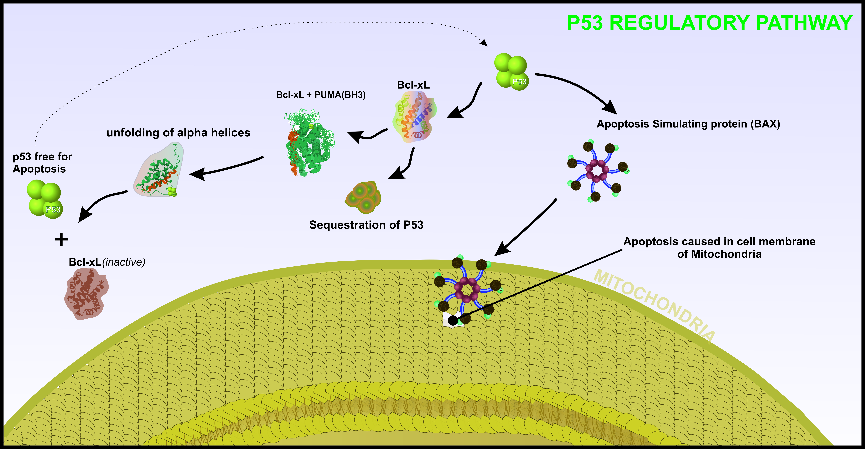
MORE PRECISELY
CONTENT
VISUALIZATION
IDPs in protein unfolding:
Tumor suppressor gene p53 mediates apoptosis by its association with various proapoptotic proteins like BAX, leading to outer membrane permeabilisation of mitochondria and cell death. the apoptotic function of p53 is inhibited by the association of antiapoptotic protein Bcl-xL, leading to sequestration of p53 from the cytosol and subsequent inactivation of the complex. The sequestering of p53 is regulated by the intrinsically disordered BH3 domain of p53 upregulated modulator of apoptosis (PUMA) by binding with Bcl-xL and folding into a single α- helix. The Association of Bcl-xL and PUMA also leads to unfolding of two alpha helices (α2 and α3) of Bcl-xL at the interface between p53/Bcl-xL. The unfolding event leads to the dissociation of Bcl-xL from p53 lets p53 perform its apoptotic function in an independent manner (Walin, 2017). Computational investigations with molecular dynamics and simulations of free Bcl-xL have revealed that the alpha-helices α2 and α3 are highly dynamic in their native state. Such behaviour of alpha-helices in this protein reminds us of the concept of metamorphic proteins, which exhibits decreased stability and high dynamic behaviour and thus can switch between ordered and disordered states very comfortably (Murzin, 2008, Wallin, 2017). The conditions and factors that drive regulated unfolding in critically functional proteins are similar to those that drive state change in metamorphic proteins (Bryan and Orban, 2010). Future research would be more driven by how these regulatory proteins allow conformational switching between folded and unfolded states, thus efficiently performing their underlying functions.

Slide 5
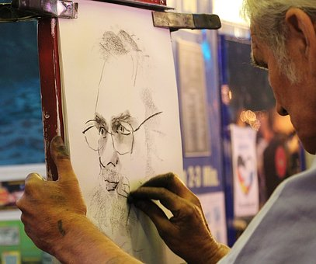
Why?
Simple Answer:
Not every research Scholar is a good illustrator, likewise not every illustrator can have a deep scientific understanding
THE GAP
Researchers
Illustrators

Slide 6
Bioillus Designs : Scientific Illustration Assistance
Scientific illustration company that creates accurate, visually appealing, and informative illustrations to help researchers communicate their findings to a wider audience.
Our team of experienced scientific illustrators is committed to delivering high-quality work and excellent customer service.
We bridge the gap between researchers and non-expert audiences, enhancing the understanding and impact of scientific research.

Slide 7
INDUSTRY OUTLOOK – Graphic Designing Market
5.2%
CAGR
~ $50.4 billion
Current Value (Est.)
$83.8 billion
Expected Value (2032, Est.)
Demands:
Increase as more companies and organizations seek to communicate complex scientific concepts and data in a clear and concise manner.
Scientific illustrations are used in a variety of industries such as healthcare, technology, engineering, and education, with focus on biotechnology, pharmaceuticals, and environmental sciences.
https://www.factmr.com/report/graphic-design-market

Slide 8
FINANCIALS
Pricing & Packaging - Business Model
Pricing based on per illustration generated.
Additional costing for extra-visualization and planning requirements.
Revenue Model & Financial Accounting
Service based revenue and application in future
Finance & Funding
Bootstrapping and Later,
Fund Raising by dilution of Equity (For Networking and Capital)

Slide 9
MINIMUM VIABLE PRODUCT
Product Roadmap
Market research
Prototyping
Product launch
Identifying the need of the product for an Indian market
Website and basic outline of service,
Launching the service while ensuring regular updates to illustrations based on customer feedback and the latest scientific advancements
establishing standard operation protocol (SOP)
Survey and offering free service among researchers.
Taking regular feedback from clients.
Time: 0-6 Months
Time: 6-12 Months
Further Iterations and Upgrades

Slide 10
VISION
Enhancing the Understanding and Impact of Scientific Research
To make Research accessible by making it more visually appealing
MISSION
Providing the Highest Quality Scientific Illustration Services.
committed to accuracy, attention to detail, and creativity in our work, and we strive to build long-term relationships with our clients.
Our goal is to contribute to the success of our clients' research endeavors by helping them effectively communicate their findings to a wider audience.

Slide 11
Total Addressable Market (TAM)
LARGE AND GROWING MARKET FOR SCIENTIFIC ILLUSTRATION SERVICES
Academics
Healthcare
And what not?
Pharmaceuticals
Biotechnology
Scientific research

Slide 12
LEGAL AGGREMENTS
Legal agreement to be signed among company and client for usage of illustration.
Allow client to completely own the image but minor elements used in building the image can be reproduced in other images.

Slide 13
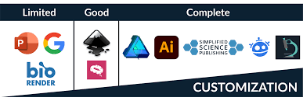
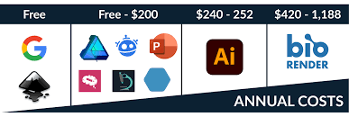
COMPETETION
Direct Competition with BioRender
While other services offer high prices and limited customization with extra efforts on learning to use the use
OUR VALUE PROPOSITION:
Fast, Scientifically accurate, Economical and personalized illustration curated as per your needs

Slide 14
The Business Model Canvas
The Business Model Canvas
Key Partners
Key Activities
Value Propositions
Customer Relationships
Customer Segments
Software Engineers
Content Writers
Illustrators
Scientific illustrations
Content Visualization
Graphics Designing
Reaching out to faculty, research scholars.
Services initially at discounted prices
Research Scholars
Professors
Scientist
Industrialist
Publishing Houses
Content Specific Illustrations with High Quality
Personalized Touch to illustrations
Competitive Pricing
Key Resources
Channels
Software’s (Adobe)
Images Library
Information Repository
Social Media
Conferences Advertising
Word of mouth referral
Cost Structure
Revenue Streams
Package of 5 illustrations – Rs. 2499 (1 GA + 4 Figures, with three proof reading)
Visualization – Rs 499 for single para, Rs 1499 for 4 figures
Illustration Service
Software support for basic illustrations ( Future)
©Moonshot Junior Inc. 2019

Slide 15
TEAM
TANUJ HANDA – CEO and Co-Founder
Debanjan Kundu – Content Head and Co- Founder
Tech Head to be decided

Slide 16
THANK YOU
<Bioillus Designs> Team: 2
Tanuj Handa
PhD (Biosciens and Bioengineering)
Indian Instittue of Technology, Roorkee
Email – tanuj@bt.iitr.ac.in
Mobile No - 8851952060
Notes:
done

