Slide 1

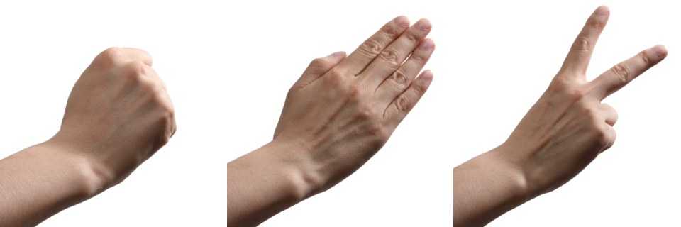
ROCK PAPER SCISSORS
SHOOT
©Moonpreneur Inc. 2019

Slide 2
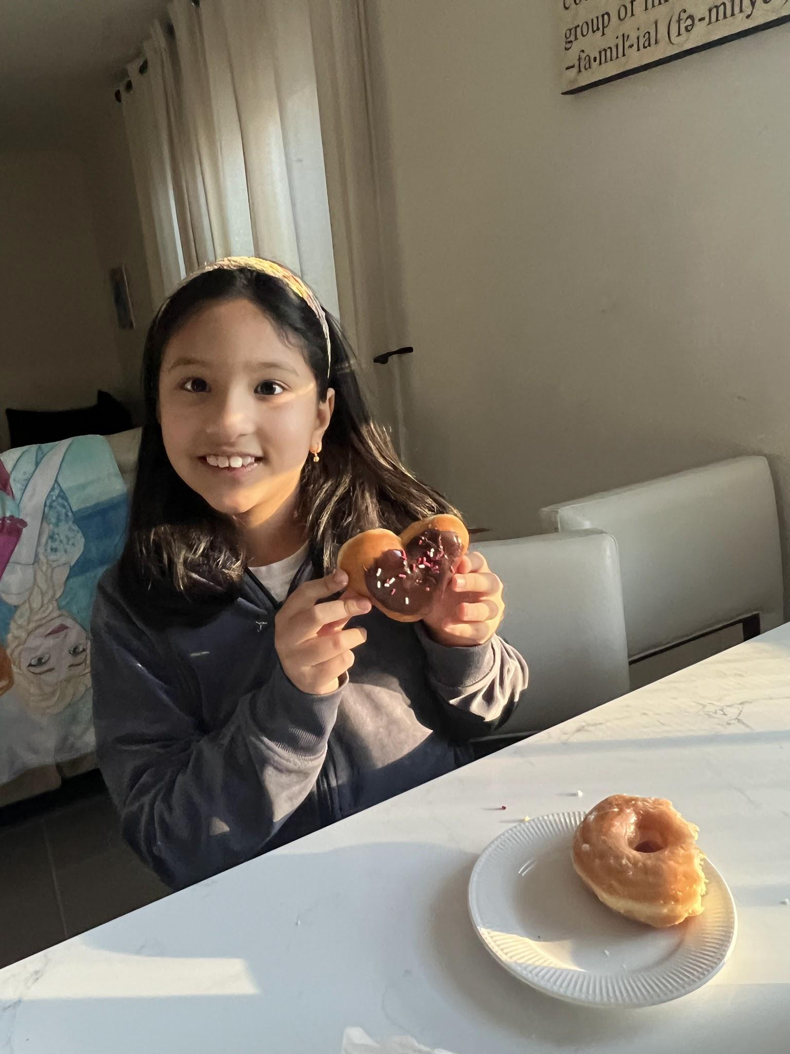
INTRODUCTION TO OMNA KARKI
Hello,
My name is Omna Karki. I will tell you 7 fun facts about me.
My favorite food is Pizza.
There are 4 people in my family me, my brother and my dad and mom.
I play for an Elite soccer team.
My favorite subject is math.
My favorite animal is a duck.
I LOVE TO CODE! :D
My favorite video game is Roblox.
©Moonpreneur Inc. 2019

Slide 3
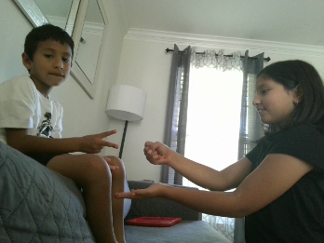
SHOW AND TELL TOPIC
My show and tell topic is Rock Paper Scissor. Rock paper scissor is game where you resolve your fights. Rock paper scissors is a very handy game when it comes to resolving your fights.
Lastly I compared numbers with the double equal sign.
For this game I used the command called “import random”. “Import random is to make random numbers in the micro bit.
I also used variables.
Notes:
Can you unmute your mic one by one and shay hello?
If any of them is unable to do that, only then share your ppt and show them how to mute and unmute.

Slide 4
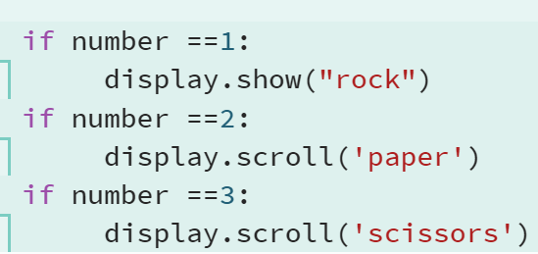

PROJECT HIGHLIGHTS
.
.
My project highlights are the random numbers because random numbers would not work without the command “import random”.
The last project highlight would be comparing number i used comparing numbers when i used the variables. I compared when i typed == it means if it equals to 1
Another project highlight is variables because if it were not for variables it would not say rock it would say 1.
©Moonpreneur Inc. 2019
Notes:
Sometimes you might want to turn your video on or off during a Zoom call.
Can you try to turn off your camera and turn on again?

Slide 5
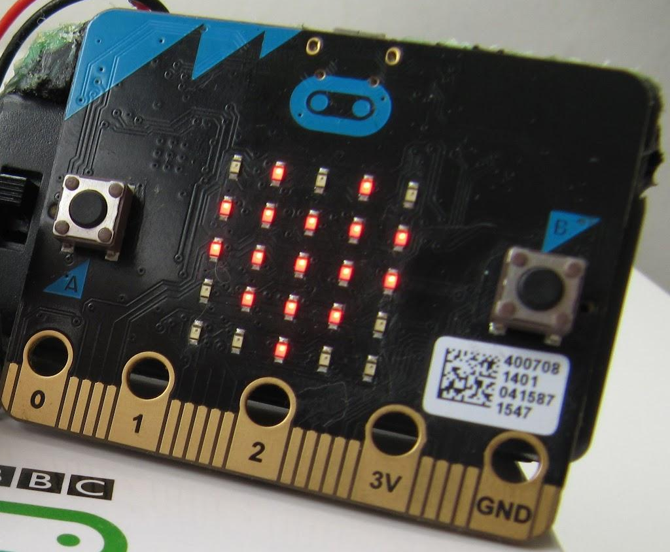

Thanks!
Thank you
©Moonpreneur Inc. 2019

