Slide 1

Magic 8 Ball
By Maha
©Moonpreneur Inc. 2019

Slide 2
INTRODUCTION
Hi, my name is Maha. I am turning 11 years old in a few days, and I am in 5th Grade.
I have been learning in Moonpreneur for the last two months. It is very fun and I have been enjoying it a lot. I’ve always wanted to learn coding and this year I finally am. I am enjoying to do the homeworks and learning different codes every class. I will be presenting you my project, the Magic 8 Ball. I picked the Magic 8 Ball because in my opinion it is a fun toy to play with, it’s like a fortune teller ball. I can’t wait to show you my project!
©Moonpreneur Inc. 2019

Slide 3
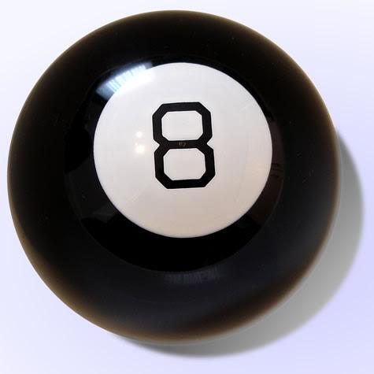
SHOW AND TELL TOPIC
Summary:
The Magic 8 ball is a random fortune toy. You can ask it anything, like will I get this toy, Will I eat this food, ETC. You will ask a question and shake the 8 ball and randomly it will give you an answer. That is the Magic 8 Ball
The Magic 8 Ball

Slide 4
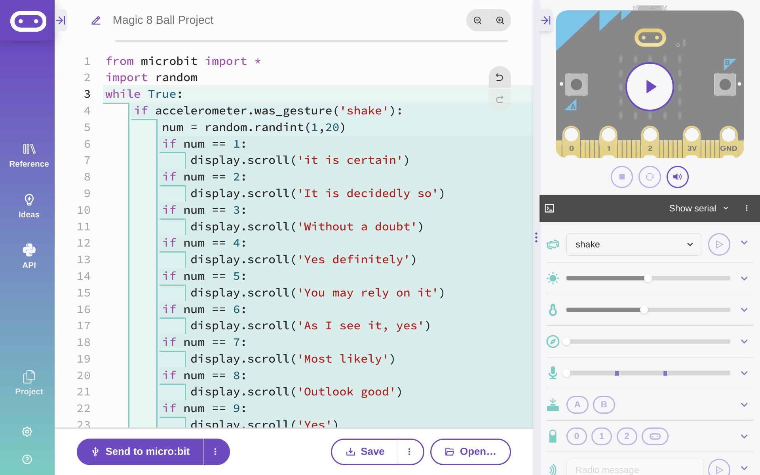
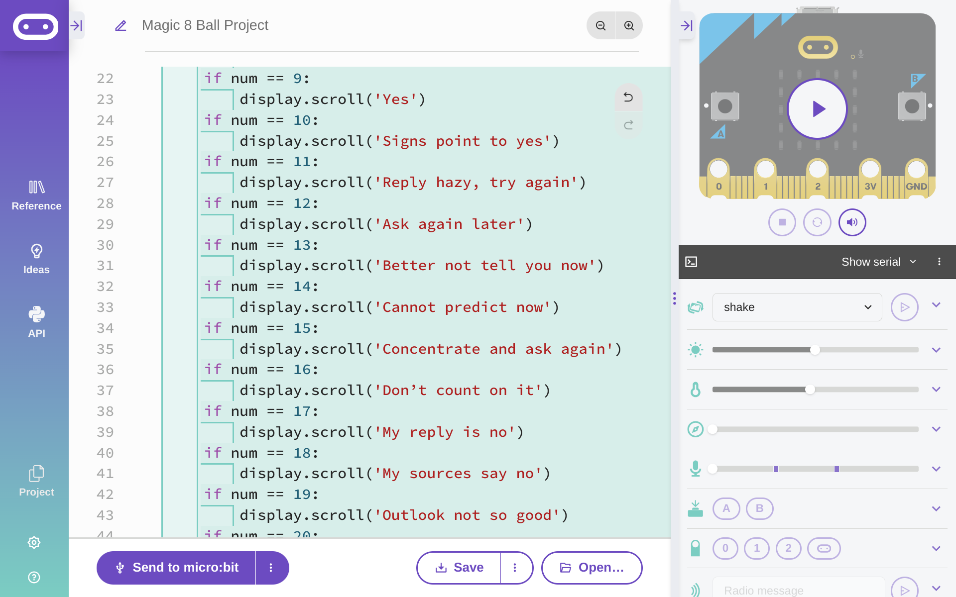
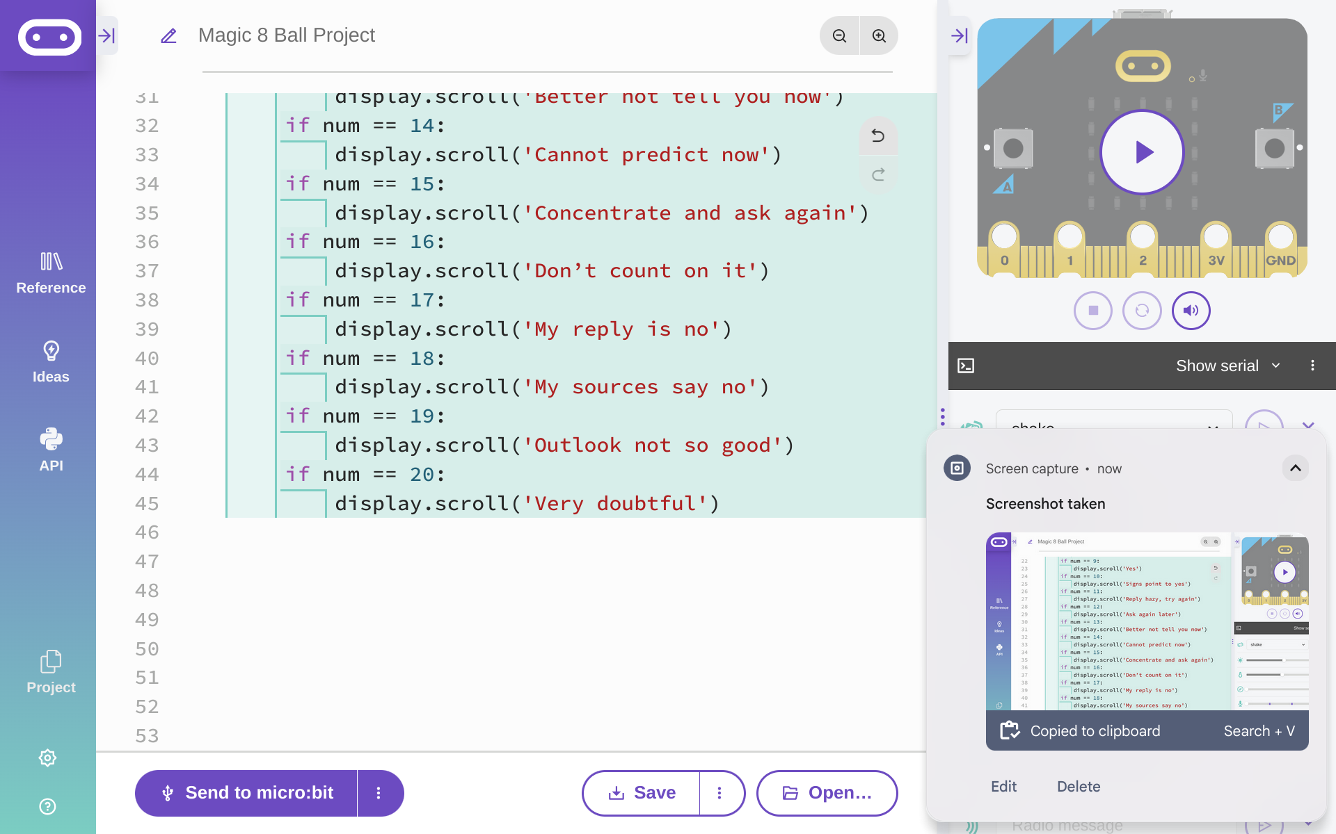
PROJECT HIGHLIGHTS
©Moonpreneur Inc. 2019
Notes:
from microbit import *
import random
while True:
if accelerometer.was_gesture('shake'):
num = random.randint(1,20)
if num == 1:
display.scroll('it is certain')
if num == 2:
display.scroll('It is decidedly so')
if num == 3:
display.scroll('Without a doubt')
if num == 4:
display.scroll('Yes definitely')
if num == 5:
display.scroll('You may rely on it')
if num == 6:
display.scroll('As I see it, yes')
if num == 7:
display.scroll('Most likely')
if num == 8:
display.scroll('Outlook good')
if num == 9:
display.scroll('Yes')
if num == 10:
display.scroll('Signs point to yes')
if num == 11:
display.scroll('Reply hazy, try again')
if num == 12:
display.scroll('Ask again later')
if num == 13:
display.scroll('Better not tell you now')
if num == 14:
display.scroll('Cannot predict now')
if num == 15:
display.scroll('Concentrate and ask again')
if num == 16:
display.scroll('Don’t count on it')
if num == 17:
display.scroll('My reply is no')
if num == 18:
display.scroll('My sources say no')
if num == 19:
display.scroll('Outlook not so good')
if num == 20:
display.scroll('Very doubtful')

Slide 5
Thank You!
©Moonpreneur Inc. 2019

