Slide 1

Show and Tell
©Moonpreneur Inc. 2019

Slide 2
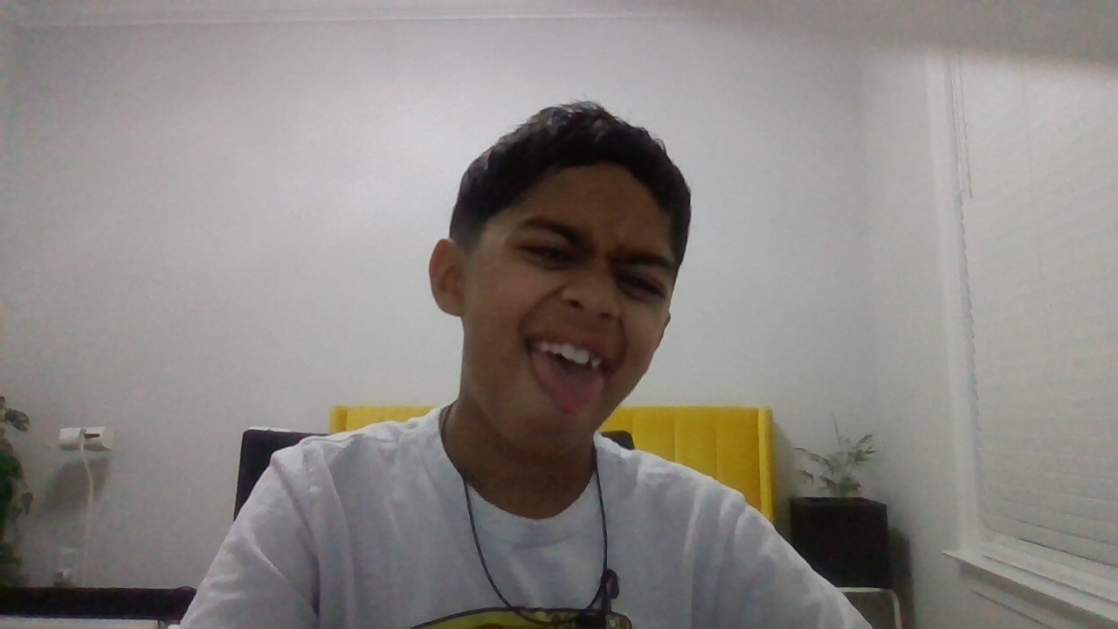
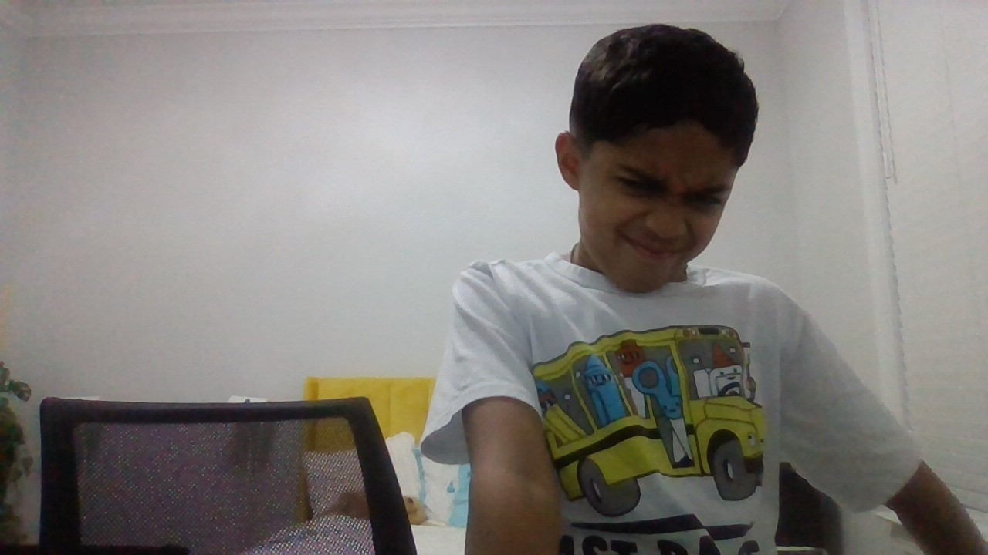
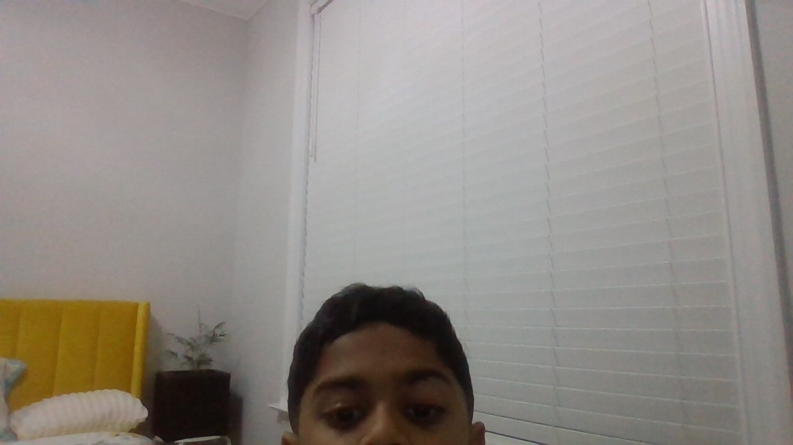
INTRODUCTION
I am Darsh. I am nine, I am in fourth grade. I know you might think this is odd but I like to animate and if you don’t know what animation is then it’s like a bunch of pictures together but they move I mean how do you think Tom and Jerry move ???
©Moonpreneur Inc. 2019

Slide 3
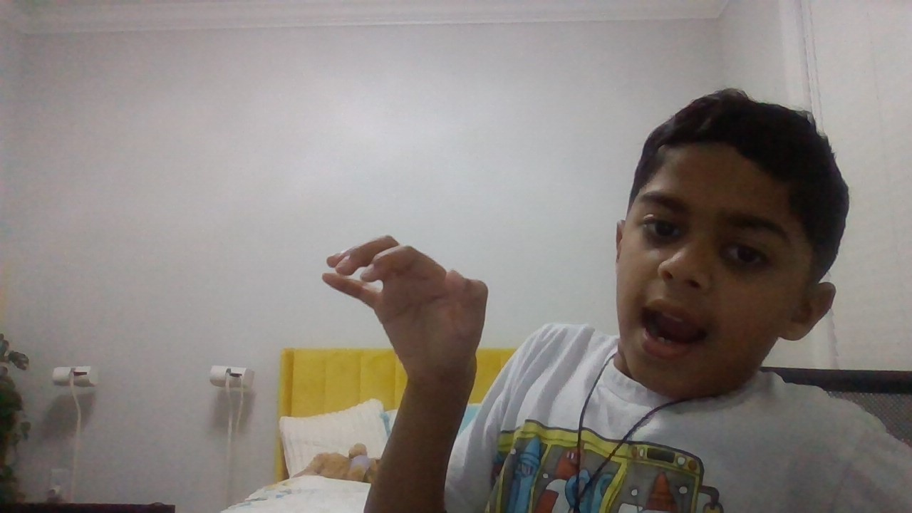
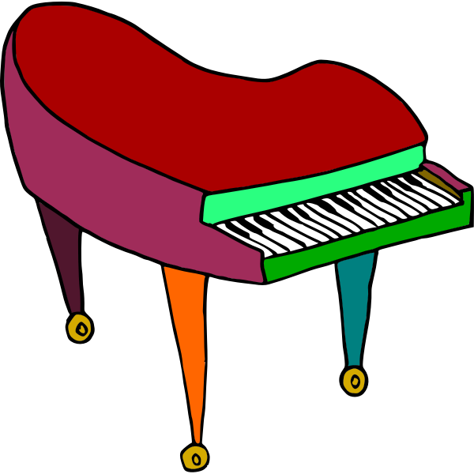
SHOW AND TELL TOPIC
My “SHOW AND TELL TOPIC” will be music and I will be performing this by coding it on “micro:bit Python Editor” because a real piano will be weird and off topic.
Notes:
Can you unmute your mic one by one and shay hello?
If any of them is unable to do that, only then share your ppt and show them how to mute and unmute.

Slide 4
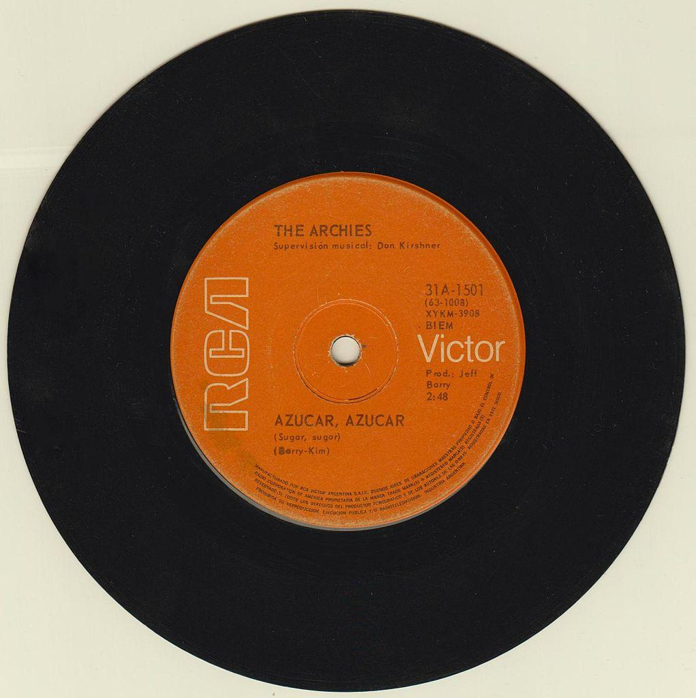
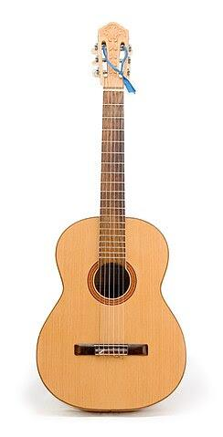
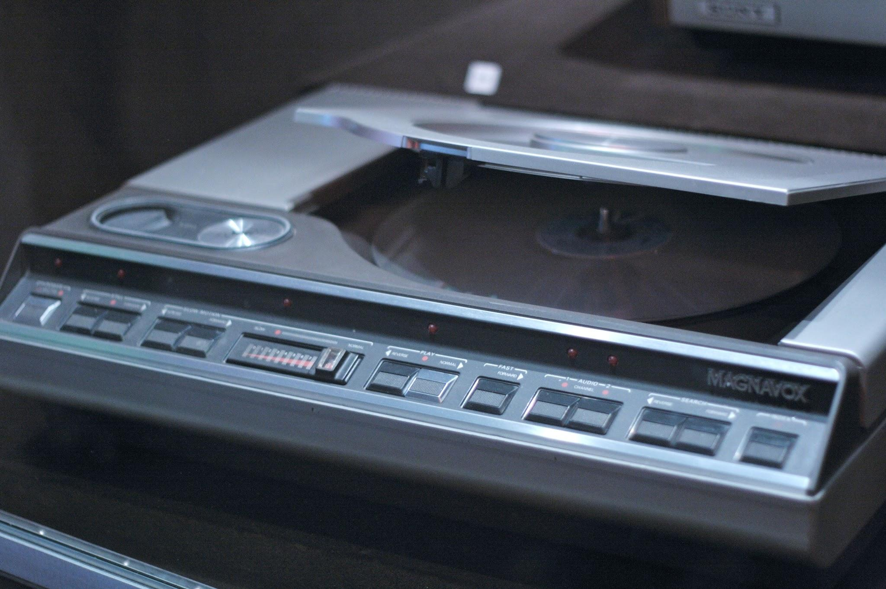
PROJECT HIGHLIGHTS
I’m going to play “Sugar sugar” because it has a nice melody to it and it’s my favorite song. Also because other songs are hard.
©Moonpreneur Inc. 2019
Notes:
Sometimes you might want to turn your video on or off during a Zoom call.
Can you try to turn off your camera and turn on again?

Slide 5
Thanks!
©Moonpreneur Inc. 2019

