Slide 1
MY IDEA PITCH TEMPLATE

Slide 2
The Controllers
PRESENTS
SnackBot
So you never have to miss a minute of the game!
Team Members:
Adhishri, Harini, Pragnya and Roshni

Slide 3
SNACKBOT
PROBLEM that you see and want to solve.
When people go to sports events, they love to cheer for their favorite team and have fun while watching the game. Imagine going at a football game and having to miss a crucial part, because you have to go get some snacks? That would be a bummer, won’t it? That’s the problem I want to solve.

Slide 4
SNACKBOT
SOLUTION you want to provide.
A robot that will deliver the snacks from the concession stand, to your seat! That way, the audience will get to enjoy tasty snacks AND won’t have to miss any part of the game.

Slide 5
SNACKBOT
IDEA with which you help.
The solution to that, is SnackBot. A SnackBot is a device that will be programmed to bring snacks to your seat. You can order your food from an app in your phone, give the robot your seat and section number; and the robot will deliver your good to you, while you enjoy the game!!

Slide 6
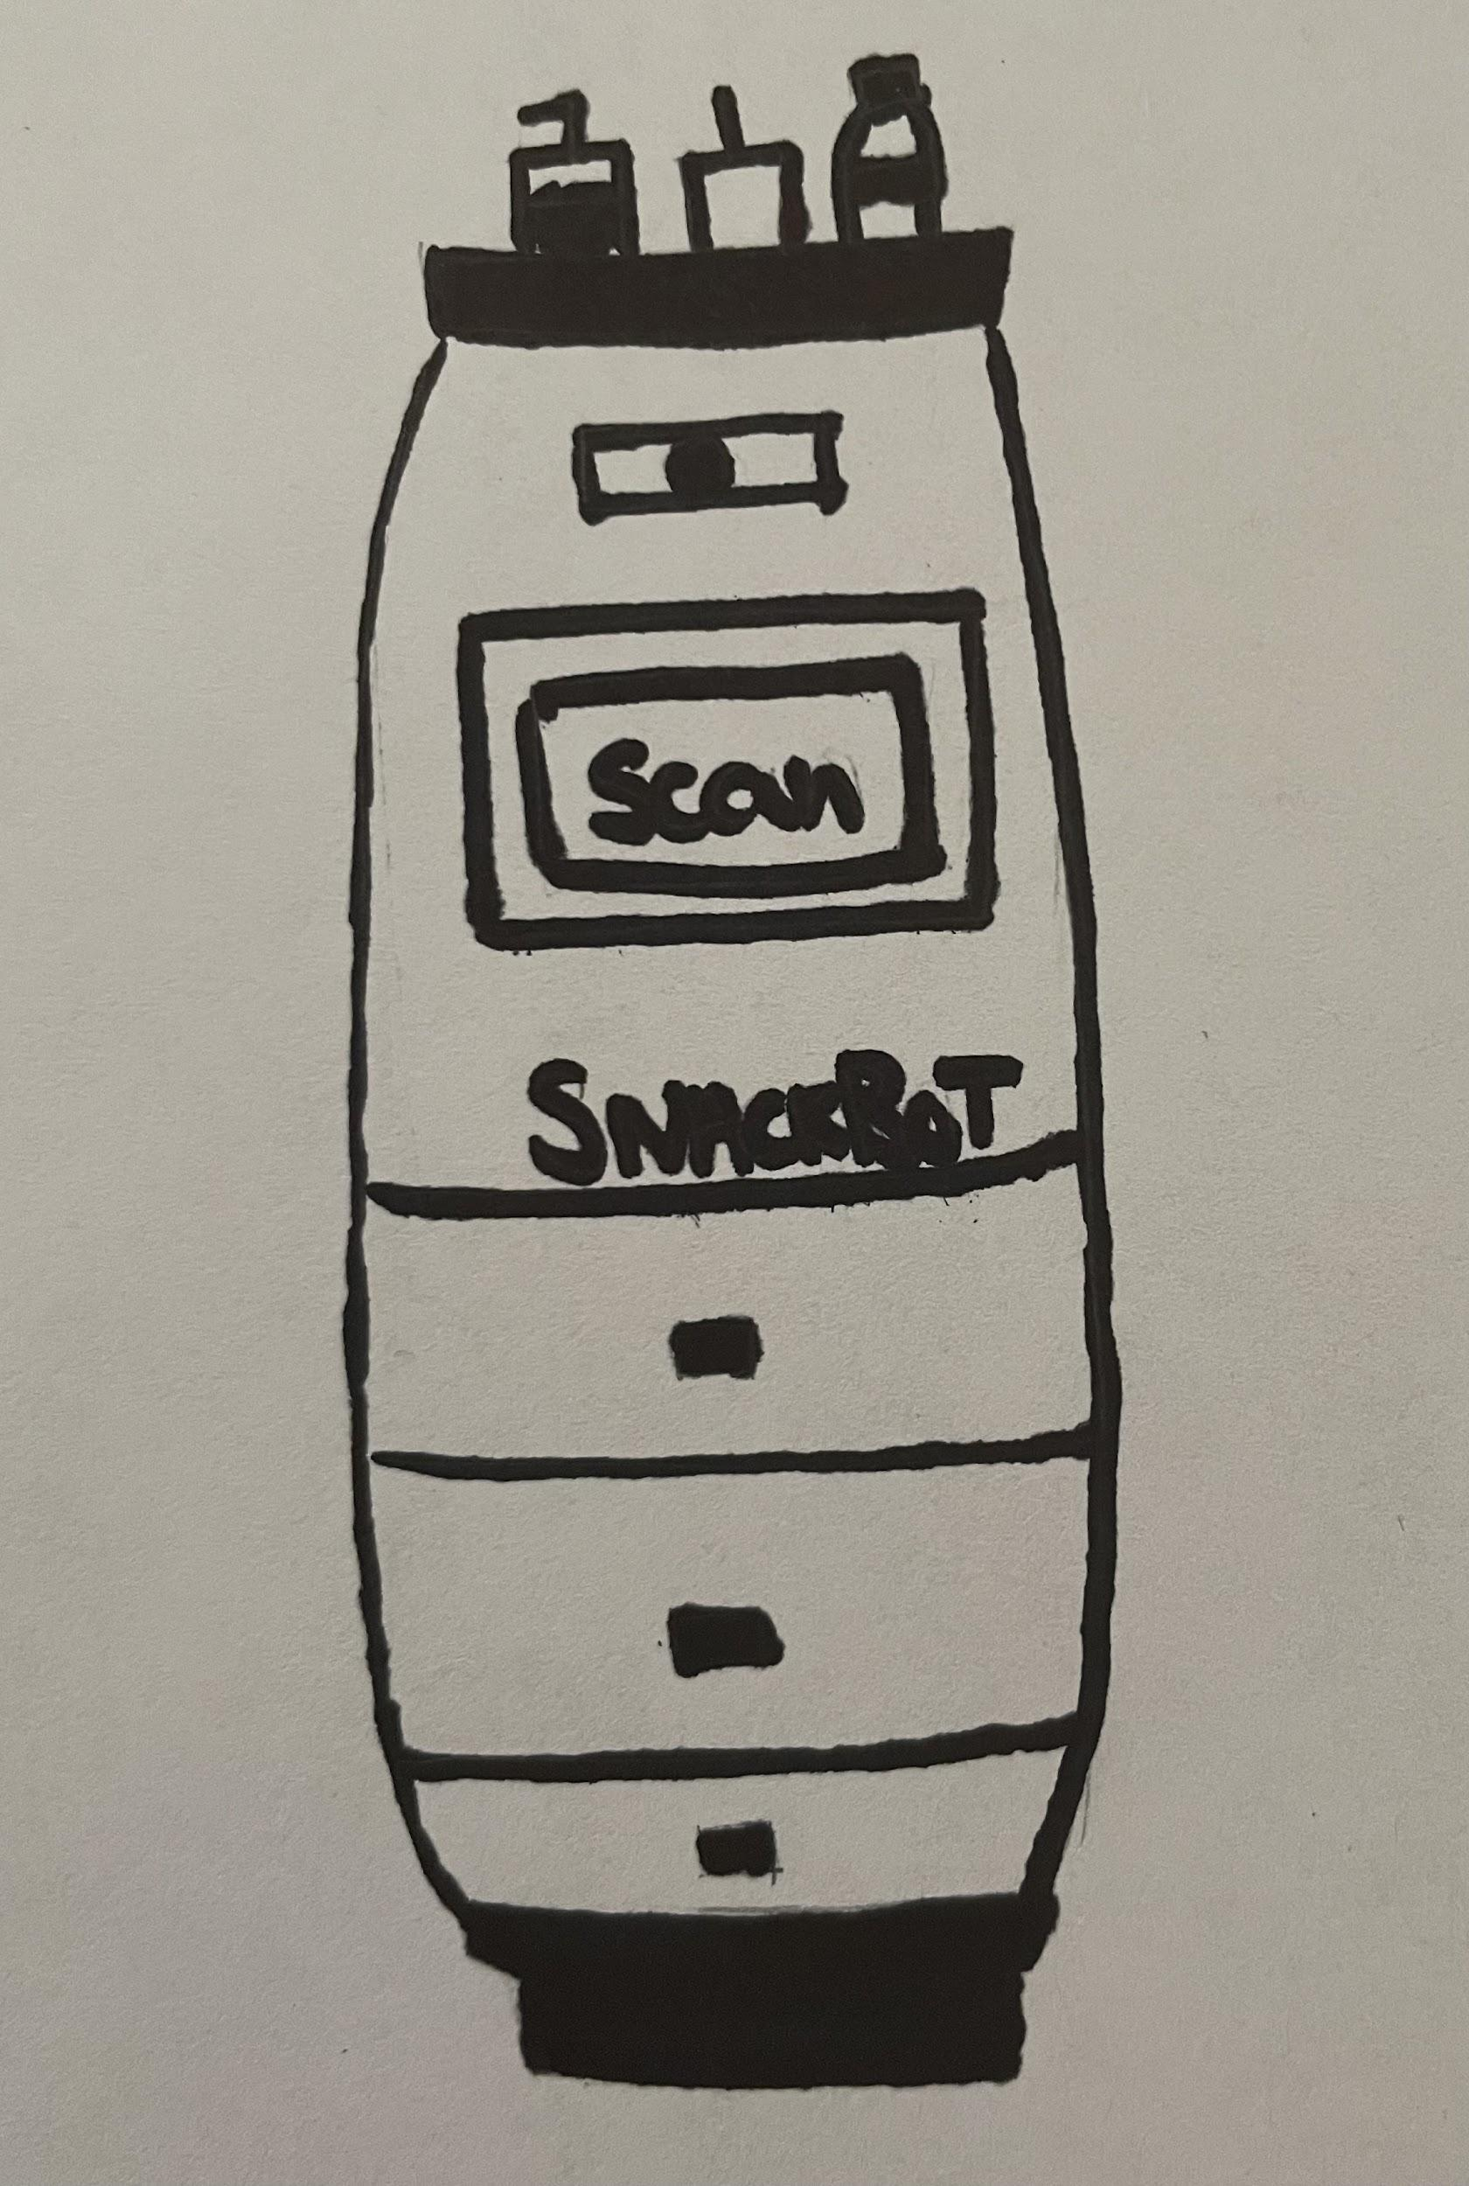
SNACKBOT
INNOVATION which you have designed.
Easy to order
Safe and effective
Delivers to your seat
Provides you with food, first aid and drinks
Saves time and energy

Slide 7
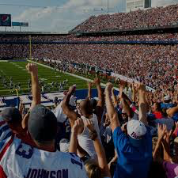
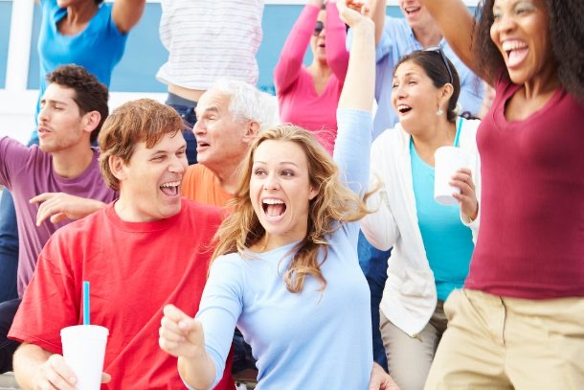
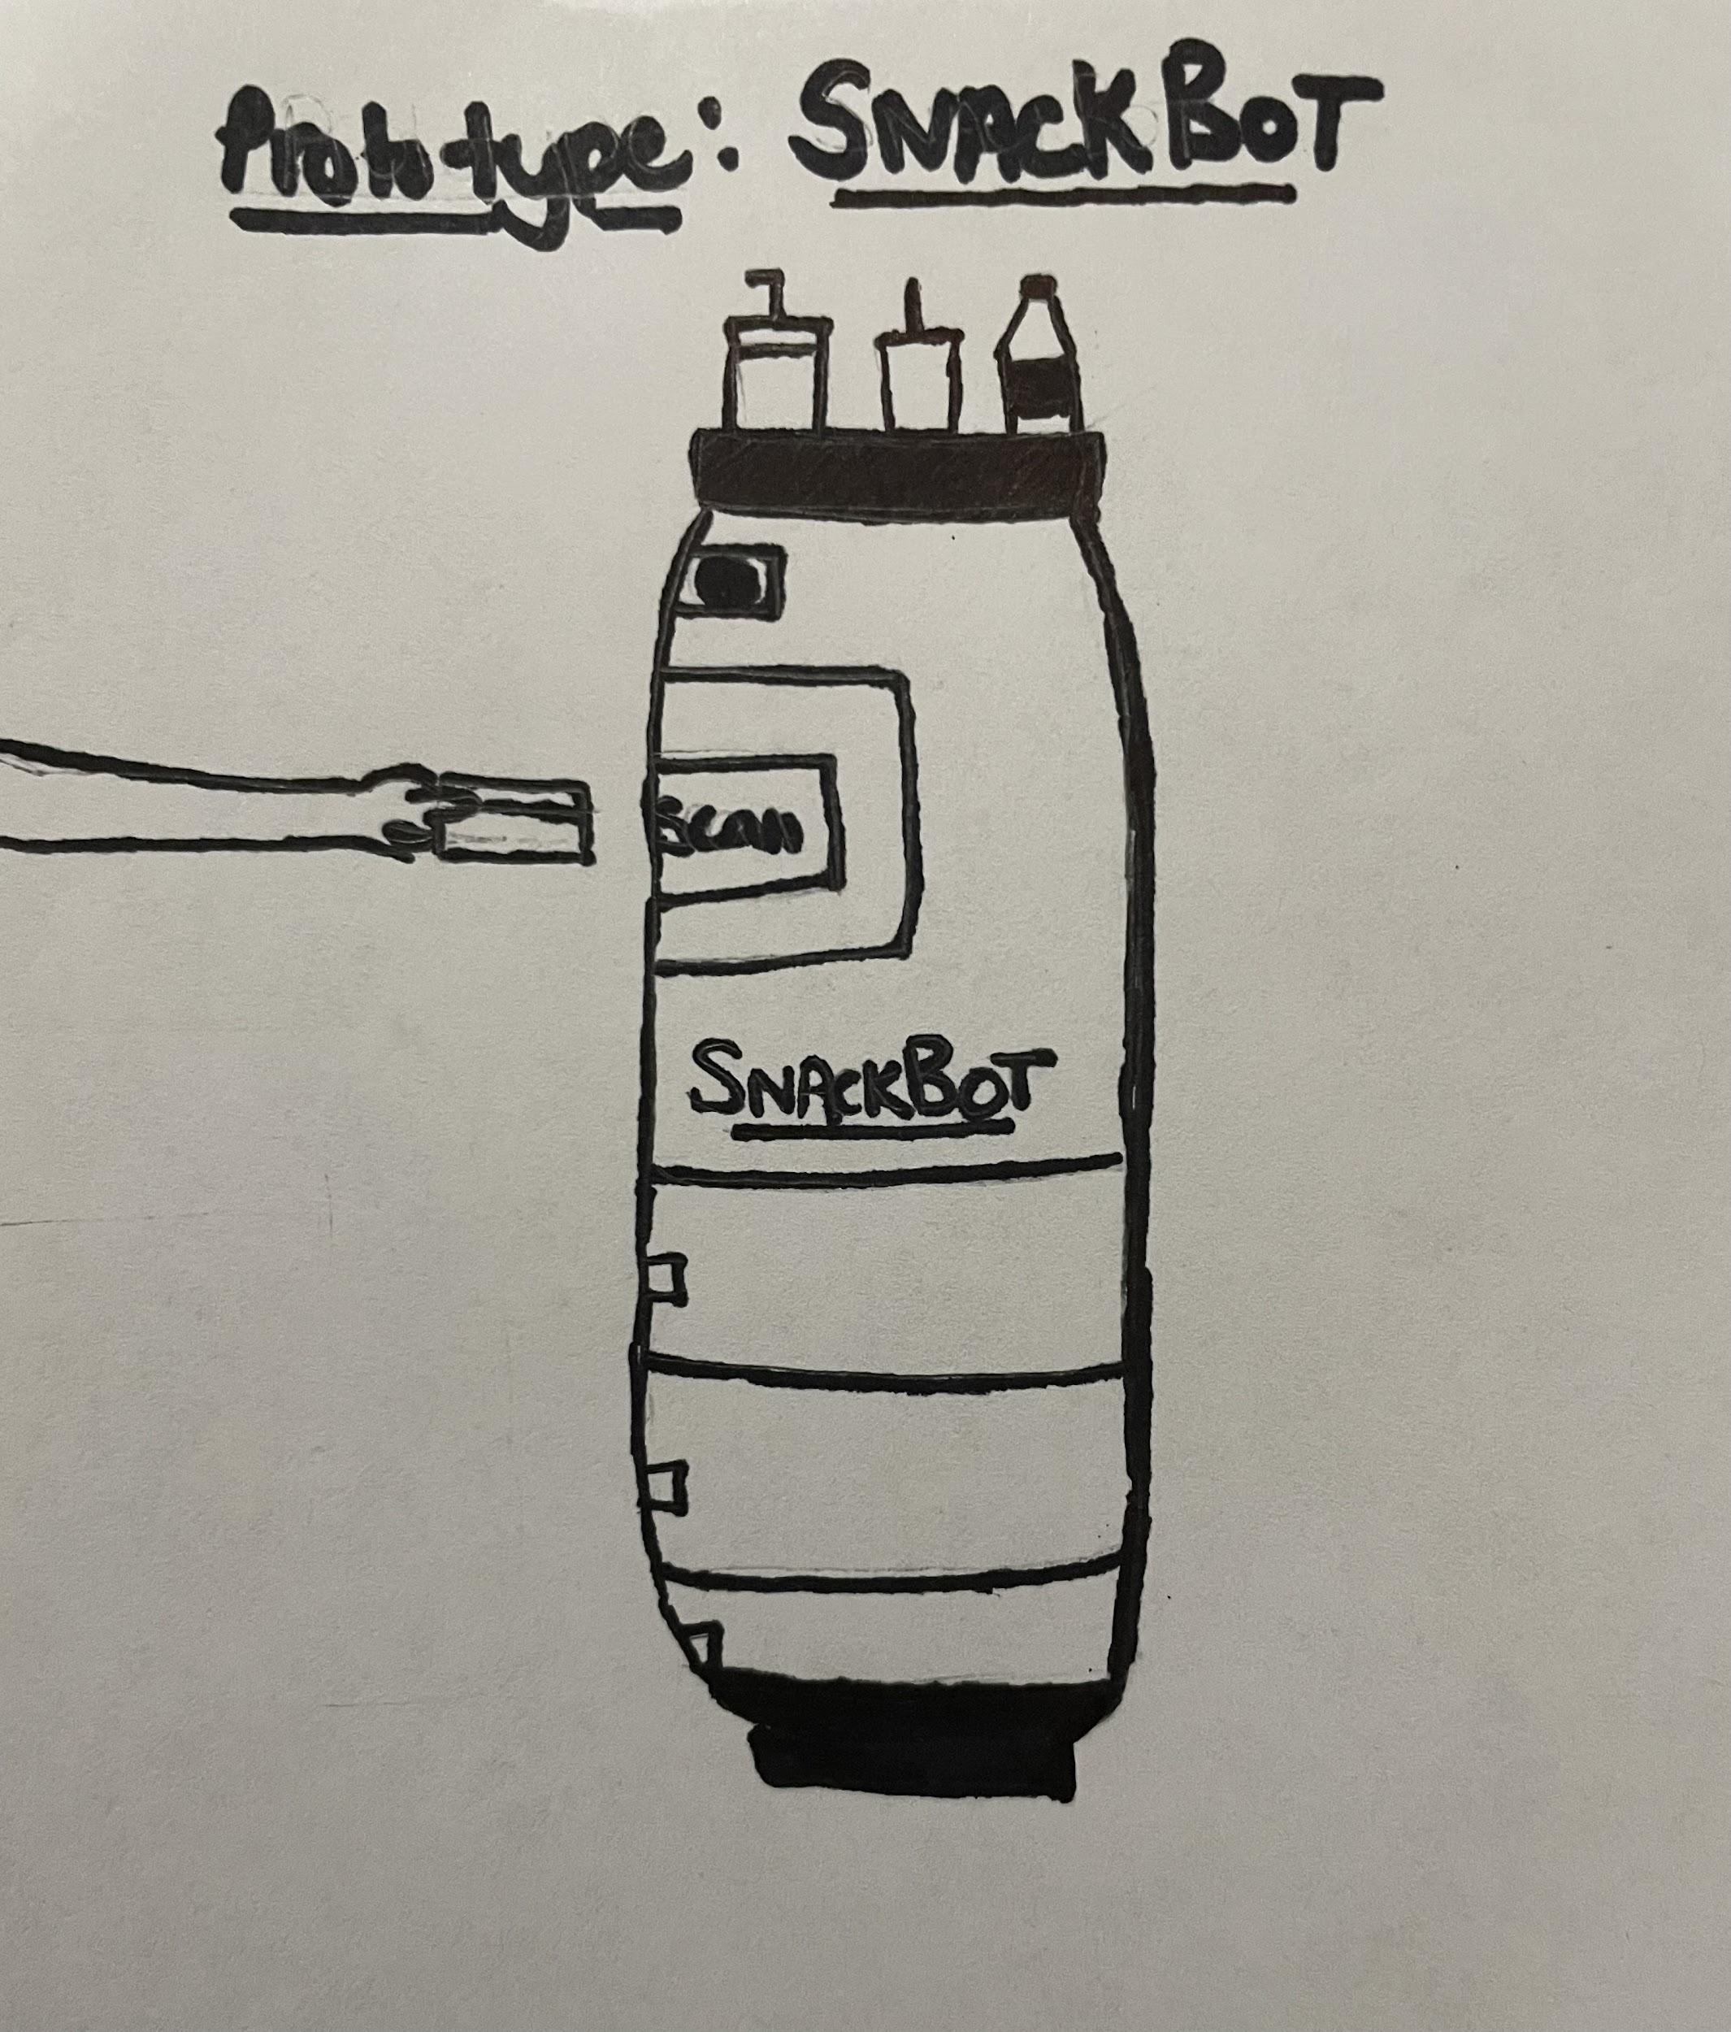
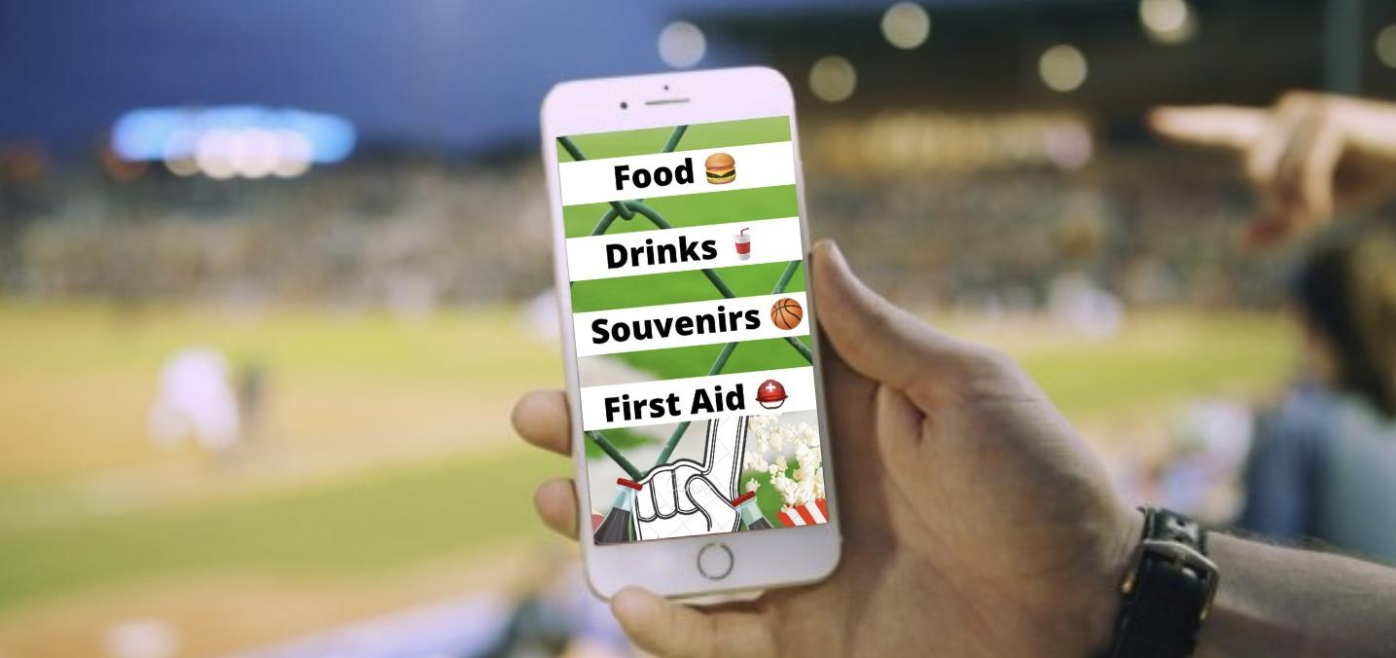
SNACK BOT
HOW IT HELPS by solving people’s problem.
Show your product features in pictures or drawing here.
Write down how it addresses the problem and helps people. Explain in 3-4 sentences or in points below.
Feature-1 Pic
Feature-2 Pic
Feature-3 Pic
Feature-4 Pic
Order some tasty treats on the SnackBot app!
You won’t have to miss a minute of the game!
Delivers right to your row!
Safe and secure

Slide 8
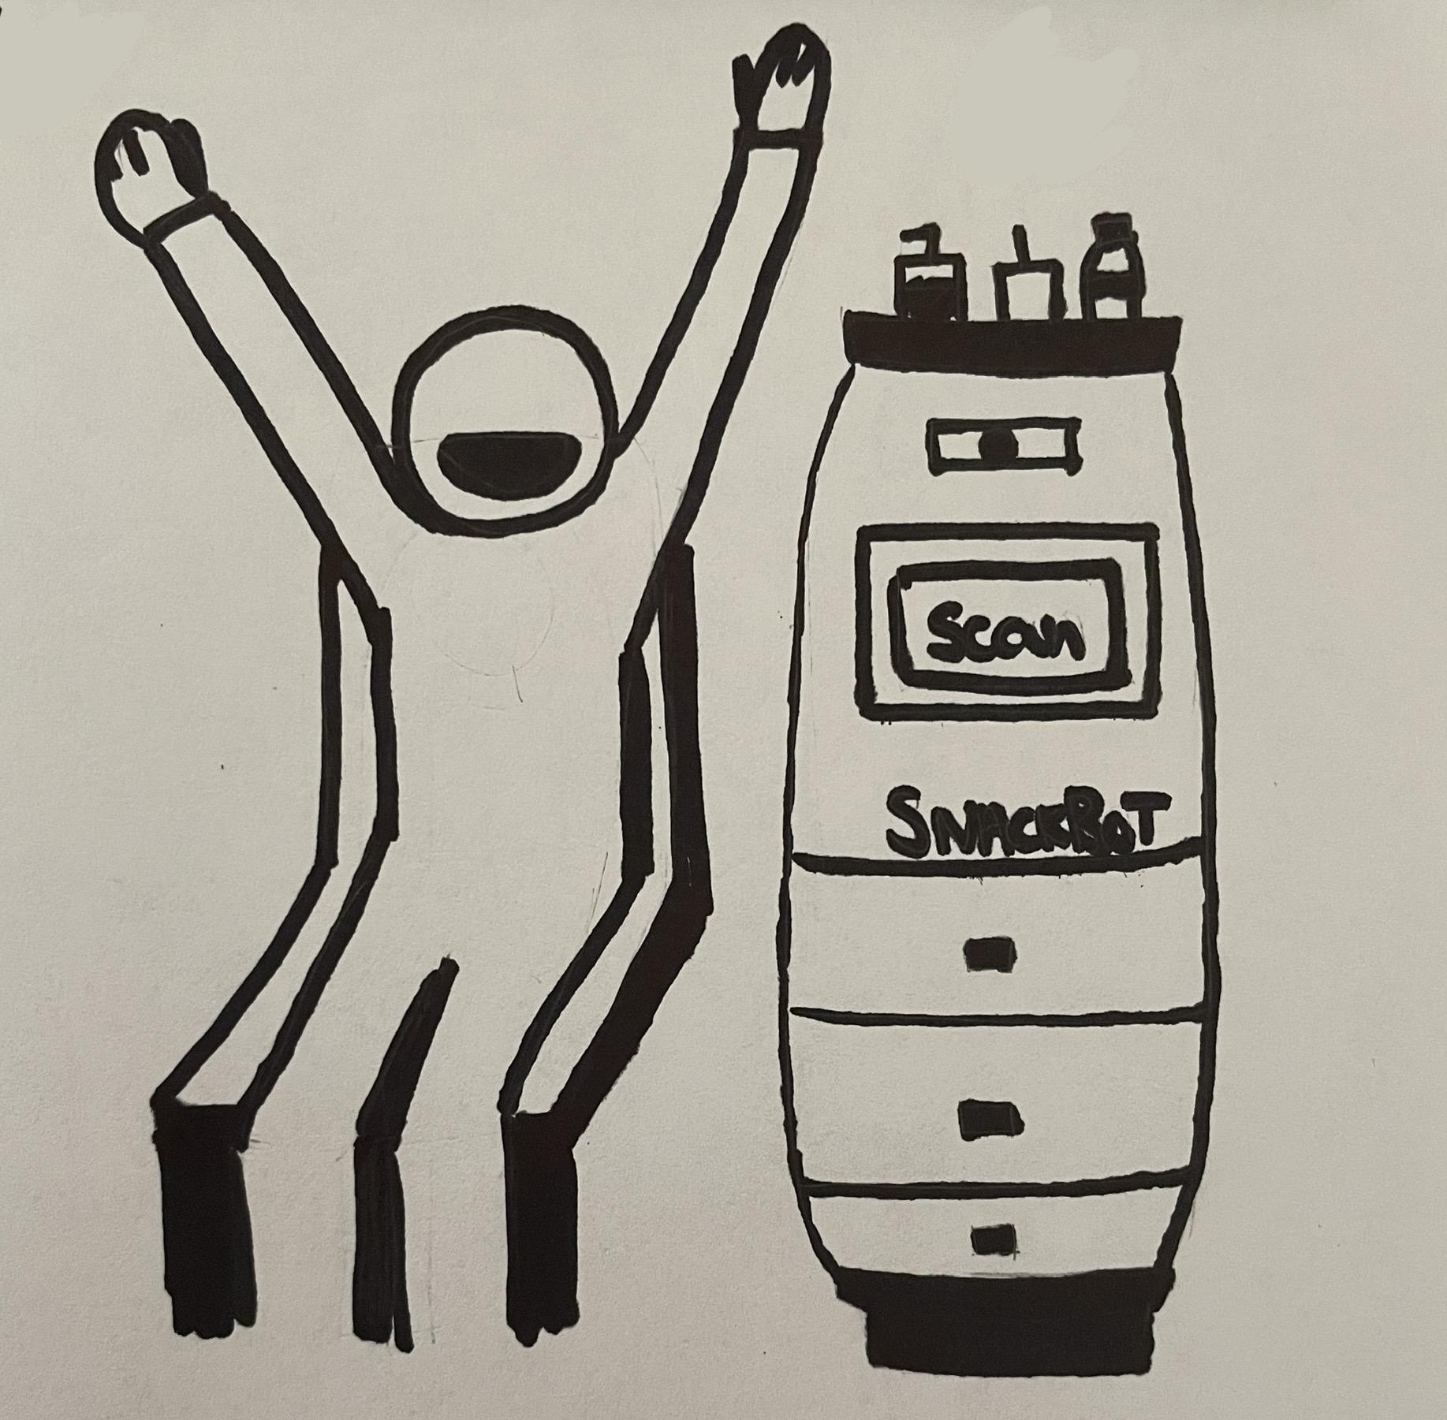
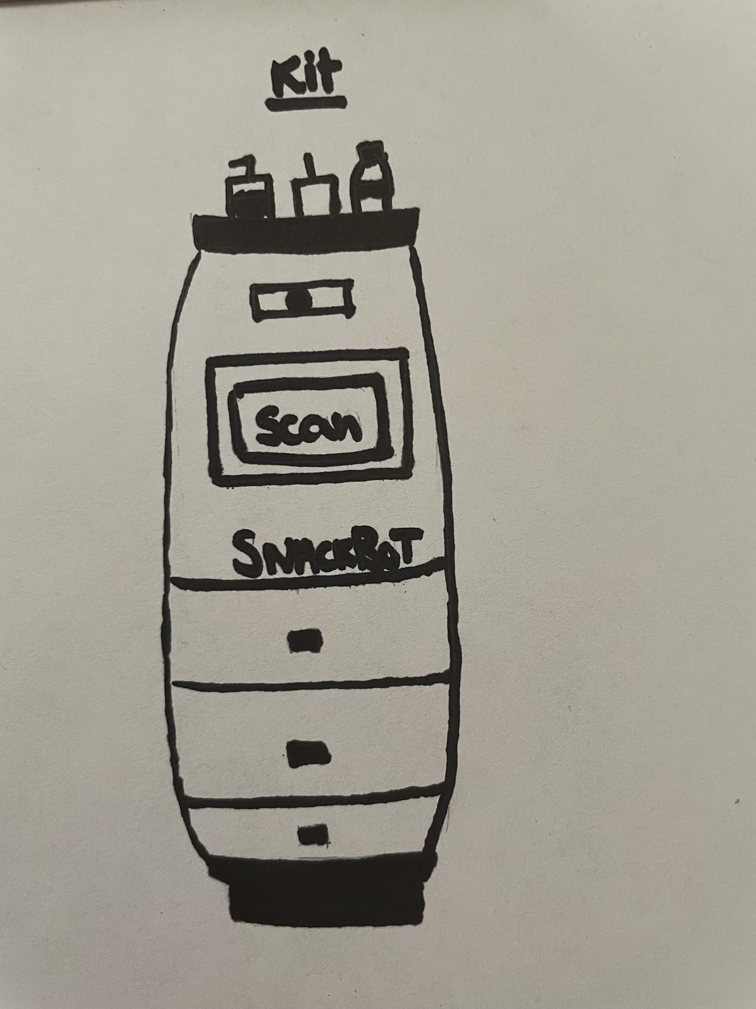
WRITE THE TITLE OF YOUR PROJECT
DEMONSTRATION of your product / idea.
Show how your product / innovation works here in 3 to 4 steps or as many ways that steps that are essential.
KIT / PIC
Step / Way-1
Step / Way-2
Step / Way-3
Step / Way-4
Order on the app
The SnackBot will deliver to your row and then you can pick it up
Pay on the SnackBot
Enjoy!!

Slide 9
WRITE THE TITLE OF YOUR PROJECT
TESTIMONIALS of your product / idea.
Proof that your customers like your product. Write their feedback here.
Customer-1
Name: Amit
Customer-2
Name: Pooja
Customer- 3
Name: Gaurangi
Feedback:
The SnackBot should also provide hygienic stationary like wet wipes, and sanitizer. Sport Stadiums are very crowded so it would be good to have things like these for the pandemic also.
Feedback: You should pay for your food on the app before hand. After you pay for your food and place the order, you will receive an order number and code. When the SnackBot comes to your aisle/row, you go there and enter your order number and code. When that is verified, the bot will release your food and you can enjoy! You should also be able to time your orders. For example, you can enter when you want your food, for example, after 45 minutes.
Feedback:
There should be a tracker feature on the app. That way the customer can know where the SnackBot is. The customer will receive a notification on the app when the SnackBot is here, so they can go pick up their food.

Slide 10
BE INSPIRED TO WIN! THANK YOU!
URL

